Slide 1
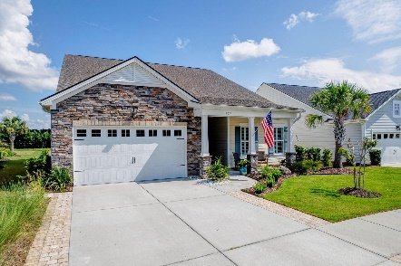
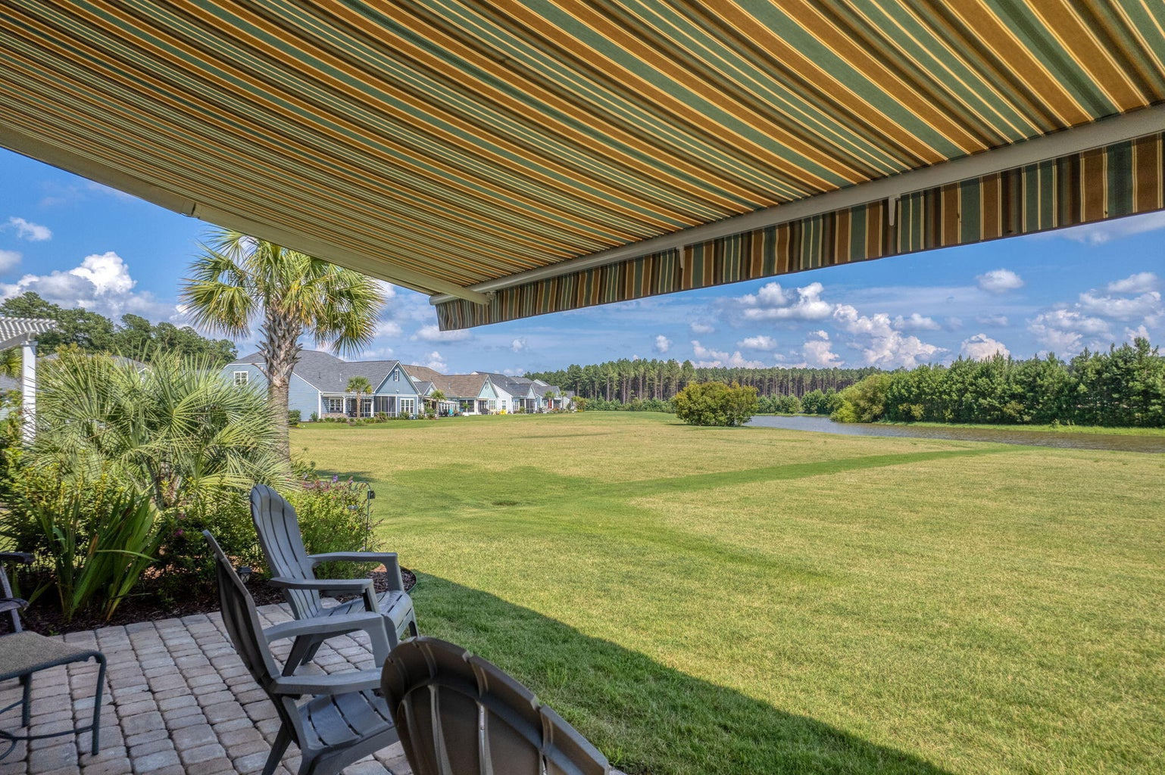
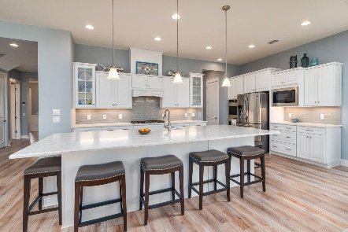
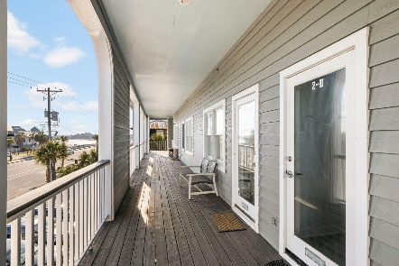
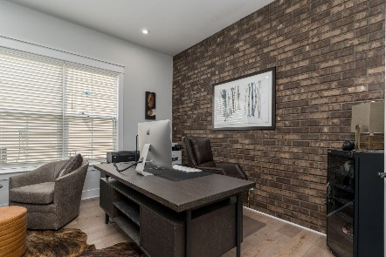
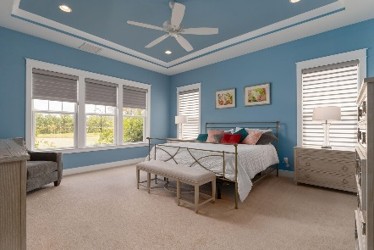
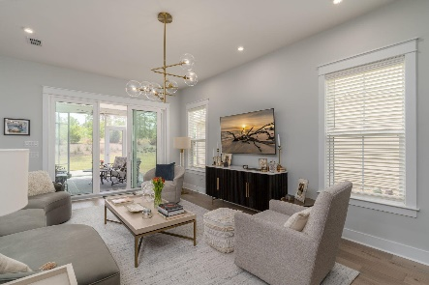
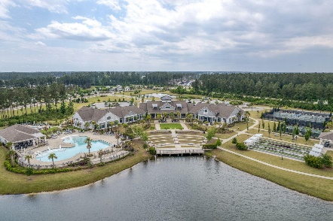

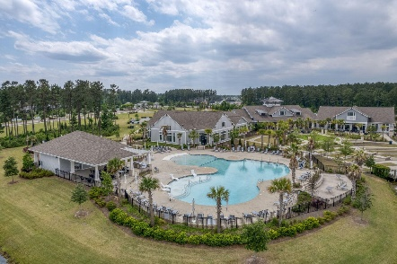
577 Tidewater Chase Lane
Four Seasons @ Cane Bay Plantation | Summerville, SC 29486
MLS# 23016976 | $749,000
Darrell Creek Elevated Home With Elevator & Salt Pool
Just Listed on the Lake in Four Seasons
Open House Saturday 7/29, 12-2PM
Co-sponsored by
Offering $3000
Lender Credit
Welcome Home to 577 Tidewater Chase Ln! This exquisite home is situated on a Premium LAKEFRONT LOT in Four Seasons, Summerville's Premier 55+ Gated Community! This Mont Blanc Loft, the most popular floorplan in the community, has just been completely repainted. It is a true open, airy, and luxurious home that boasts custom upgrades such as Cottage Molding, Wainscoting, and LVP Flooring throughout. You can feel the Lowcountry Luxury as soon as you enter the Soaring Foyer. The guest wing with en-suite bath is to the front of the home for privacy, along with the Study and Powder Room. The home then opens up to a bright Living and Dining Space. The Gourmet Kitchen is a show-stopper with 12-ft quartz island, double oven, gas range, farmhouse sink, and glass tile backsplash.
The Living and Dining room also have soaring tray ceilings and are filled with natural light. The Master Suite, with incredible views of the lake, also boasts tray ceilings and a large en-suite bath with a walk-in shower with 3 showerheads, a dual vanity, and a generous walk-in closet. Also, not to be missed outside the Master is the Hov Hub, a built-in convenient office space!
There is also a spacious Mudroom and Laundry Room with Built-In Cabinets that can make laundry fun again! The spacious 3- car garage is finished with epoxy flooring, cabinets, and workshop.
Travel upstairs to the Private Loft Area, where your guests can have their own Living Area, Bedroom and Full Bathroom!
The Grand Finale is THE LOT itself! Enjoy stunning sunrises from your fully screened porch with ceiling fans or your extended Paver Patio with gas grill connection and electric awning. Drop your kayak in the lake or fish right from your backyard! The yard is also professionally landscaped and includes Wifi Enabled Irrigation.
Some other upgrades and highlights include high hat lighting, ceiling fans in every room, smart thermostats, Simply Safe Security, and Generac 20KW whole house natural gas generator.
In Four Seasons you will never be bored, as this is the only Active Adult Community in the area that is built around a 300-acre lake with its own private boat dock! Other amazing amenities include an indoor and outdoor pool, fitness center, dog park, bocce, pickleball, tennis courts, a kayak launch and so much more! There is also a packed monthly events calendar and Full-time Lifestyle Director. Once you move to the Four Seasons, you will never want to leave! And this home is the perfect way to retire in LUXURY!
ALL MAJOR APPLIANCES CONVEY AND $3500 in CLOSING COSTS AVAILABLE with Preferred Lender!
House Tour | Amenity Tour
Elissa Campbell
843-853-1433 | elissa.campbell@agentownedrealty.com
AgentOwned Realty Preferred Group | 824 Johnnie Dodds Blvd | Mt Pleasant, SC 29464

