Slide 1
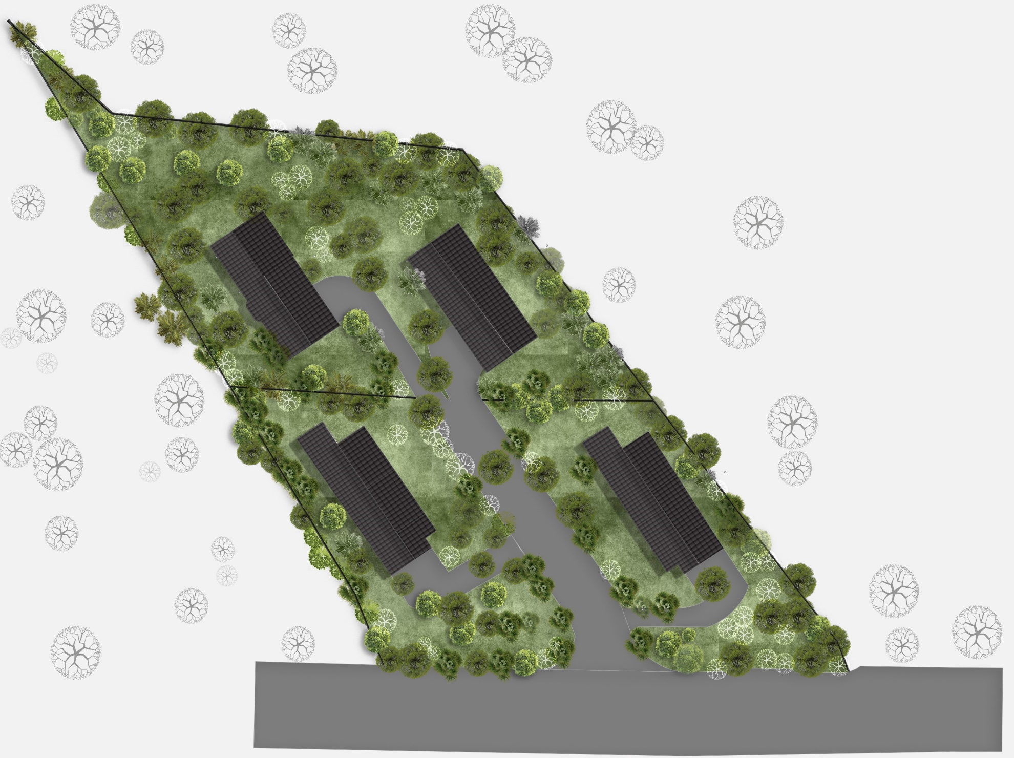
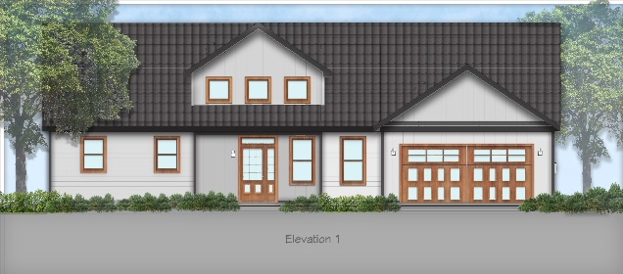



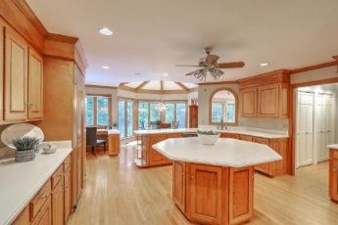




Parkshore Marshfront
4 Shovel Ready Lots
Sample Construction
5786 Scott White Road
Hollywood, SC 29449 | $250,000 For All Four or $62,500 Each
This is an exceptional opportunity to acquire four vacant lots in Hollywood! With two lots spanning approximately 0.23 acres each and two lots measuring approximately 0.25 acres each, this offering provides lots of opportunities for buyers or potential investors. Situated in Hollywood, SC, this property offers a peaceful and serene setting away from the hustle and bustle of city life while maintaining close proximity to essential amenities and attractions. With its prime location, residents will enjoy a harmonious blend of natural surroundings and modern conveniences. Don't miss out on this outstanding opportunity to own these four residential lots in Hollywood, SC. Whether you're looking to build your dream home or embark on a potential development project, these well-sized lots, coupled with their convenient location, make them an enticing prospect.
This property is located only 18 miles from downtown Charleston, 20 miles from CHS (Charleston International Airport), and 26 miles from Folly Beach.
Sale includes four lots/TMS #s: 191-00-00-130, 191-00-00-320, 191-00-00-620, 191-00-00-621 (5778, 5782, 5784, and 5786 Scott White Road)
*Buyers/buyer's agent are responsible for determining land uses, zoning guidelines, etc with all governing bodies.
Rodney Lockwood | sweetlock63@gmail.com | (843) 860-7325

