Slide 1
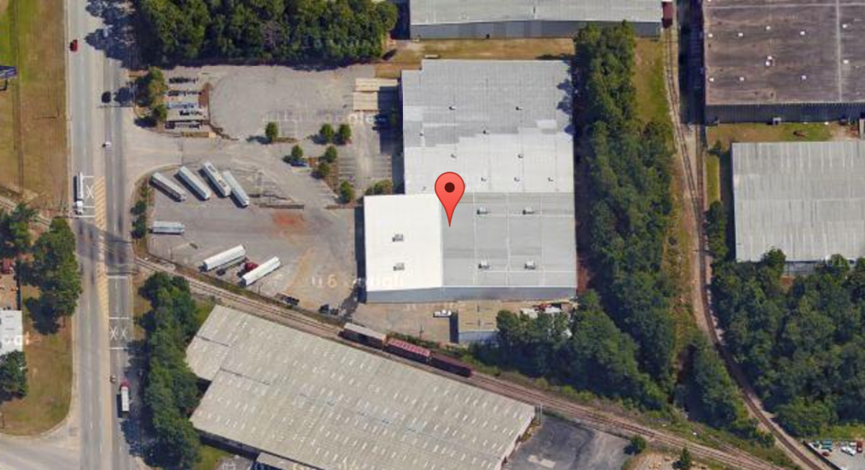
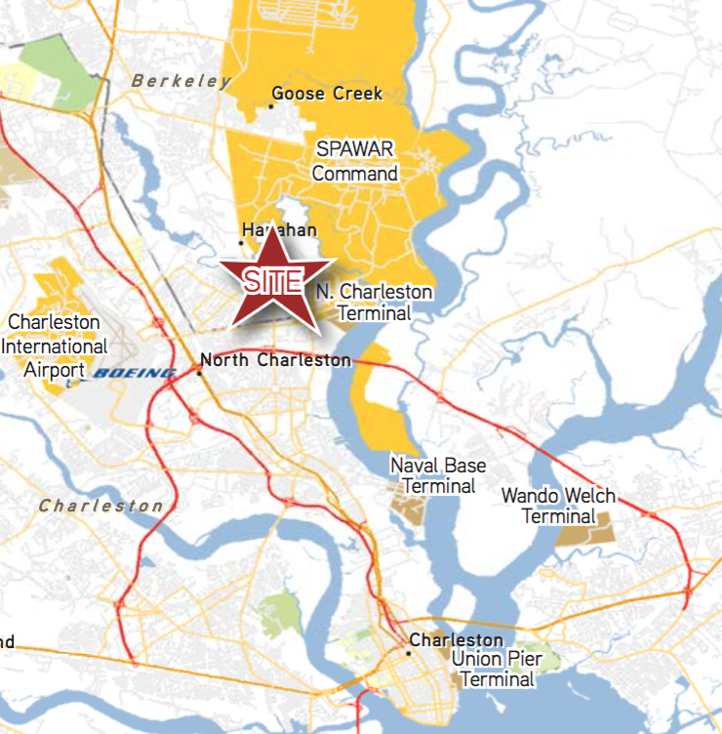

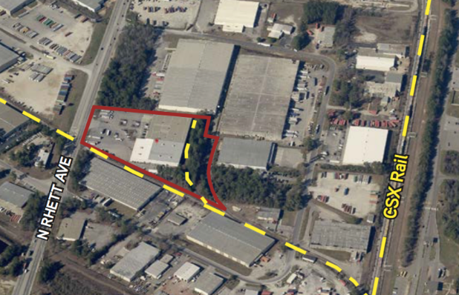

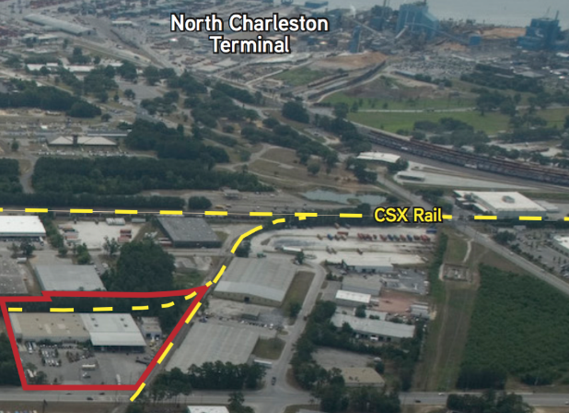


Charleston Distribution Facility - Trident Industrial Park
5802 N. Rhett Avenue
Hanahan, SC 29410
INDUSTRIAL FOR LEASE
Potential Rail with CSX and much more exist at this approximately 90,000 square foot facility consisting of a 67,504 square foot main warehouse (half of which is conditioned), 8,486 refrigerated room within main warehouse, 8,268 square foot office and 5,200 square feet of space in two stand alone maintenance buildings. Located just off the N. Rhett, I-526 exit, this location is flat, secure and easy to access in Hanahan. Multiple access points to I-26, this facility offers many flexible uses from distribution to corporate headquarters.
Catylist ID: | #30021299
Building Size (RSF): | 89,458 SF
Gross Land Area: | 7.75 Acres
Lease Rate: | $7.25 PSF (Annual)
Lease Types: | NNN
Docks/Doors: | 5 Docks
Drive In Bays: | 2 Bays
County: | Berkeley
Tax ID/APN: | 266-09-00-001
David H Seay
CCIM, BIC, CCIM, REALTOR
(843) 364-6720
david@seaydevelopment.com
Seay Development, LLC
3404-202A Salterbeck Street
Mt. Pleasant, SC 29466
www.seaydevelopment.com

