Slide 1

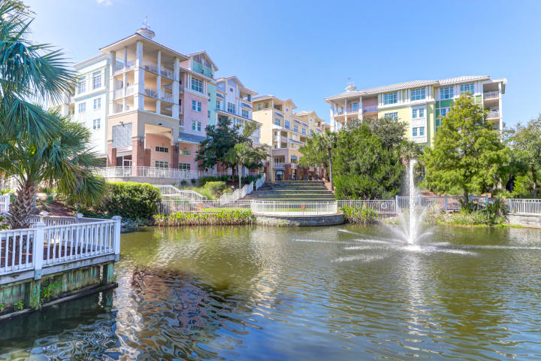
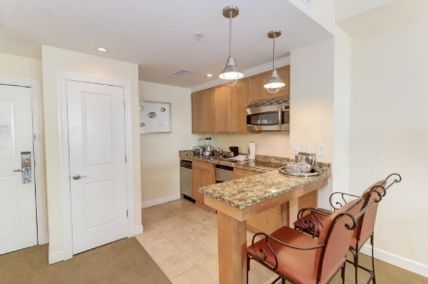
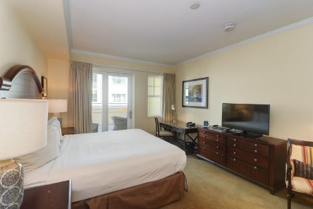
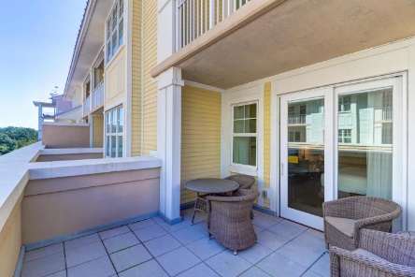
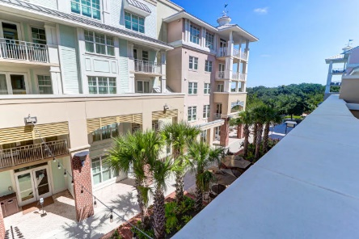
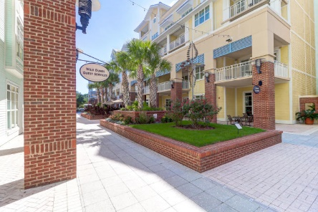
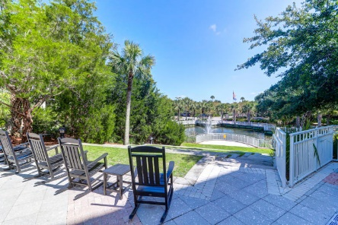


5802 Palmetto Drive B-308
Wild Dunes ~ Isle of Palms, SC 29451
MLS# 20025538 ~ $280,000
Great Ownership Opportunity!
Use Yourself AND Rent It Out!
Fantastic Rental Property
Don't miss this rare opportunity to own this beautifully appointed studio in the award winning resort community of Wild Dunes. The Village is the true heart of the Resort and just steps from the beach, pools, spa, fitness center and convenient dining locations. With a fully appointed kitchen, king size bed, and luxury bathroom amenities, this third floor unit has exceptional views of the Village Plaza from a large and private balcony. As part of the Village at Wild Dunes, this turn key rental offers valet parking, concierge services, and housekeeping. Resort amenities include access to countless pools, a fitness center, two 18 hole golf courses, tennis center, biking and walking paths, and endless unspoiled beaches. The highly anticipated opening of the new Sweetgrass Inn in 2021 will provide a new luxury spa and fitness center along with an additional pool and fine dining locations.
Come take a look at this unique opportunity to invest in and enjoy the Charleston area with its beautiful coastline and historical homes and gardens.
Ann Cortes
Office - (843) 886-8110
Mobile - (843) 324-6808
ann.cortes@carolinaone.com
Carolina One Real Estate | 1503 Palm Blvd | Isle of Palms, SC 29451-2280

