Slide 1
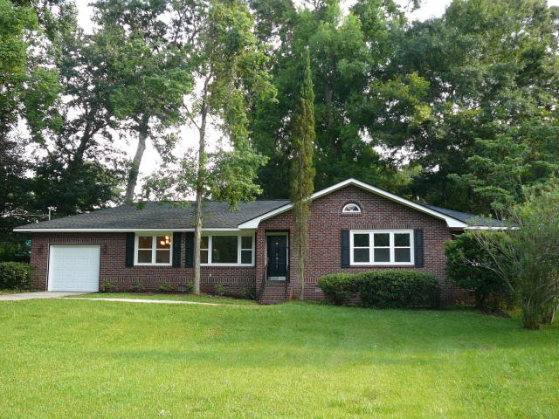
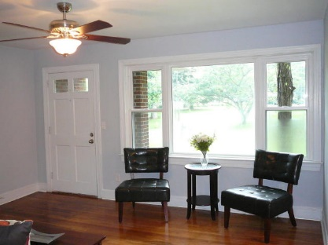
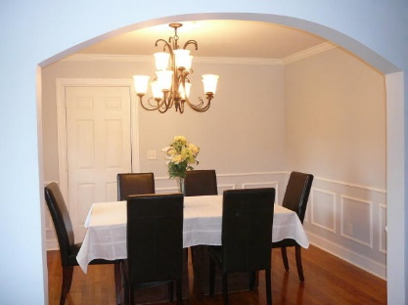
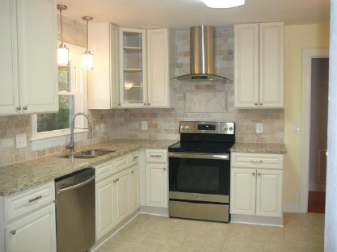
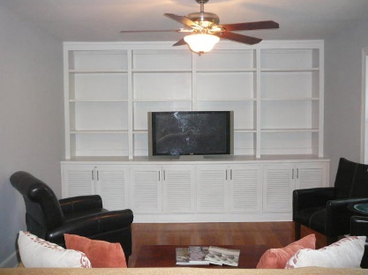
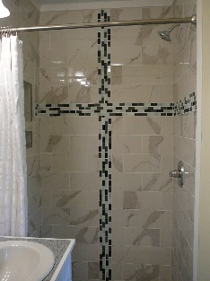
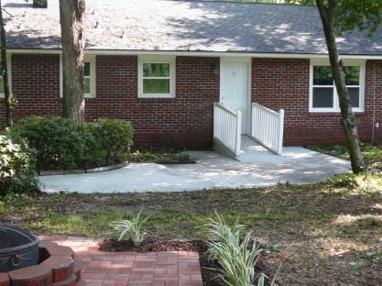
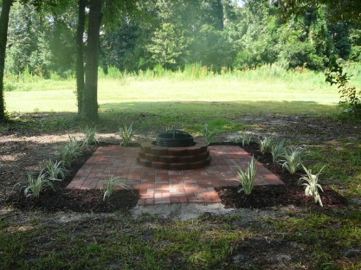

5803 Lakeview Drive Lakeview Hanahan, SC 29410 MLS# 19013085 $269,000 3 Bed · 3 Bath · 1,544sf
3.5% AGENT COMPENSATION BEING OFFERED IF A CONTRACT IS RATIFIED PRIOR TO OCTOBER 22, 2018.
3.5% AGENT COMPENSATION BEING OFFERED
IF A CONTRACT IS RATIFIED PRIOR TO OCTOBER 20, 2019
BEAUTIFULLY RENOVATED HOME IN DESIRABLE LAKEVIEW SUBDIVISION!!
New 30 year architectural shingles on roof
New HVAC packaged unit and new water heater
New Windows and new light fixtures throughout
New cabinets, granite countertops, and new stainless appliances
Kitchen and all 3 bathrooms newly tiled
Hardwoods sanded and refinished
New garage door and remote controlled opener
Nicely landscaped with new fire pit
Bryant Pearson
(843) 860-7667
Bryant@SouthernShoresRE.com
Southern Shores Real Estate Group
834 Wappoo Rd
Charleston, SC 29407

