Slide 1
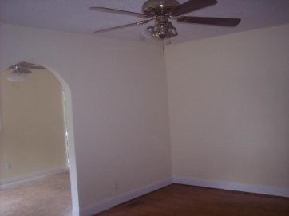
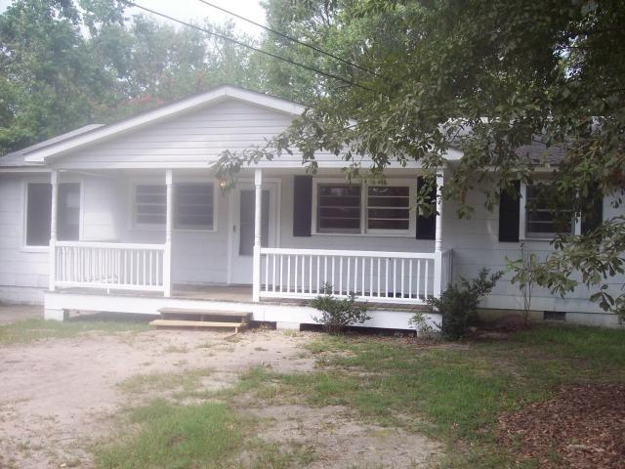
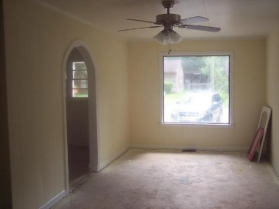
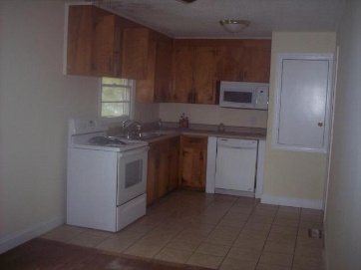
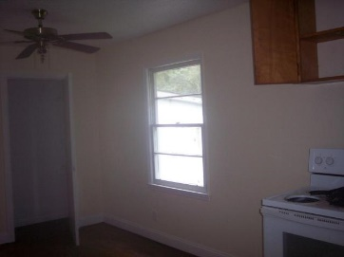
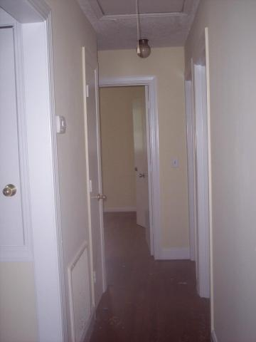
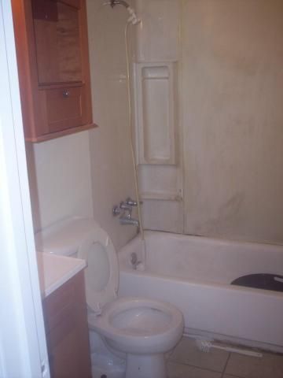
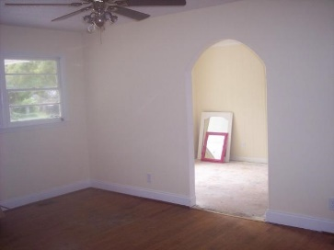
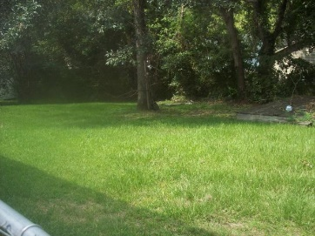
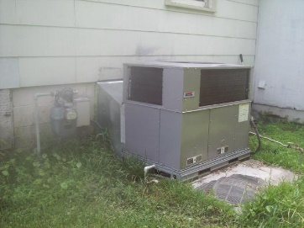
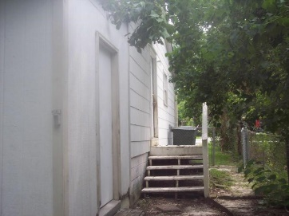


5806 Canterbury Drive Yeamans Park Hanahan, SC 29410 MLS# 15020423 ~ $77,000
Price Drastically Reduced!!
Home is being sold in AS IS condition, however lots of work has been done, ie painting inside, New H/A, New HW Heater, Termite Bond in place. Great home that needs some TLC, by the right person who can see the potential… Nice Hardwood Floors are in the LR, 3 BR, Hall and Breakfast Room. Home has 1.5 bathrooms, with Ceramic tile, and washer/dryer connections are in a room off the back. New Ceiling Fans in bonus room and LR.. House has a not so dated Roof, New 2 yr old H/A unit and HW Heater. Nice lot and wonderful front porch to relax on or close in for a Sunroom... Walk to the Hanahan Schools. If Sq Footage is a question please measure. Home is price for quick sale and won't last in this hot market.
John H. Beckroge
ABR, EPRO
jbeckroge@gmail.com
Mobile 843-367-3196

