Slide 1
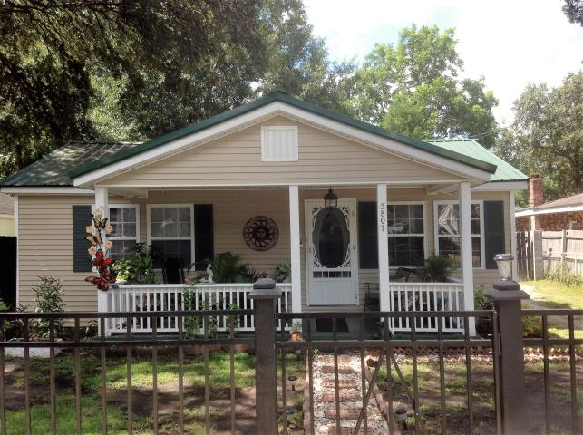
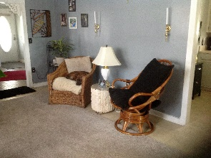
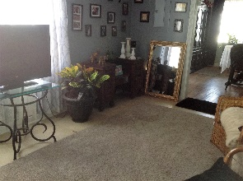
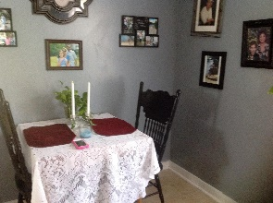
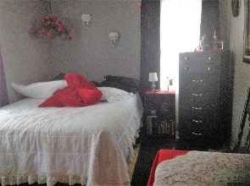
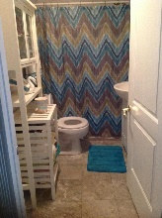
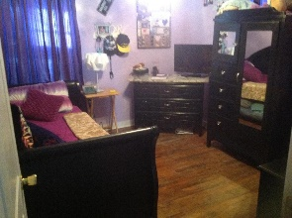
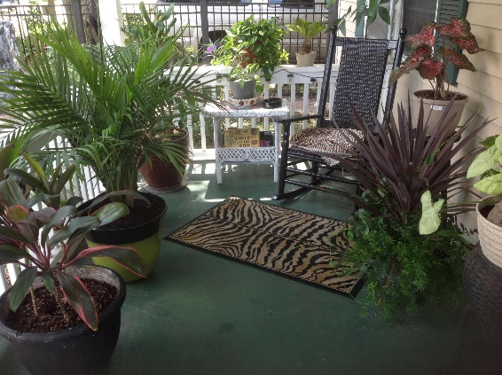
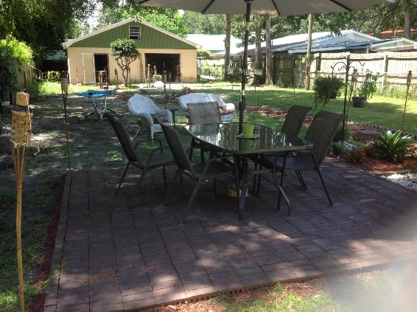
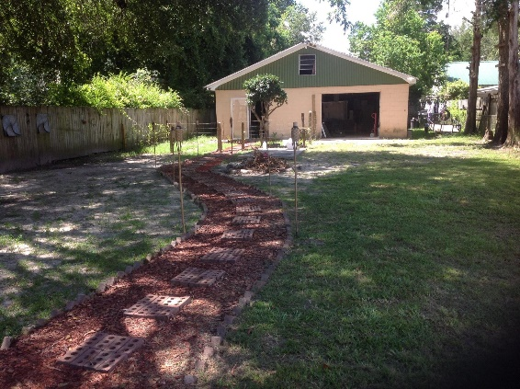

5807 Sledge Street
Port Park
Hanahan, SC 29410
MLS# 16021971
$99,900
2 Beds | 1 Bath | 1,050 Sq Ft
Property being sold AS IS. Property has beautiful landscaping, amazing outside for entertaining and enjoying the outdoors. Make your appointment today because this property will not last long.
Walking distance to shopping, hardware store and food establishments. Seller will not do repairs. The pictures were taken at the time of the listing appointment.
Carla C Davis
Mobile - (843) 437-4873
gaweber@tds.net
AgentOwned Premiere Group
141 A N. Main Street
Summerville, SC 29483

