Slide 1
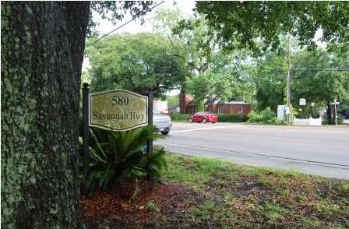
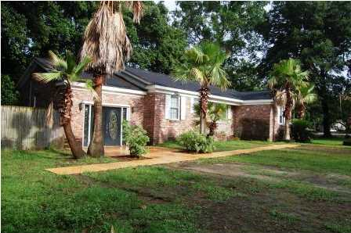
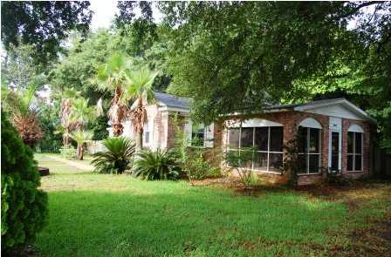
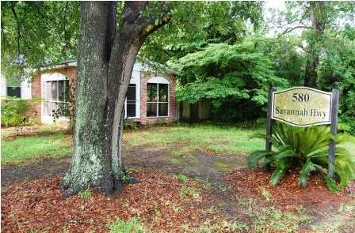
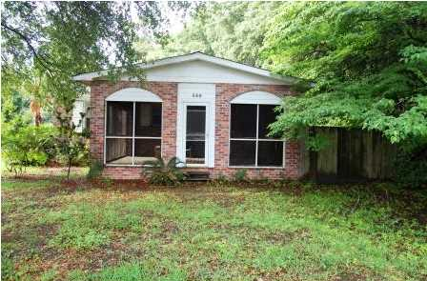
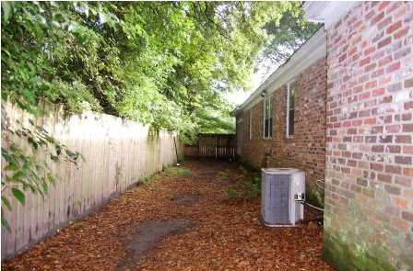
Commercial Opportunity on Savannah Hwy
580 Savannah Hwy
MLS# 1415490 ~ $255,000
Location...Location...Location!!!!
Great investment, can be zoned commercial. You must see this home in the highly sought after Moreland. In the heart of west Ashley this home is close to restaurants, Harris Teeter, city of Charleston tennis courts and minutes from downtown Charleston.
This home has a new architectural roof and hardwood flooring. HOME IS IN NEED OF UPDATING (price reflects). Seller will make no repairs regardless of inspections.
Home to be sold as is and owner will not do a CL100.
Bev Roberts
843-696-1409 | thetantteam@bellsouth.net | www.hbrtwn.com
Harbourtowne Real Estate | 672 Marina Drive, Ste 110 | Daniel Island, SC 29492

