Slide 1

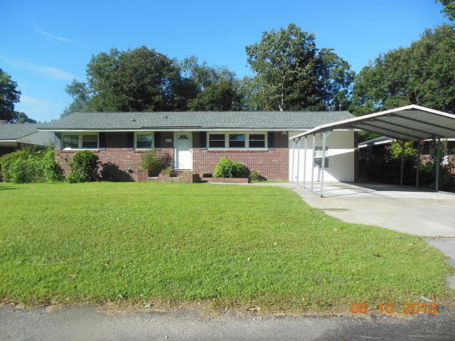
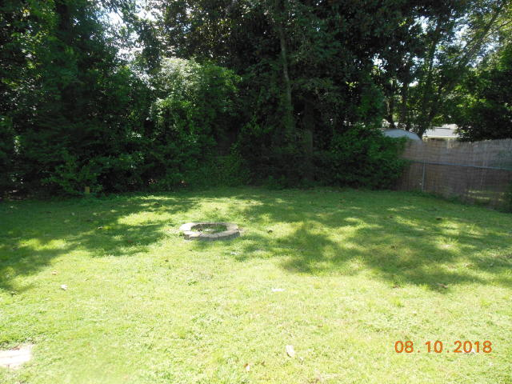
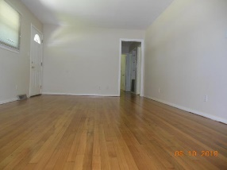
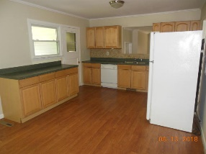
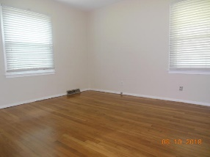
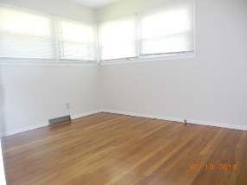
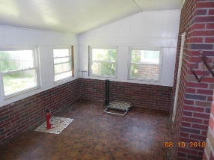
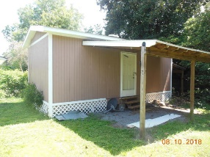


Updated Home in Hanahan
Close to Everything!
Michael Moseley
REALTOR, ABR
(843) 442-0959
michaelsmoseley@gmail.com
5819 Stewart Street| Yeamans Park 2 | MLS# 18022542 | $175,000
Brand New Flooring!
Wonderful opportunity to own in the heart of the Lowcountry!
Fresh paint, refinished hardwood floors accent this classic brick ranch. The kitchen has been redone over the last few years and has a nice tile blacksplash and laminate wood floors. Beyond the kitchen is a spacious sunroom that could be coverted into living space.
The backyard is great for afternoon BBQ's with the neighbors and is equipped with a firepit and huge 12x24 workshop. Big ticket items are fairly new: roof - 8 years old, hvac - 3.5 years old and insulted double pane windows - 8 years old.
Come live in Hanahan - great schools - 15 minutes to downtown Charleston and 5 minutes to downtown Park Circle!
Century 21 Properties Plus | 118 W Richardson Ave | Summerville, SC 29483

