Slide 1
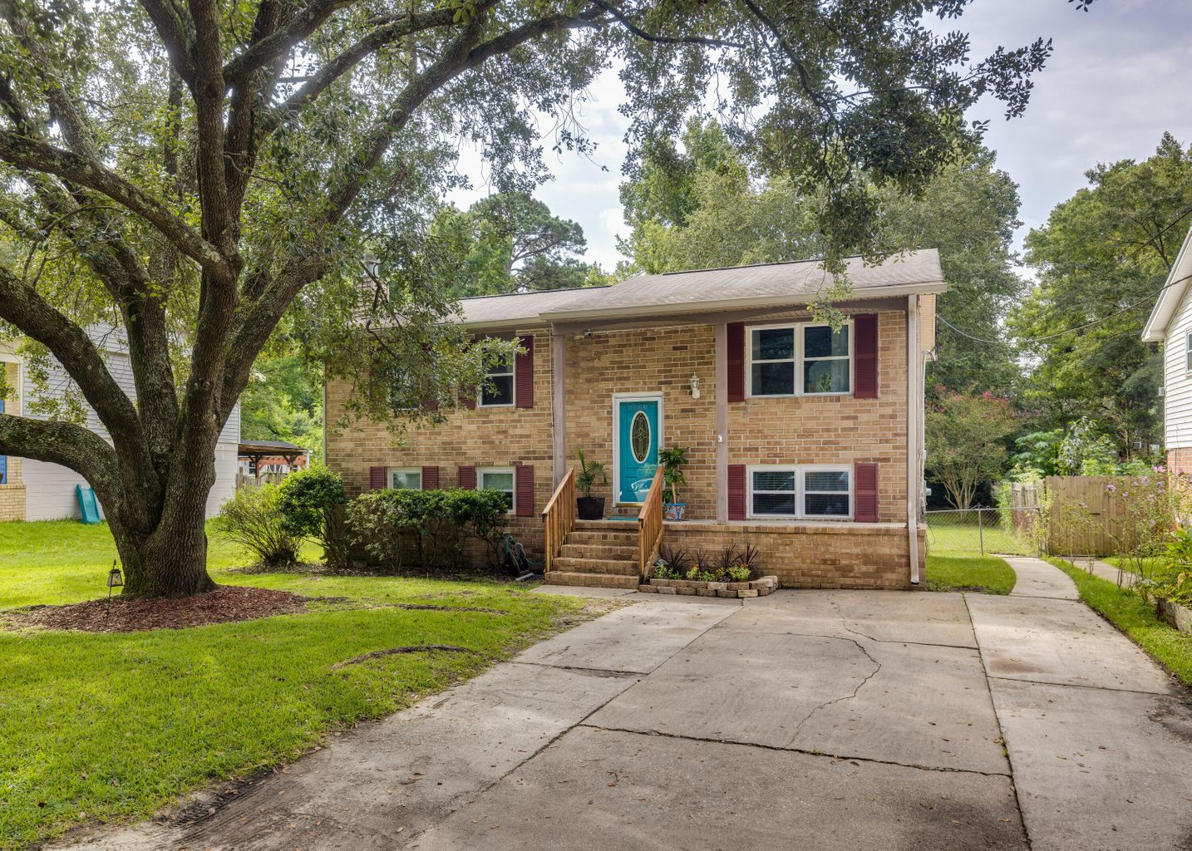
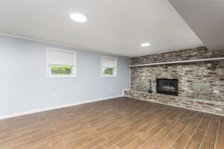
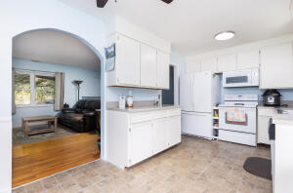
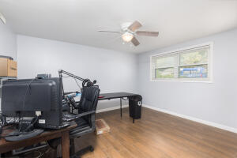
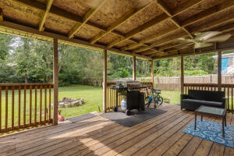

Open House Saturday Oct 29th 10:00 – 1:00 Door Prizes!
Hosted by Liz Butler
843-367-6604
lizbutlerhomes@gmail.com
5833 Beverly Drive
Forest Hills | Hanahan, SC 29410 | MLS# 22023820 | $342,400
Brick home close to Boeing, Tanger Outlet and much more! Walk to the dog park and schools. 5 bedroom, 2 bath with large family room with brick fireplace. House has been updated/renovated and is move in ready! Large fenced in backyard with covered porch for outdoor entertaining. Eat in kitchen that looks over backyard. Large laundry room and much more.
Lisa Deaton
843-224-7878
lisamdeaton@comcast.net
AgentOwned Charleston Group
902 Savannah Hwy
Charleston, SC 29407-7802

