Slide 1


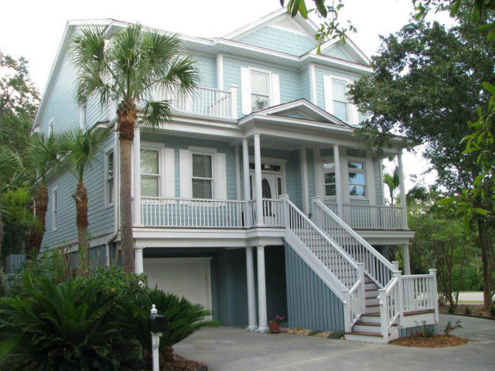
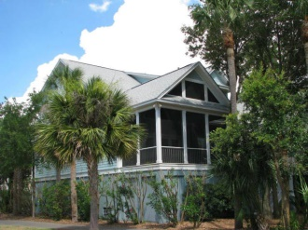
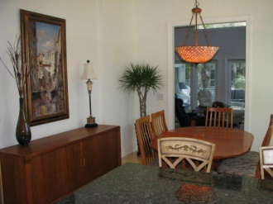
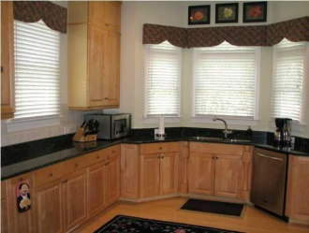
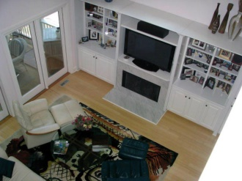
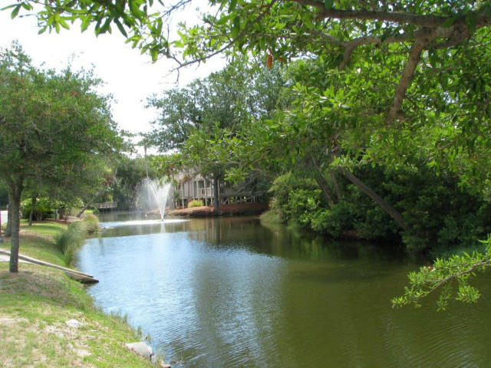

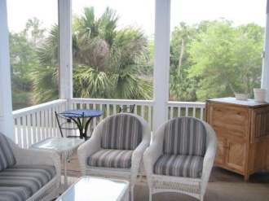
Price Reduced
Seller Must Have Contract
By The End Of April
5839 Back Bay Drive
Wild Dunes ~ Isle Of Palms
Mls# 14028333 ~ $819,900
Two garage doors - parking for 4 to 6 cars - elevator - backup generator - looks brand new - custom built cook-bonner. Seller has another opportunity - must have contract by end of April.
Priced to Sell - Located in a very quiet area yet close to most Wild Dunes Amenities and the Beach. This home has it all - Gourmet Kitchen - Top of the line appliances - Granite - Hardwood Floors Tankless water heater - Elevator. Large Loft and Screened Porch for relaxing and enjoying time at the beach. Also included Irrigation System - Outside Accent Lighting - Outdoor Shower with hot and cold water - Kohler 12 KV Generator System. Ironwood on porch, decks, and steps. Great Home in a Great Area in a Great Community plus close to the Historic City of Charleston.
John Denning
843-224-2664
jdenning@wilddunes.com
www.wilddunesrealestate.com

