Slide 1
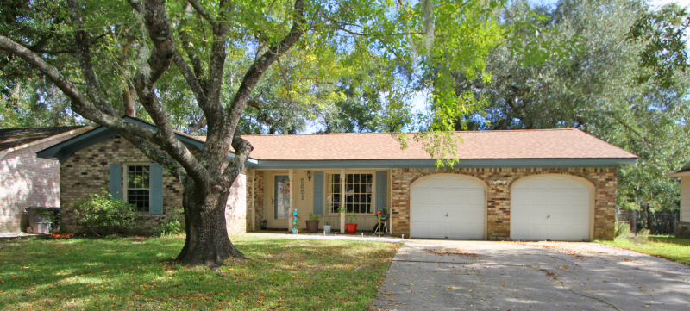
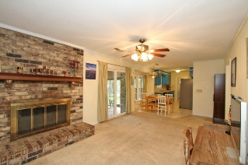
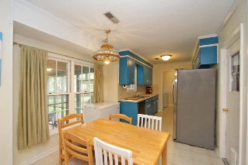
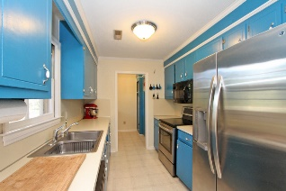
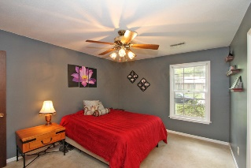
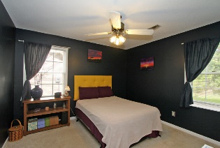
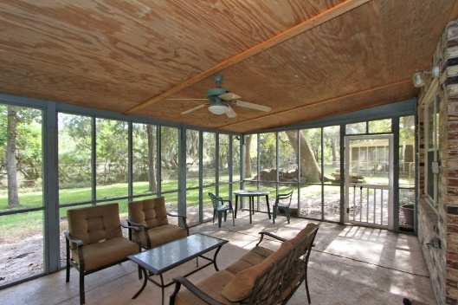
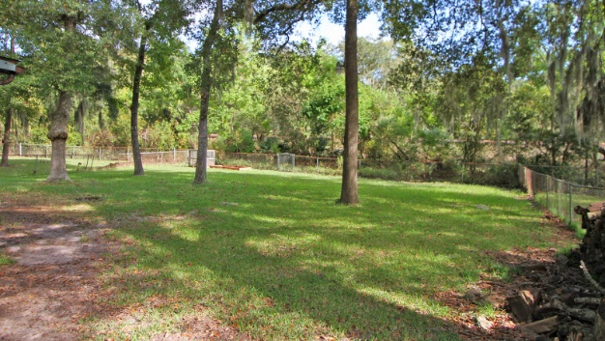
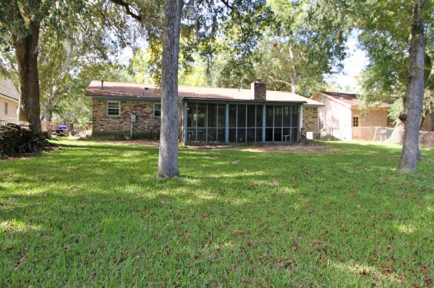


5851 Saint Angela Drive Covington Hills ~ North Charleston ~ MLS# 15027156 ~ $160,000
Just Listed! Marsh View for Under $200k!!
Open House This Weekend
Join me Saturday or Sunday 1-2:30
This adorable 3BD/2BA brick ranch in sought after Covington Hills, minutes to Boeing, the airport, I-526, I-26, and the Tanger Outlets, has it all! Hardwoods in the living room and charming brick fireplace in the den. Spacious kitchen with breakfast nook, large pantry, and connecting laundry room. NEW HVAC in 2014 and NEW ROOF in 2015. There is also a large screen porch overlooking a private spacious backyard with a view of the marsh. You can't beat the view and privacy! To top it off there is a 2 car garage with side entry for convenience. Don't miss the opportunity to put your own personal touch on this great home! It won't last long!
Sarah Ellen Lacke
Cell - (843) 607-4330
sarahellen.lacke@carolinaone.com
www.selacke.com
Carolina One Real Estate 1265 Folly Rd Charleston, SC 29412

