Slide 1
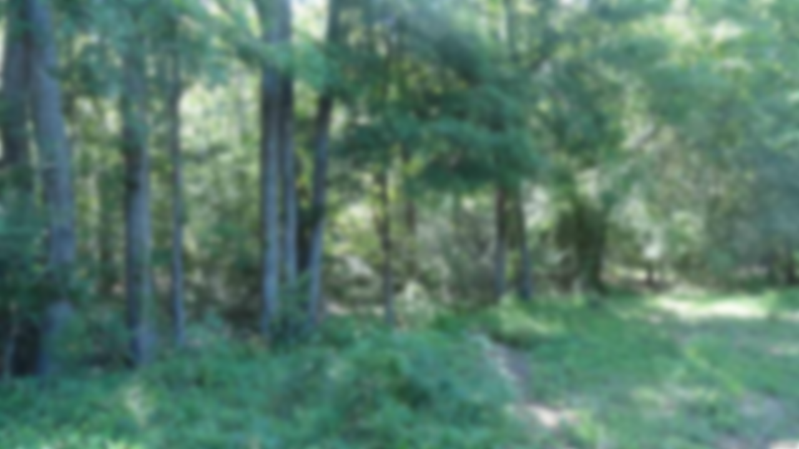
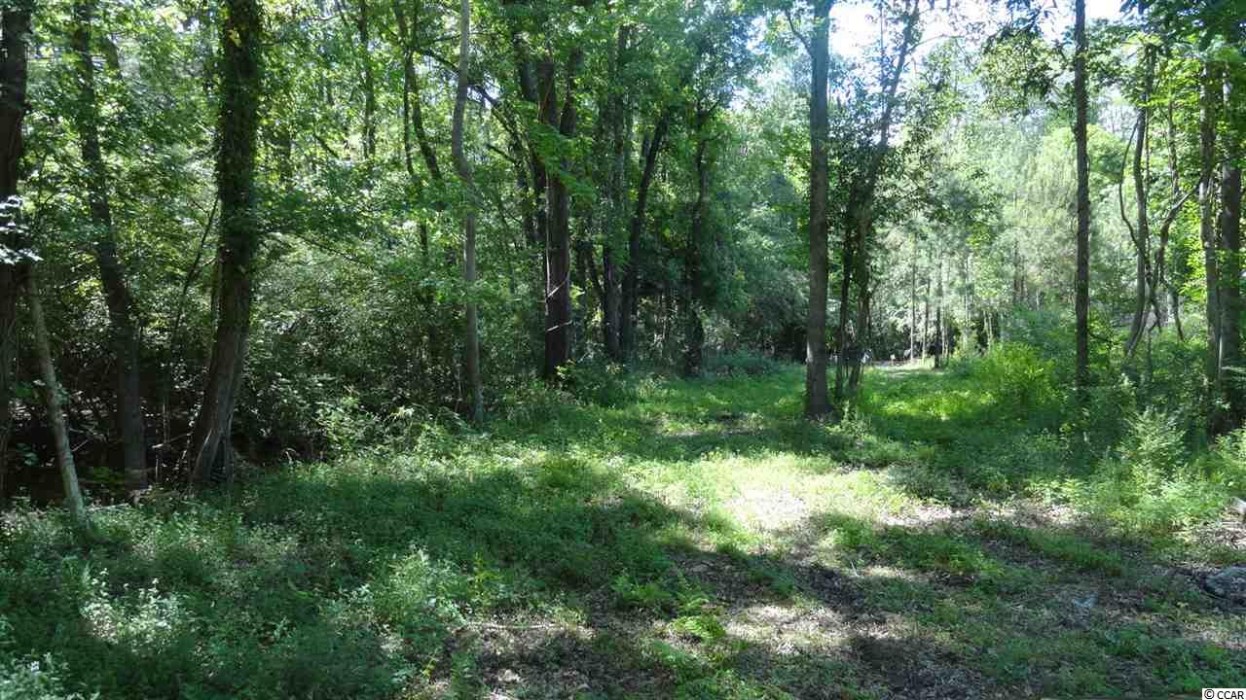
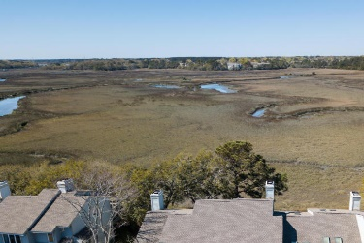
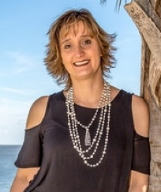
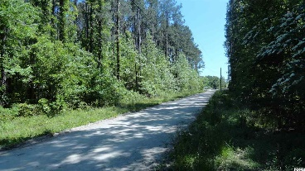
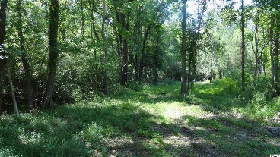
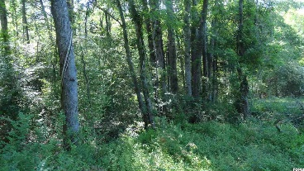
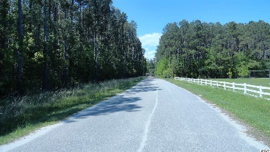

Great Estate Sized Residential Lot
5855 Leonard Rd
Myrtle Beach, SC 29588 ~ MLS#1808659
Nice, secluded location for either a larger, 3-acre estate sized property or possible residential development. Public water and sewer are accessible along Leonard Rd. frontage.
The Sun Group
P.O. Box 2278
Murrell's Inlet, S.C. 29576-2278
Don Morris
843-543-2272 (Cell/Text)
dimorris7@gmail.com

