Slide 1
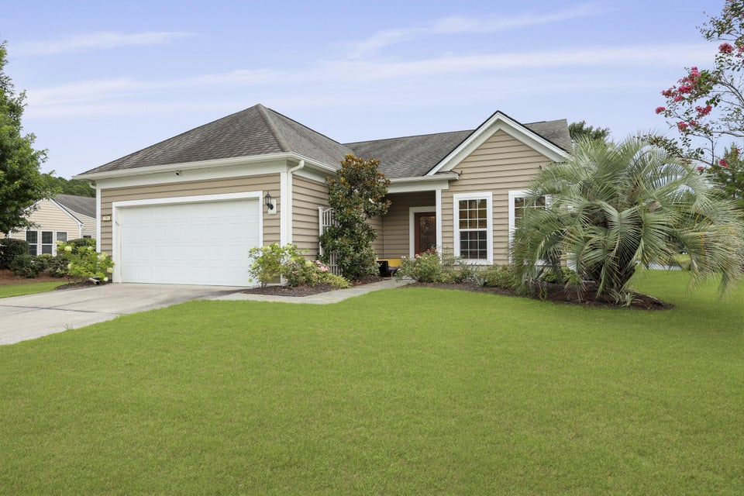
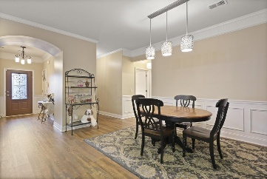
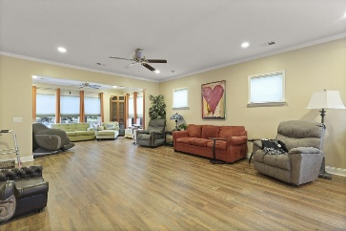
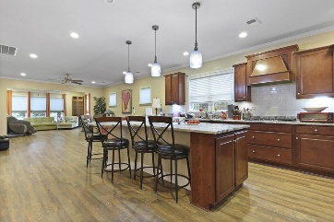
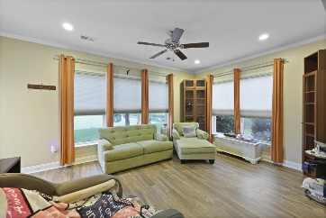
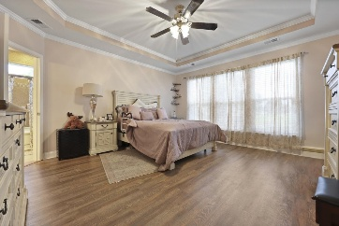
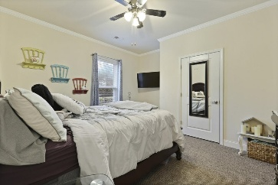
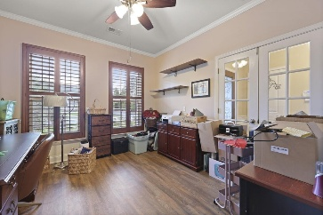
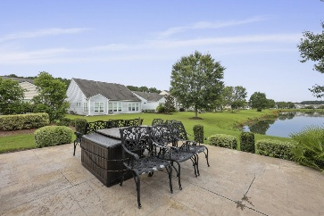
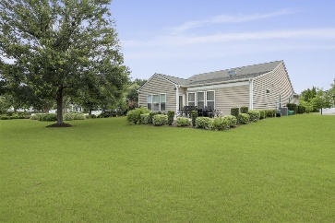
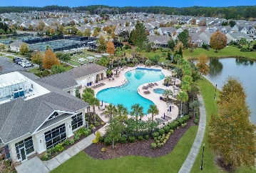



Cane Bay Del Webb (55+) Home for $450,000!
586 Eastern Isle Avenue
Cane Bay Plantation
Summerville, SC 29486
MLS# 25020272
$450,000
3 Beds | 2 Baths | 2,340 SF
Welcome to 586 Eastern Isle Avenue, a beautifully upgraded 3-bedroom, 2-bath home in the sought-after 55+ community of Del Webb at Cane Bay Plantation. Set on a uniquely private lot with no immediate neighbors to the left or right, this home offers rare tranquility and pond views that truly set it apart from others in the neighborhood. Inside, you'll find an open-concept layout filled with natural light, soaring ceilings, and spacious rooms—including a versatile office or flex space perfect for working from home or pursuing hobbies.
The flooring was updated in 2023, giving the home a fresh, modern feel, and six brand-new windows (currently in the garage and ready for installation) will only add to the bright, airy vibe. The kitchen is a cook's dream, featuring granite countertops, stainless steel appliances, and plenty of cabinetry. The home also includes a transferable termite bond that's already renewed and paid in full - providing added peace of mind for the next owner. With its premium lot, recent updates, and desirable community amenities, 586 Eastern Isle is a must-see for anyone looking to live comfortably and invest wisely in Cane Bay.
VIRTUAL TOUR
Nick Mazzilli 843-640-5575
nick@themazzilliteam.com
sellmyhousecharlestonsc.com
The Mazzilli Team
3427 W Montague Ave
Suite 6
North Charleston, SC 29418

