Slide 1
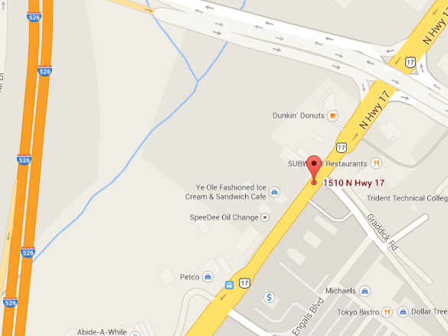
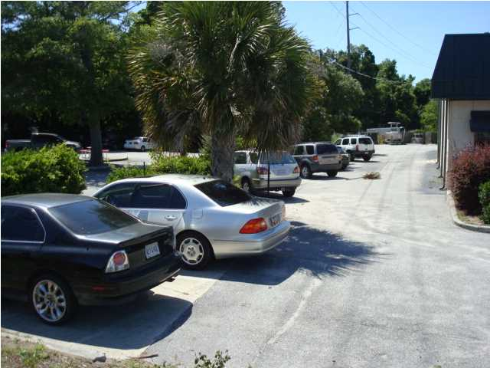
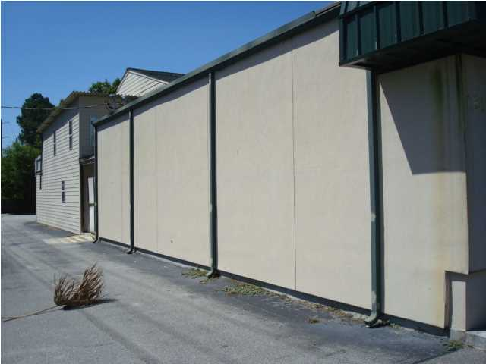
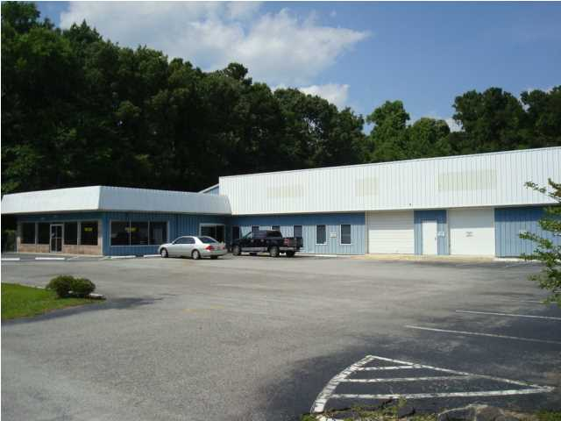
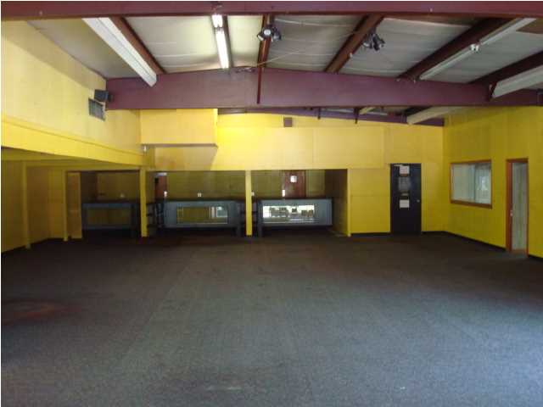
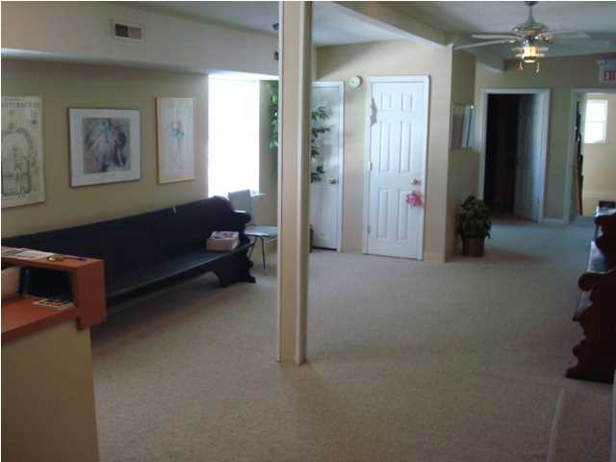
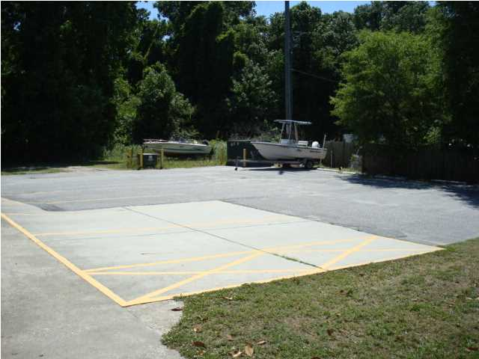
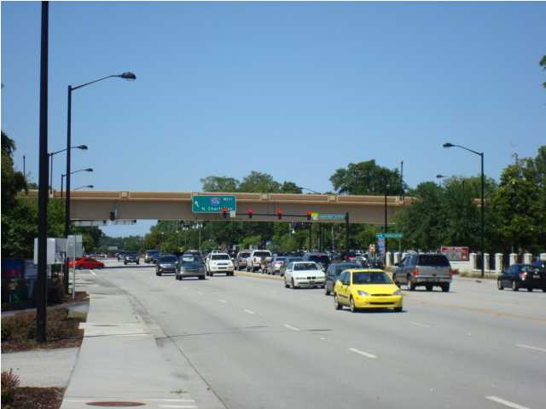
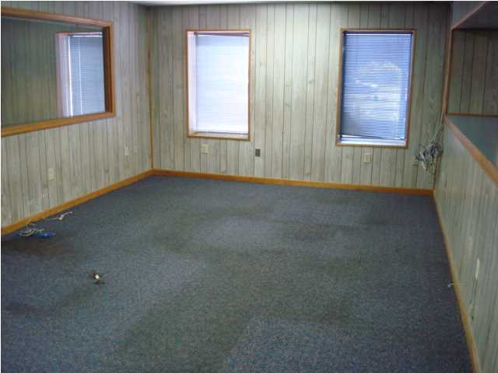
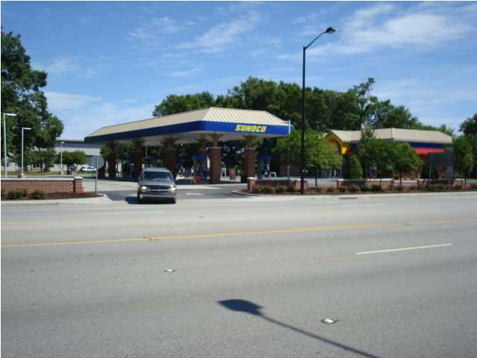
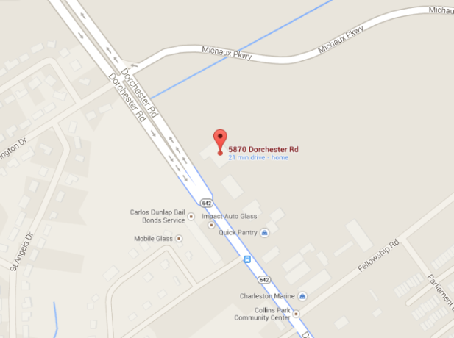
5870 Dorchester Rd, N Charleston, SC 29418
Sale - $700,000 | Lease - $6,000/Mo
SALE · LEASE · LEASE/PURCHASE
PRICE REDUCED $195,000
MLS# 1414148
MLS# 1415483
13,300 sq. ft.
Property is only 2 miles from the I-526, and adjoins property owned by Boeing. This is the closest commercial property to the entrance of Boeing and the International Airport from the Dorchester Road entrance. Property has been used in the past for motorcycle and boat sales and service. The building has a 4,000 sq. ft. showroom with 14' to 16' ceiling and adjoining the showroom are 3 large offices. There are two separate warehouse areas with 14-16 ft. height ceilings. The property is only 200 feet from the traffic light at the intersection of Michaux Parkway and Dorchester Road that leads to The Charleston International Airport and Boeing. Owner will sell...Lease/purchase or lease. Owner will also consider owner financing to Qualified Buyer
Rick Willis
843-327-3017
rwillisteam@gmail.com
The Group, LLC

