Slide 1
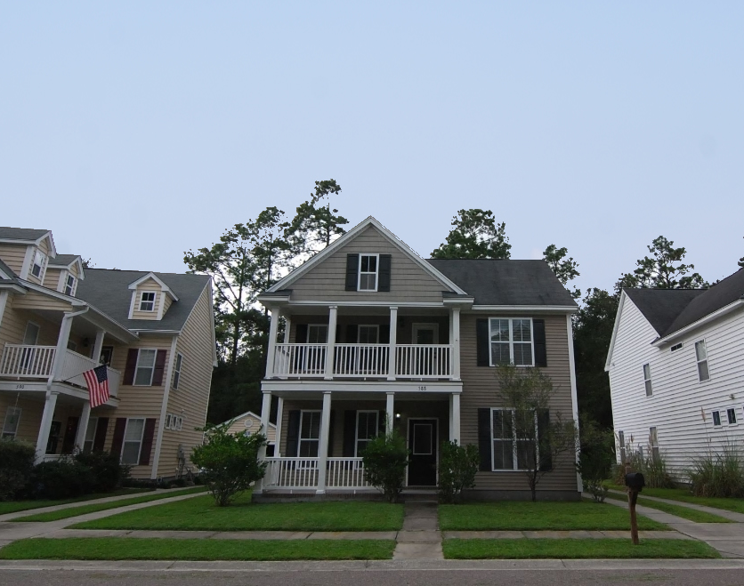
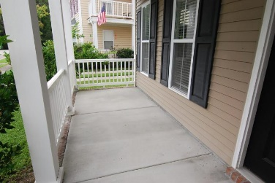
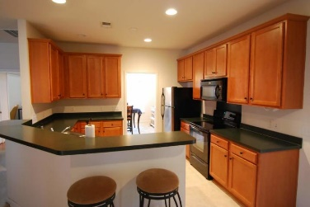
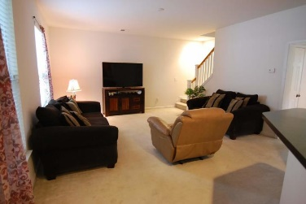
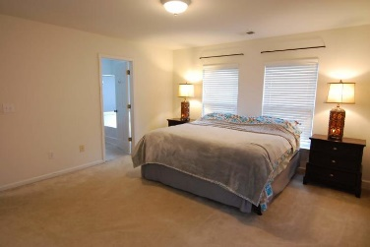
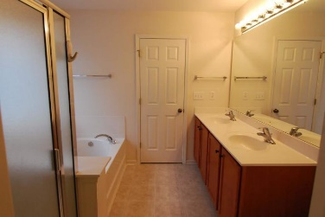
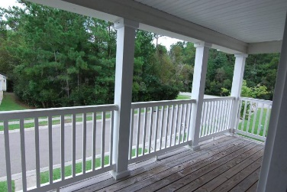
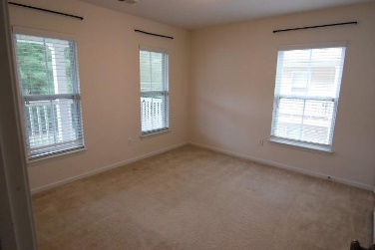
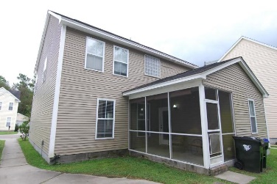


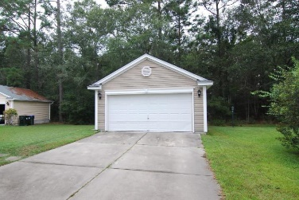

588 Delafield Drive
Weatherstone ~ Summerville, SC 29483
MLS# 18027010 ~ $239,990
Open House
Sat 11am-1pm
Just Listed!
The most affordable Charleston Single with double front porches currently available for sale with over 2,000 sqft and lots of living space with a living room (study), separate dining room, large kitchen, breakfast area and huge family room overlooking the private backyard. Upstairs, you'll find an enormous master suite with a huge walk-in closet and deluxe master bathroom including double sinks (raised vanity), separate shower and a garden tub. The second floor porch has amazing views of the woods! You'll find additional outdoor space on the screen porch! Mason Park at Weatherstone is in a prime location just off of the interstate and a stone's throw away from major shopping, restaurants, the movies and more. All three schools are Cane Bay! Schedule your appointment to tour today!
Beth Moore
M (843) 532-4892
bmoore@carolinaone.com
Meg Kandik
M (843) 814-5137 | O (843) 603-4659
Meg@HolyCityRE.com | www.holycityre.com
Bennett Construction & Realty | 804 Tennent Dr | Charleston, SC 29412

