Slide 1
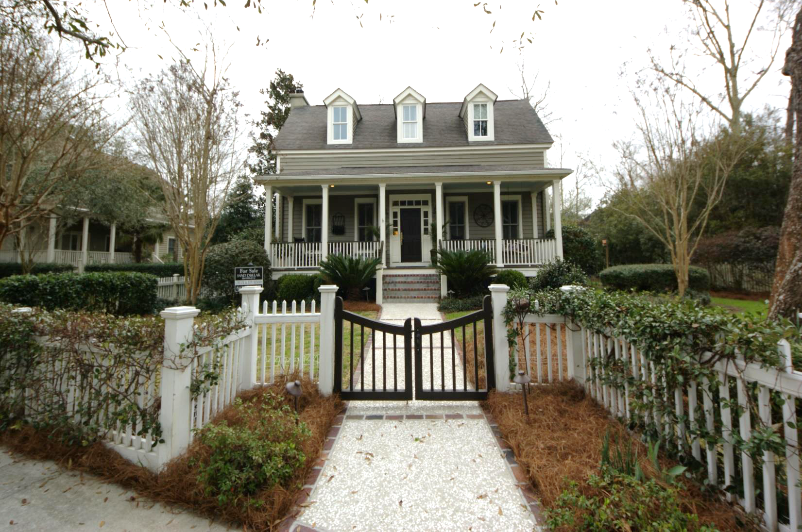
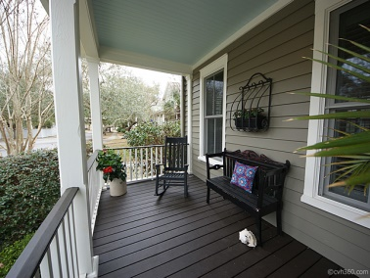
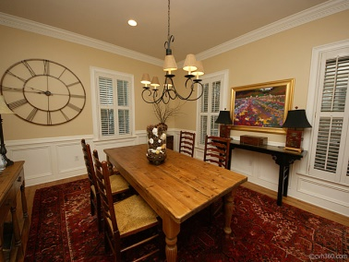
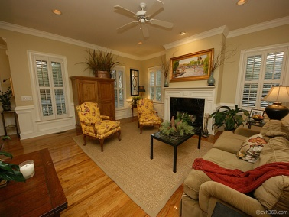
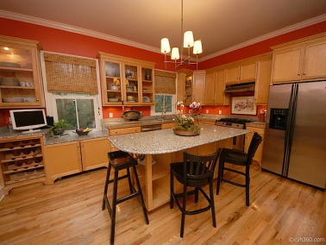
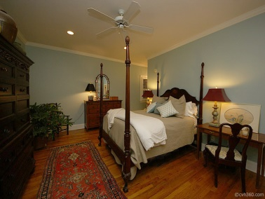
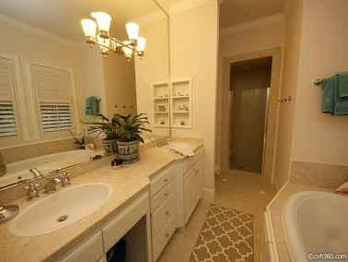
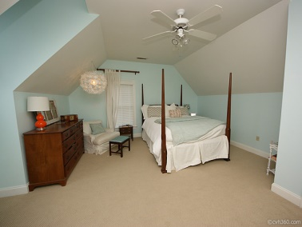
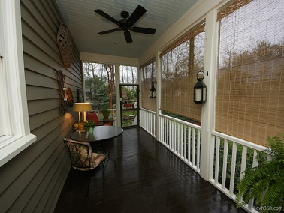
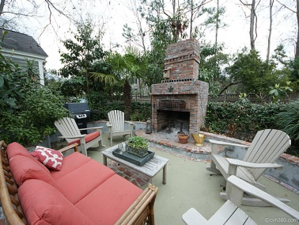
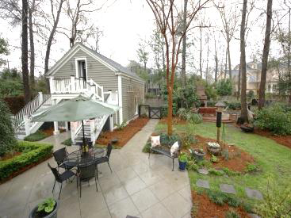


Agent Only Open House
August 6th from 11a-1p
58 Eastlake Rd
I’ON ~ Mount Pleasant, SC
MLS# 1406905 ~ $955,000
Register for Dinner at Obstinate Daughter
at our Agent Only Open House .
Welcome to this beautiful home in the highly desirable neighborhood----Ion in Mt Pleasant. This awesome family home is located very close to the Ravenel bridge, Waterfront park and Patriot's Point. Ion is also convenient to downtown shopping, award winning dining, and nationally ranked health care. This home is on one of the largest lots in ION, with a lush and carefully landscaped yard for privacy. As you enter through the white picket gates, you will love the welcoming Charleston front porch with rockers and a swing. Open the door to the inviting living area with a beautiful fireplace and a conveniently located wet bar. Notice the hardwood floors and attention to detail. The dining area is the perfect space for family suppers or dinner with special friends and extended family. The kitchen has been freshly painted and has granite countertops and custom cabinets and as an added bonus...the dishwasher is less than a year old. You will love the seclusion of the downstairs master suite and its proximity to the screened porch. The master bath has double sinks, granite counter tops, a deep soaking tub, a separate shower and linen closet. There is an additional half bath and laundry room located on the first floor. Upstairs you will find 3 nice bedrooms and an office, studio or playroom depending on your family's needs. Upstairs also has two full baths. You will not believe the backyard! If you enjoy gardening you will appreciate a variety of shrubs and flowers that offer privacy and beauty. The current owners built a wonderful outdoor living area complete with a fireplace, sitting area and a built in cooking station. You can even set up a television to enjoy the fall football season in this lovely addition. With the weather in Charleston, you will use this often. There are bluebirds that return every year. In addition to all of this, you have a separate carriage house with another full bedroom, bath and a light cooking area. Add a small fridge and owners say the separate carriage house can be rented out for added income or a nice place for your guest. The carriage house is located above a spacious two car garage. Ion has fantastic amenities including a pool, walking/biking trails, lakes and a club house. Additionally, Ion has it's own shops and several dining options--- all within walking/biking distance of your new home at 58 Eastlake. A home warranty is included.
Chuck & Edy Mimms
Cell 843-224-9507
Office 843-530-8100
www.sanddollarsc.com
www.facebook.com/Sanddollarsc
Sand Dollar Real Estate Group | 2205 Middle Street | Suite 203, Mailbox 2 | Sullivans Island, SC 29482

