Slide 1
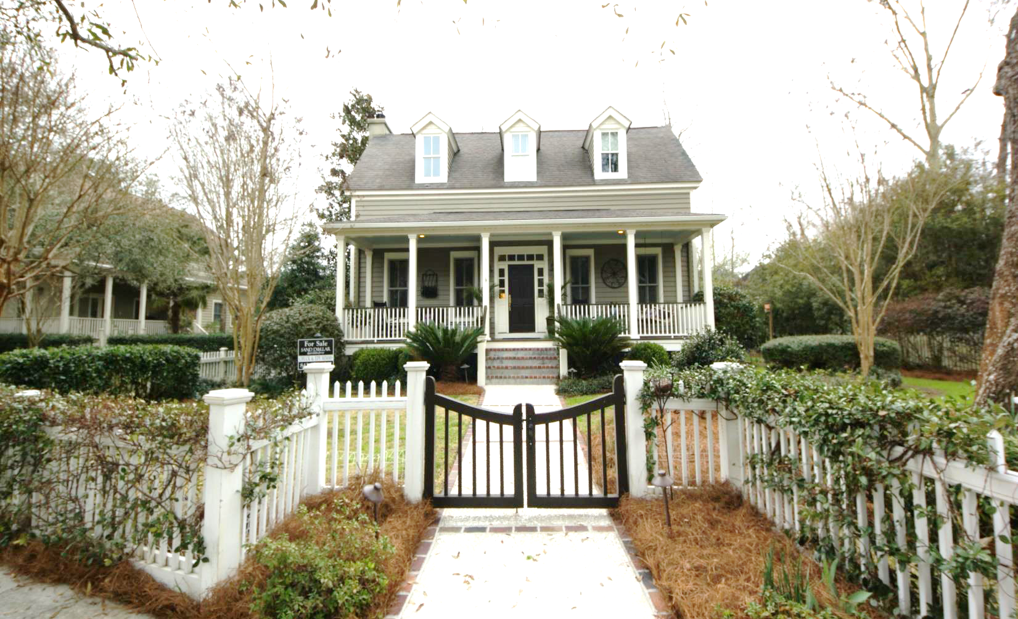
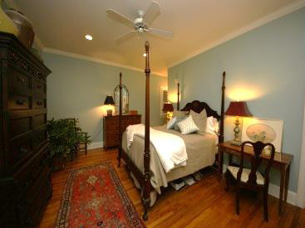
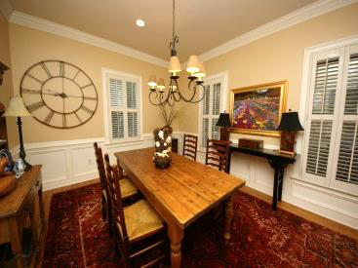
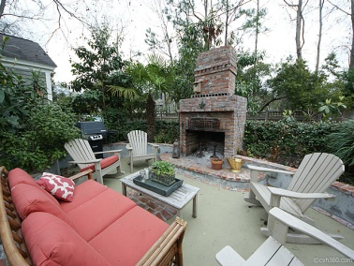
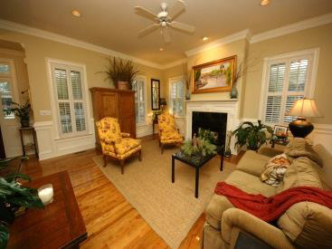
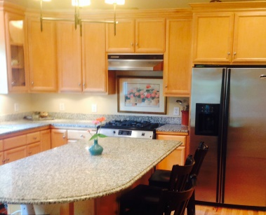
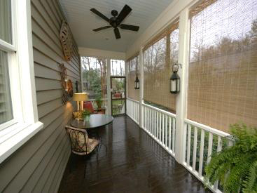


Great Family Home in I’On
Just Reduced!
58 Eastlake Rd
Mount Pleasant, SC ~ MLS# 1406905 ~ $930,000
5 Bedrooms :: 4½ Baths :: 3,336 sf :: Separate Carriage House
Chuck & Edy Mimms
Cell 843-224-9507
Office 843-530-8100
www.sanddollarsc.com
www.facebook.com/Sanddollarsc
Sand Dollar Real Estate Group | 2205 Middle Street | Suite 203, Mailbox 2 | Sullivans Island, SC 29482

