Slide 1
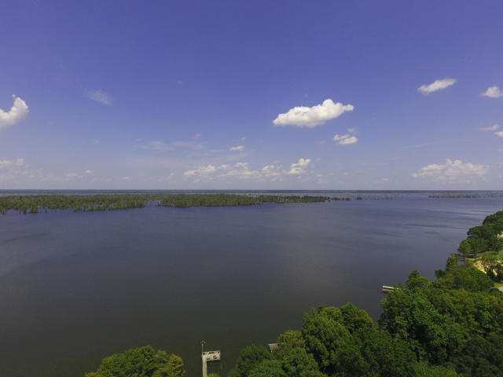
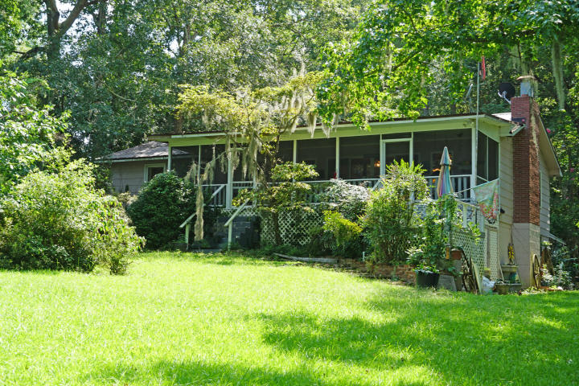
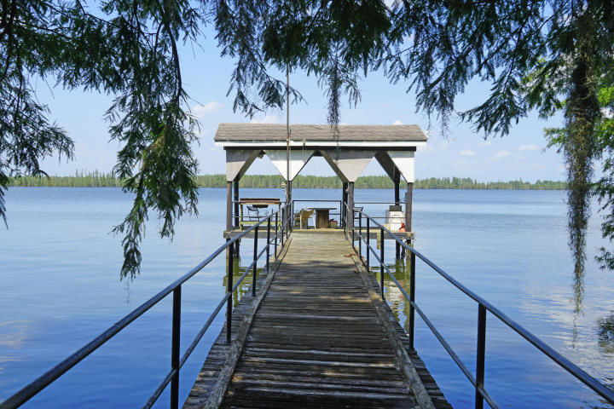
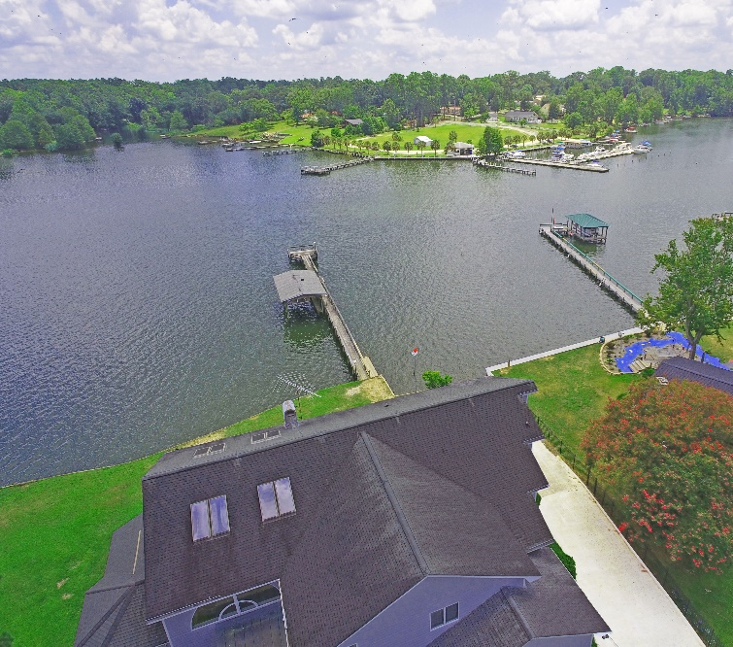
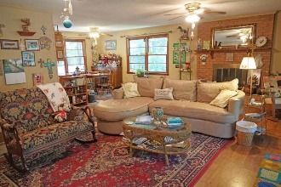
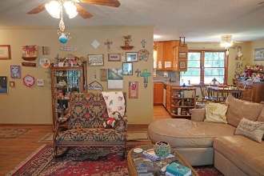
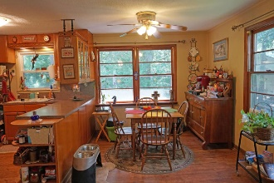
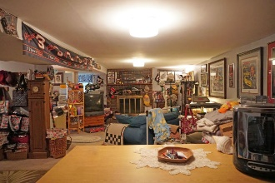
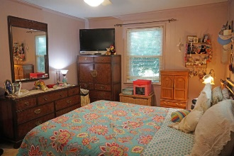
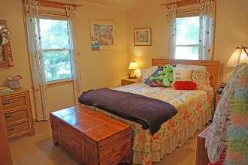
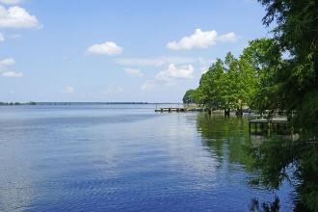

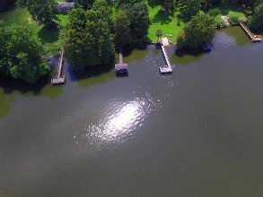


Waterfront on Lake Marion under 360k
58 Pintail Lane
Elloree, SC 29047 ~ MLS# 19021904 ~ $225,000
Travel from your dock to Charleston via the boat. Enjoy all the area has to give with boating, fishing, swimming, golfing and state / national parks. This home sits on a large natural 1.74 ac lot. The home has 3 bedrooms and 2 bath on main floor and half basement that can be the man cave or extra den. Lots of extra storage in car port and under the house. The screened in porch for coffee watching the sun rise. The home list price is $225,000 with a land buy out of $127,250 per Santee Cooper until July 2020.
Lake Homes Realty, LLC
Elloree, SC 29047
www.SCLakeLife.com
Kristie Anderson
(803) 387-9459
kristie@sclakelife.com

