Slide 1
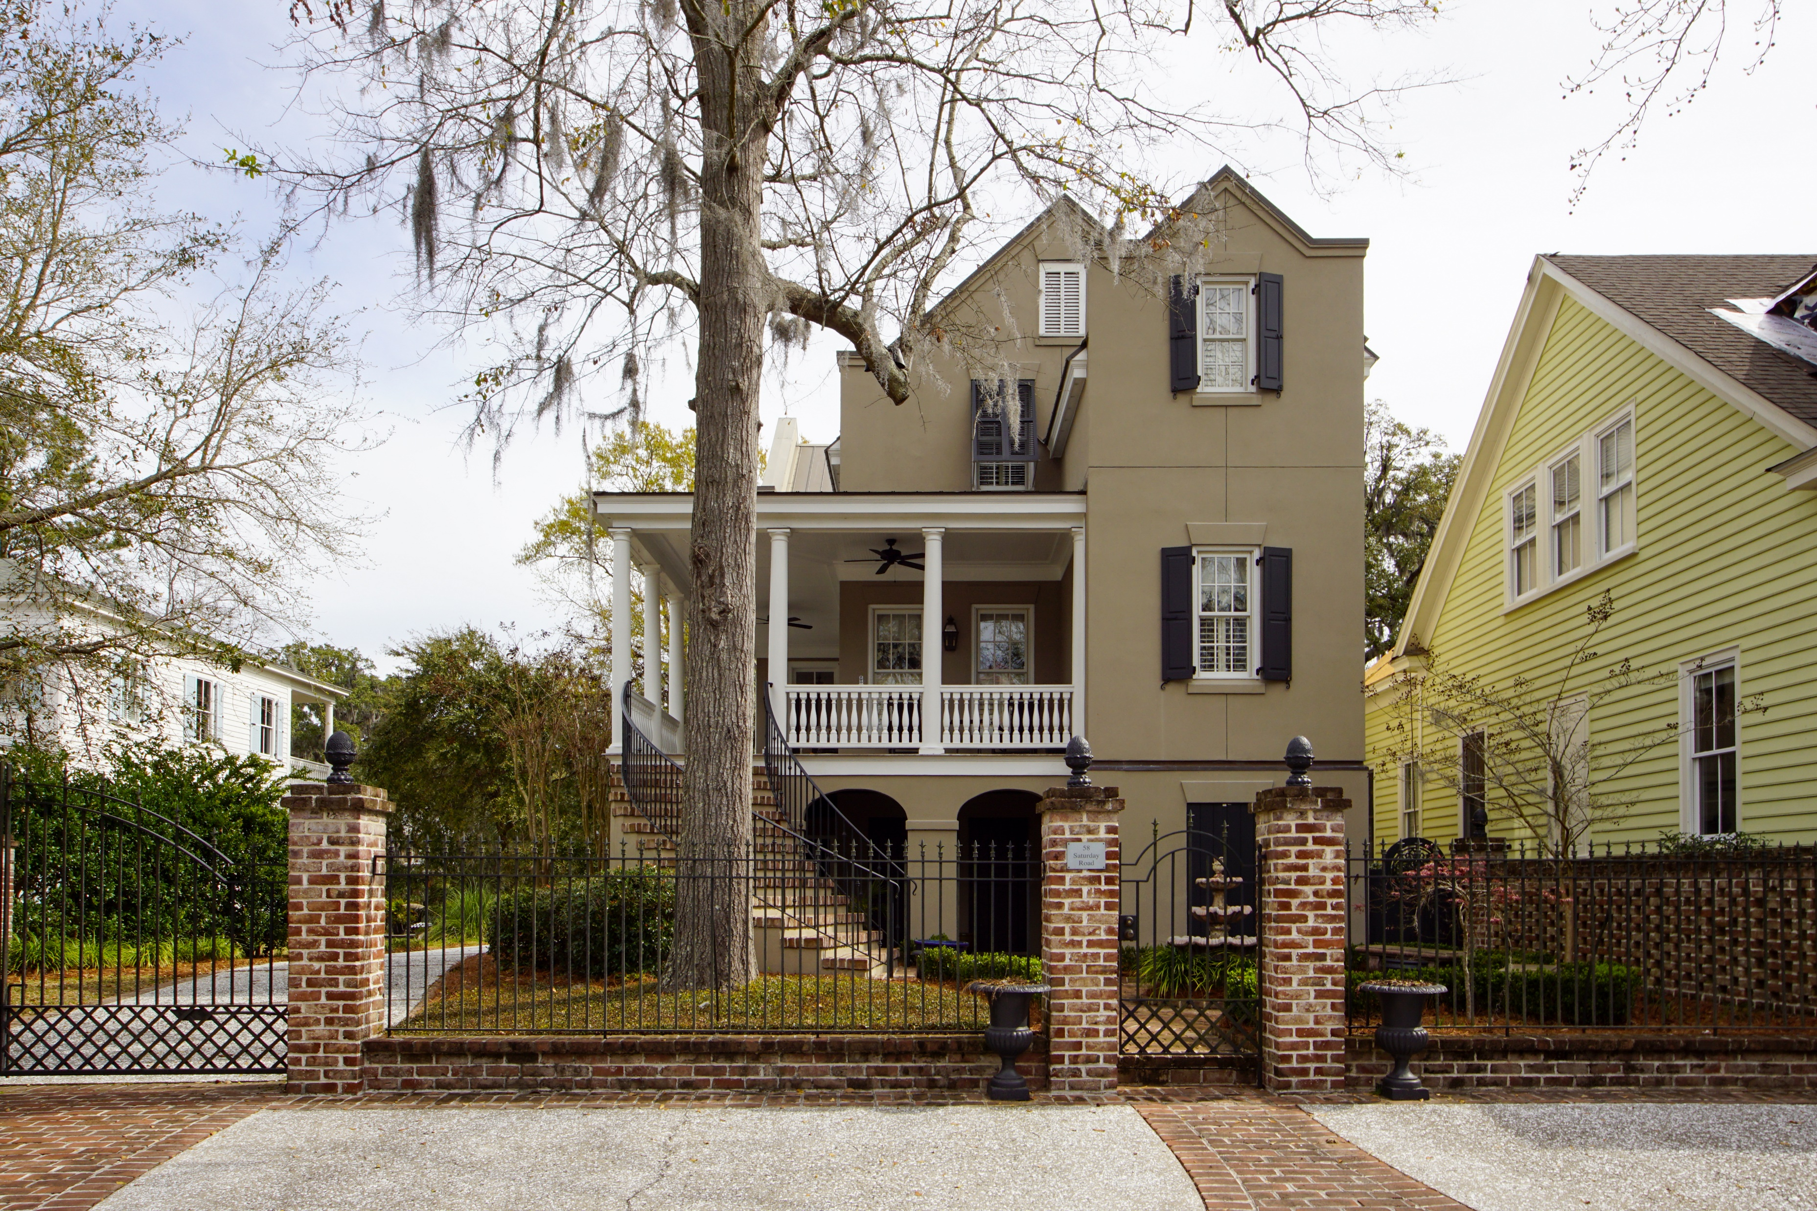
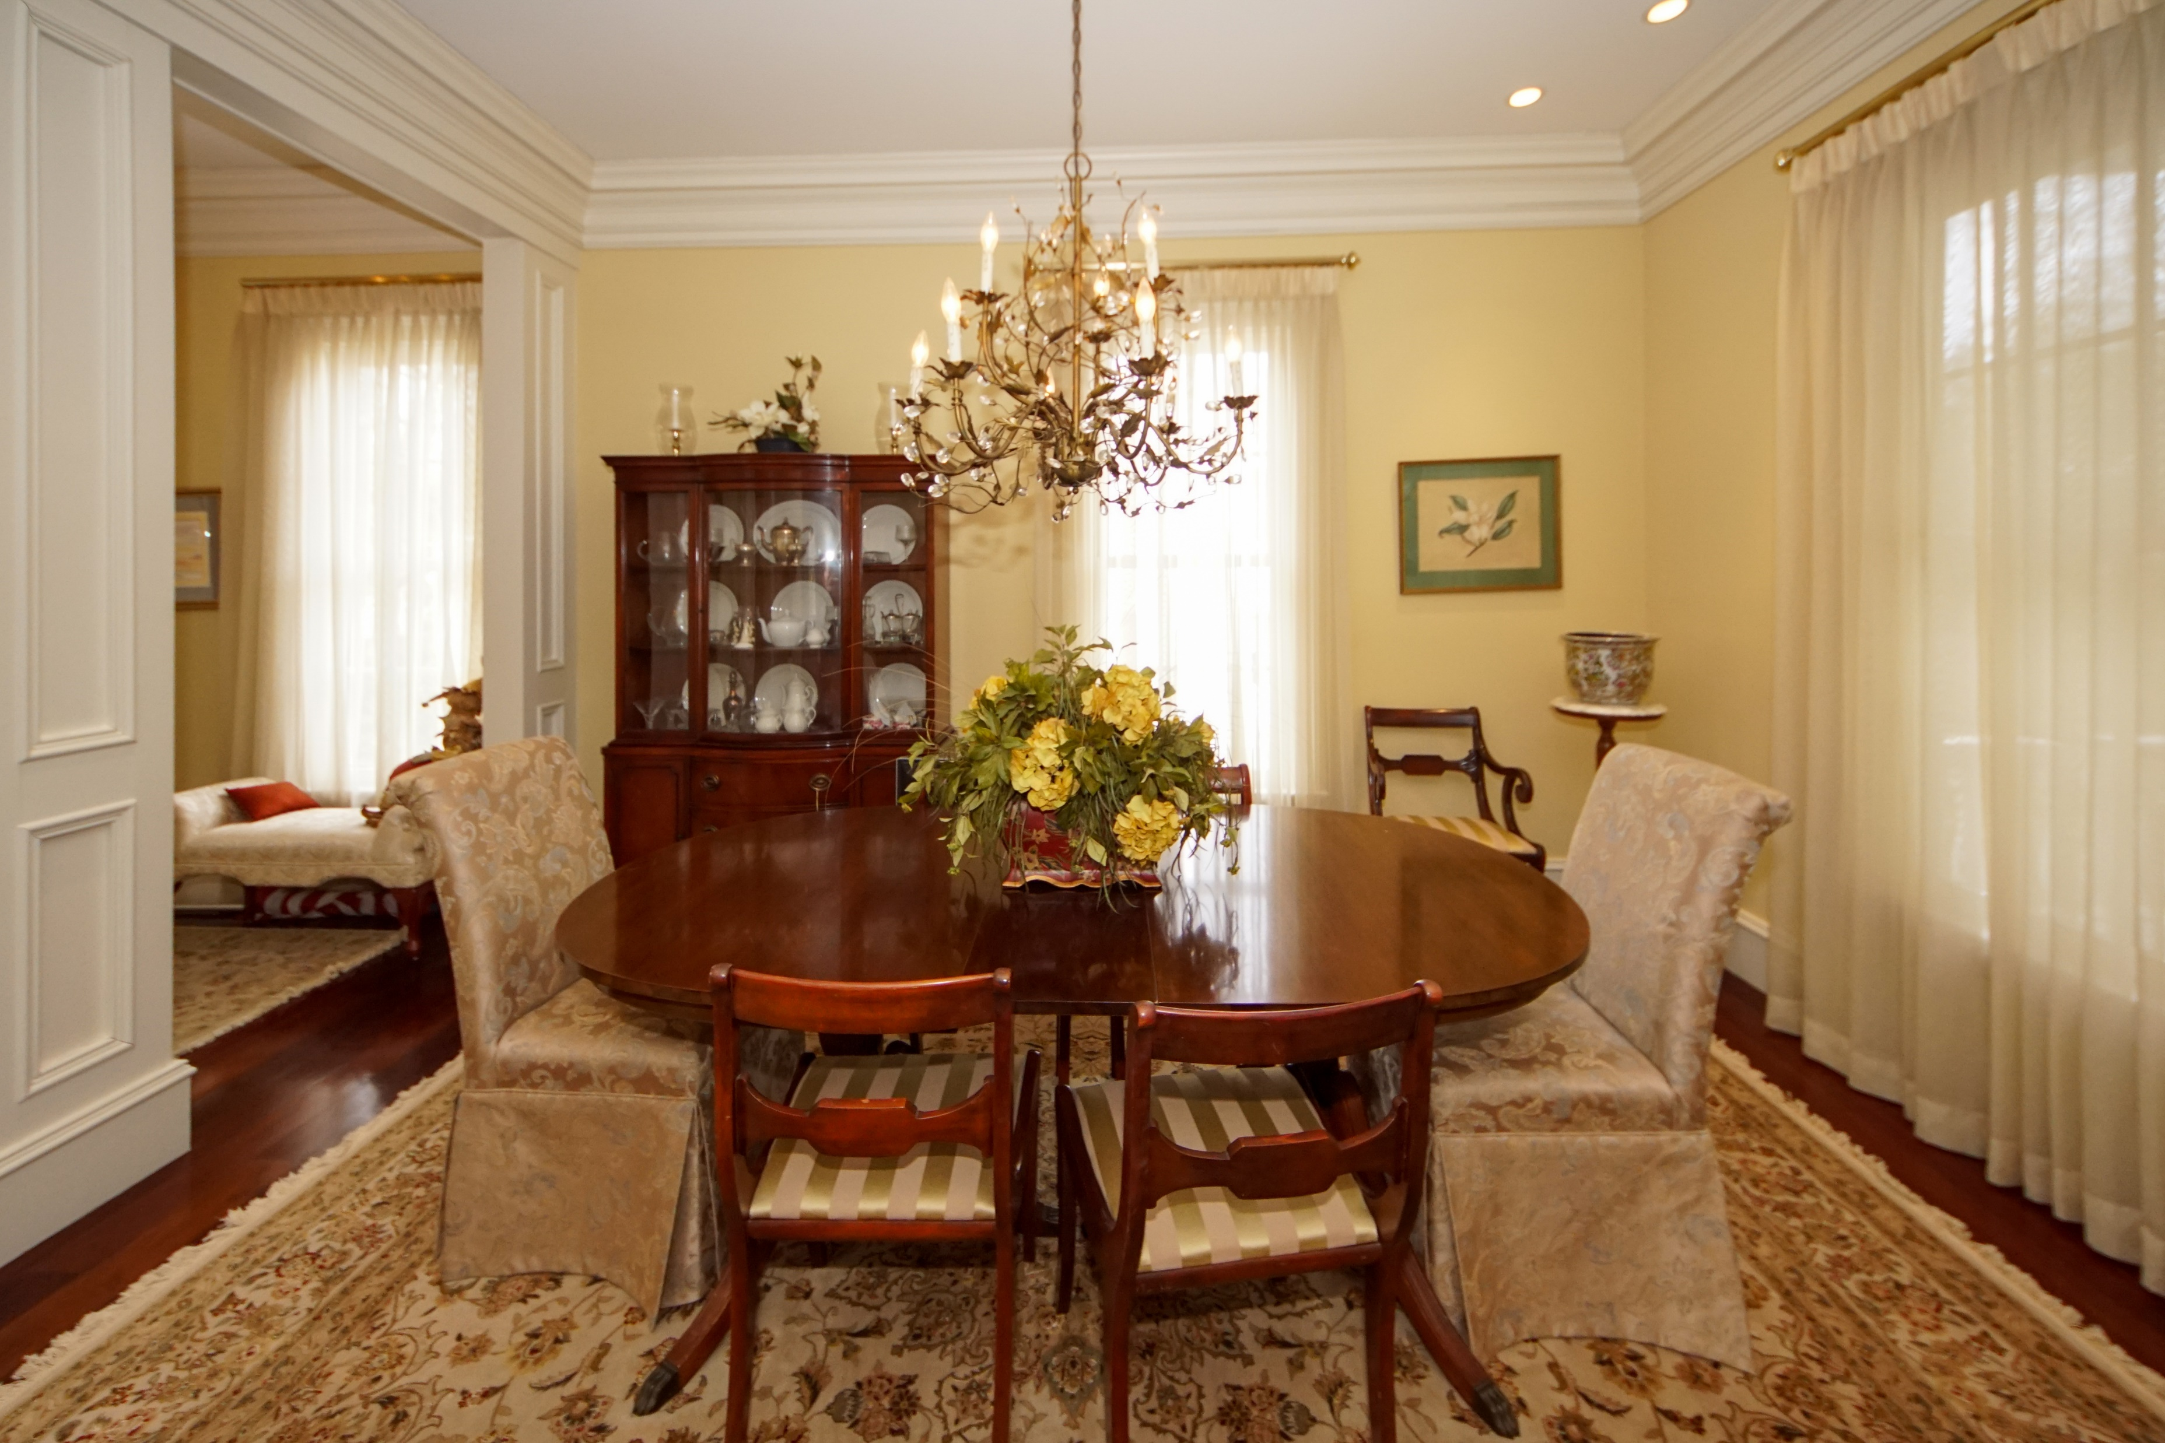
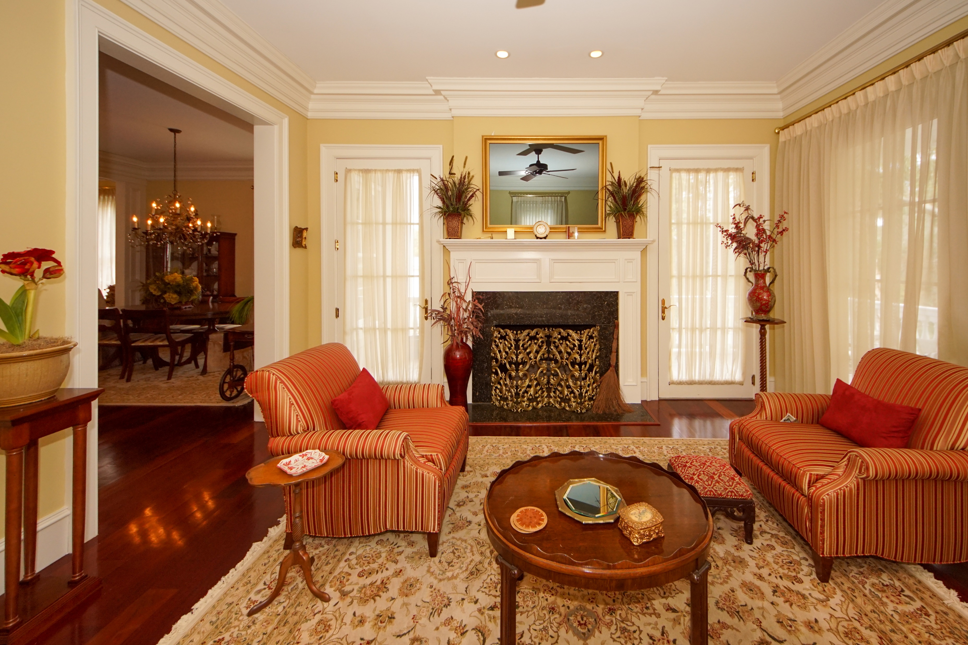
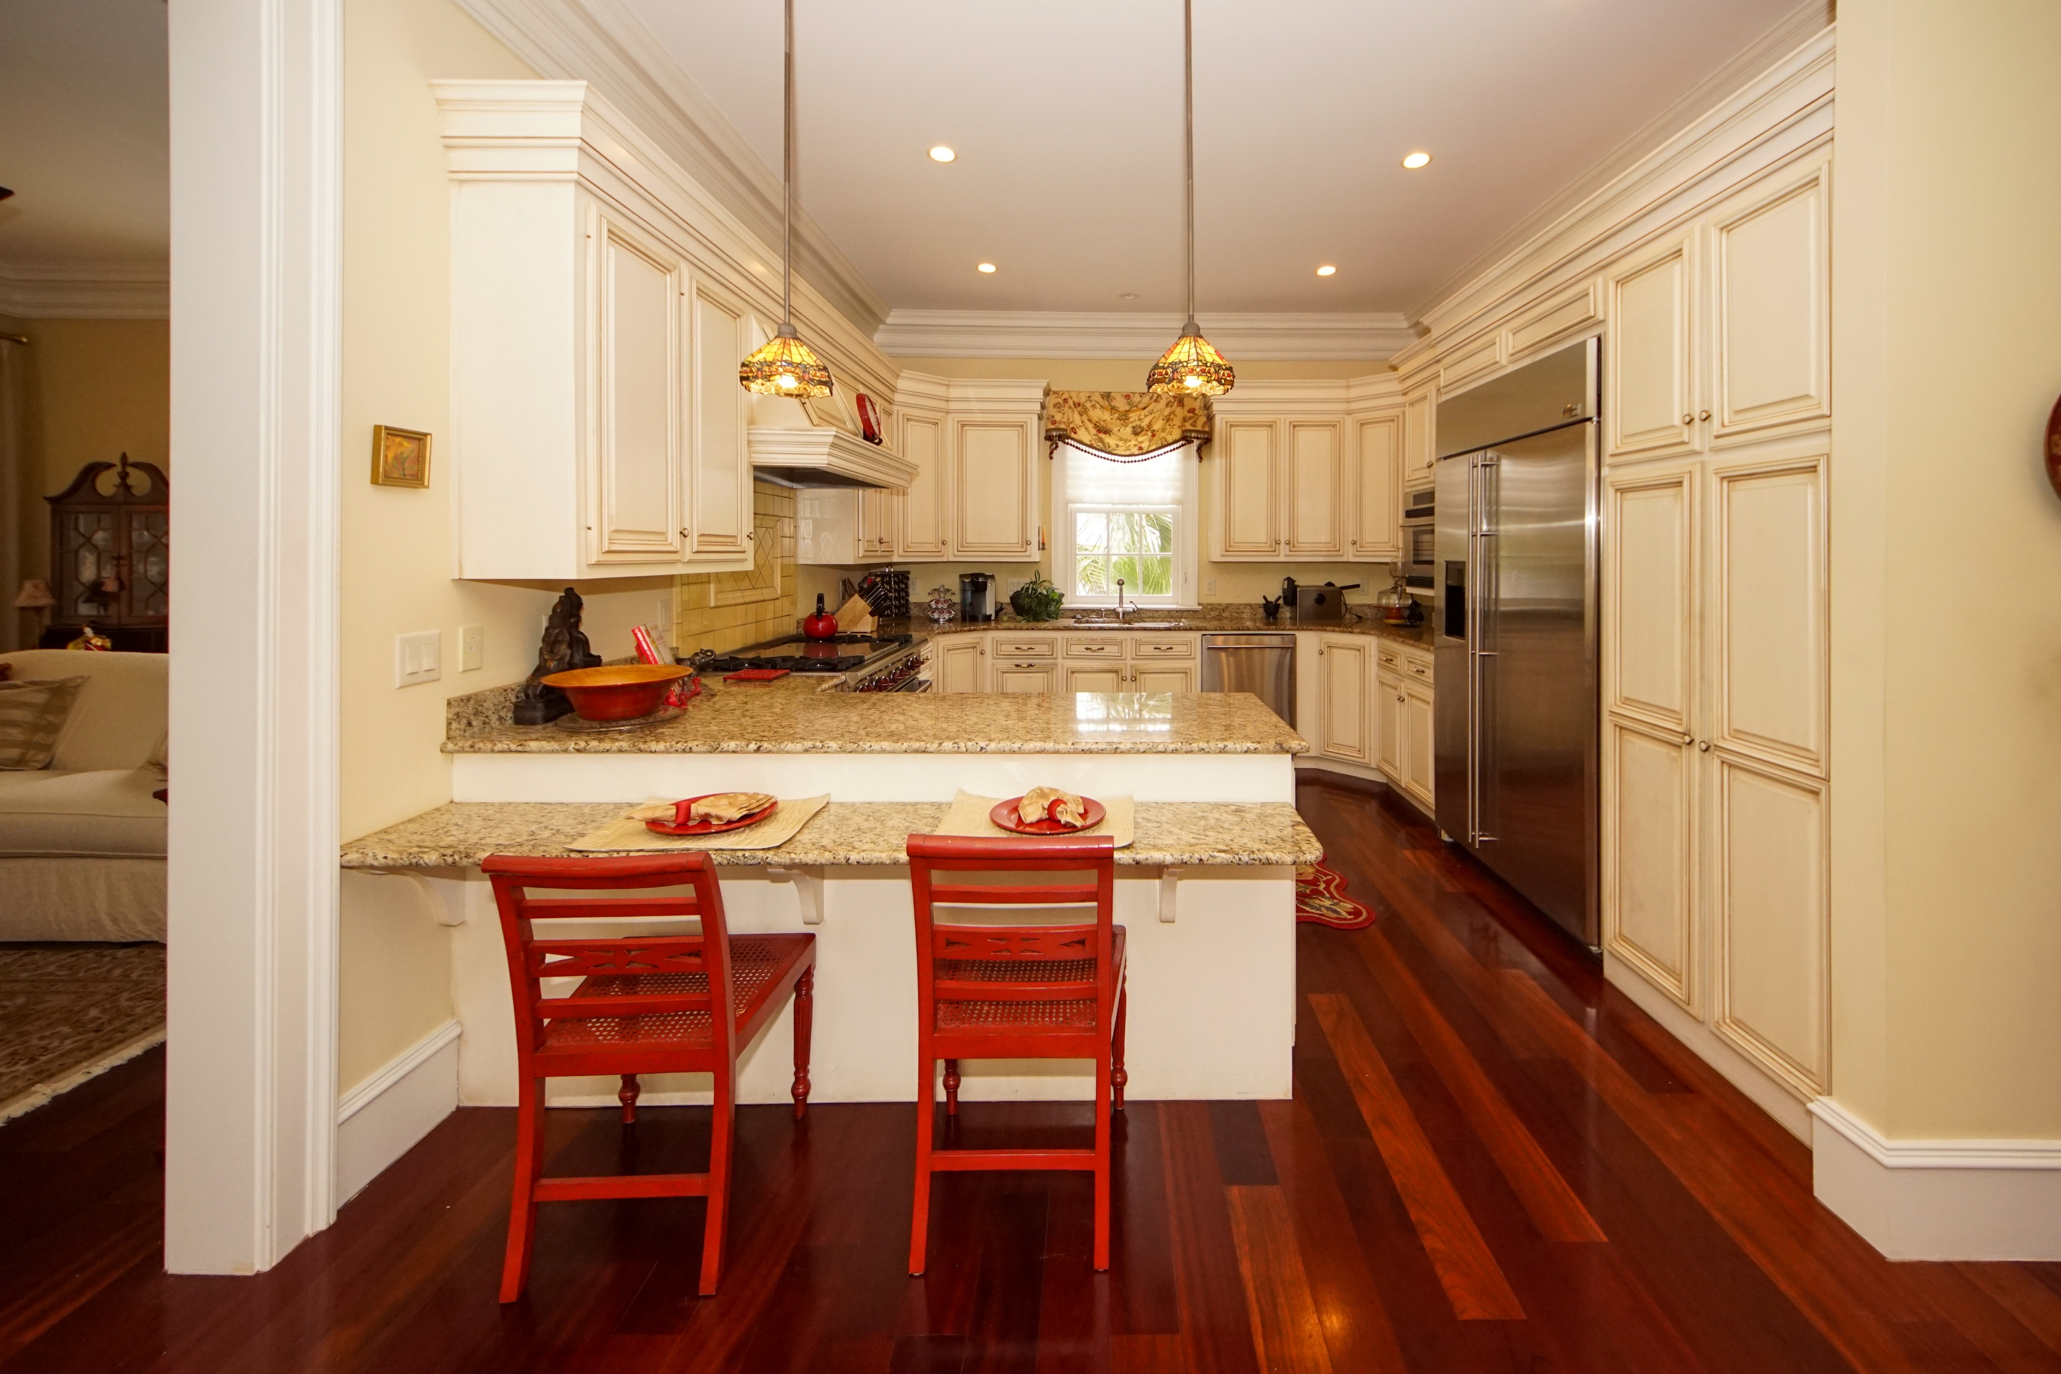
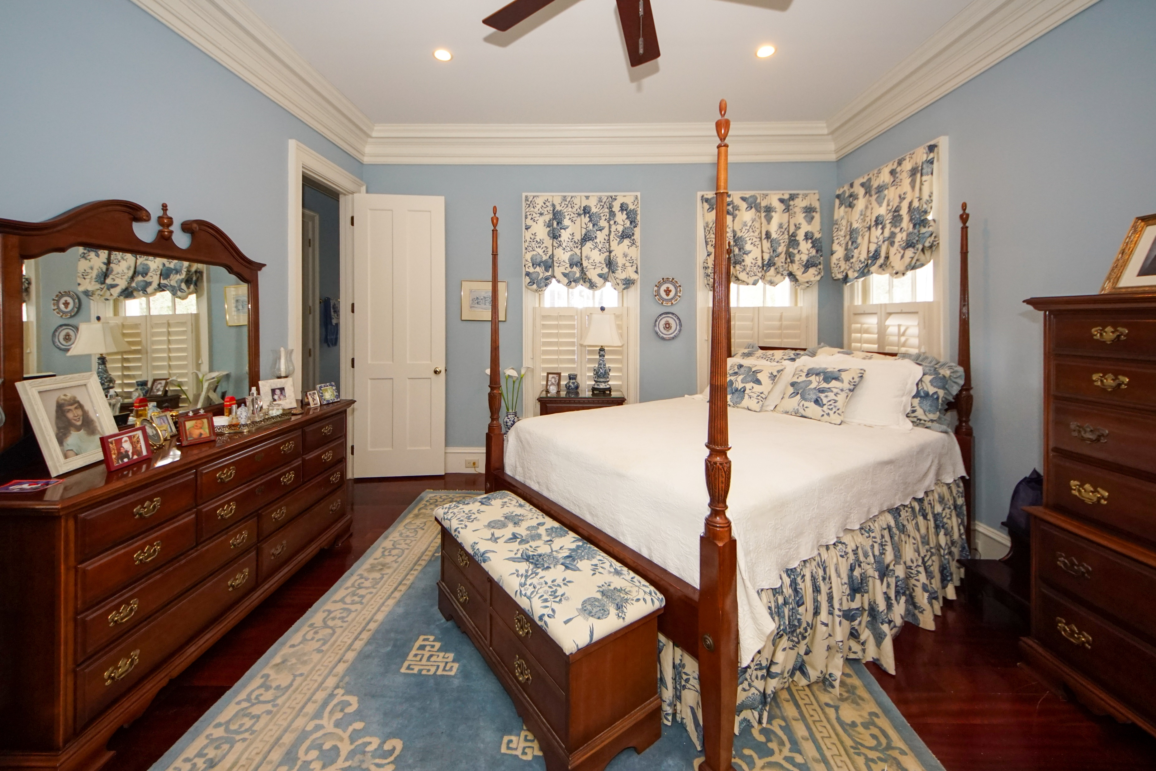
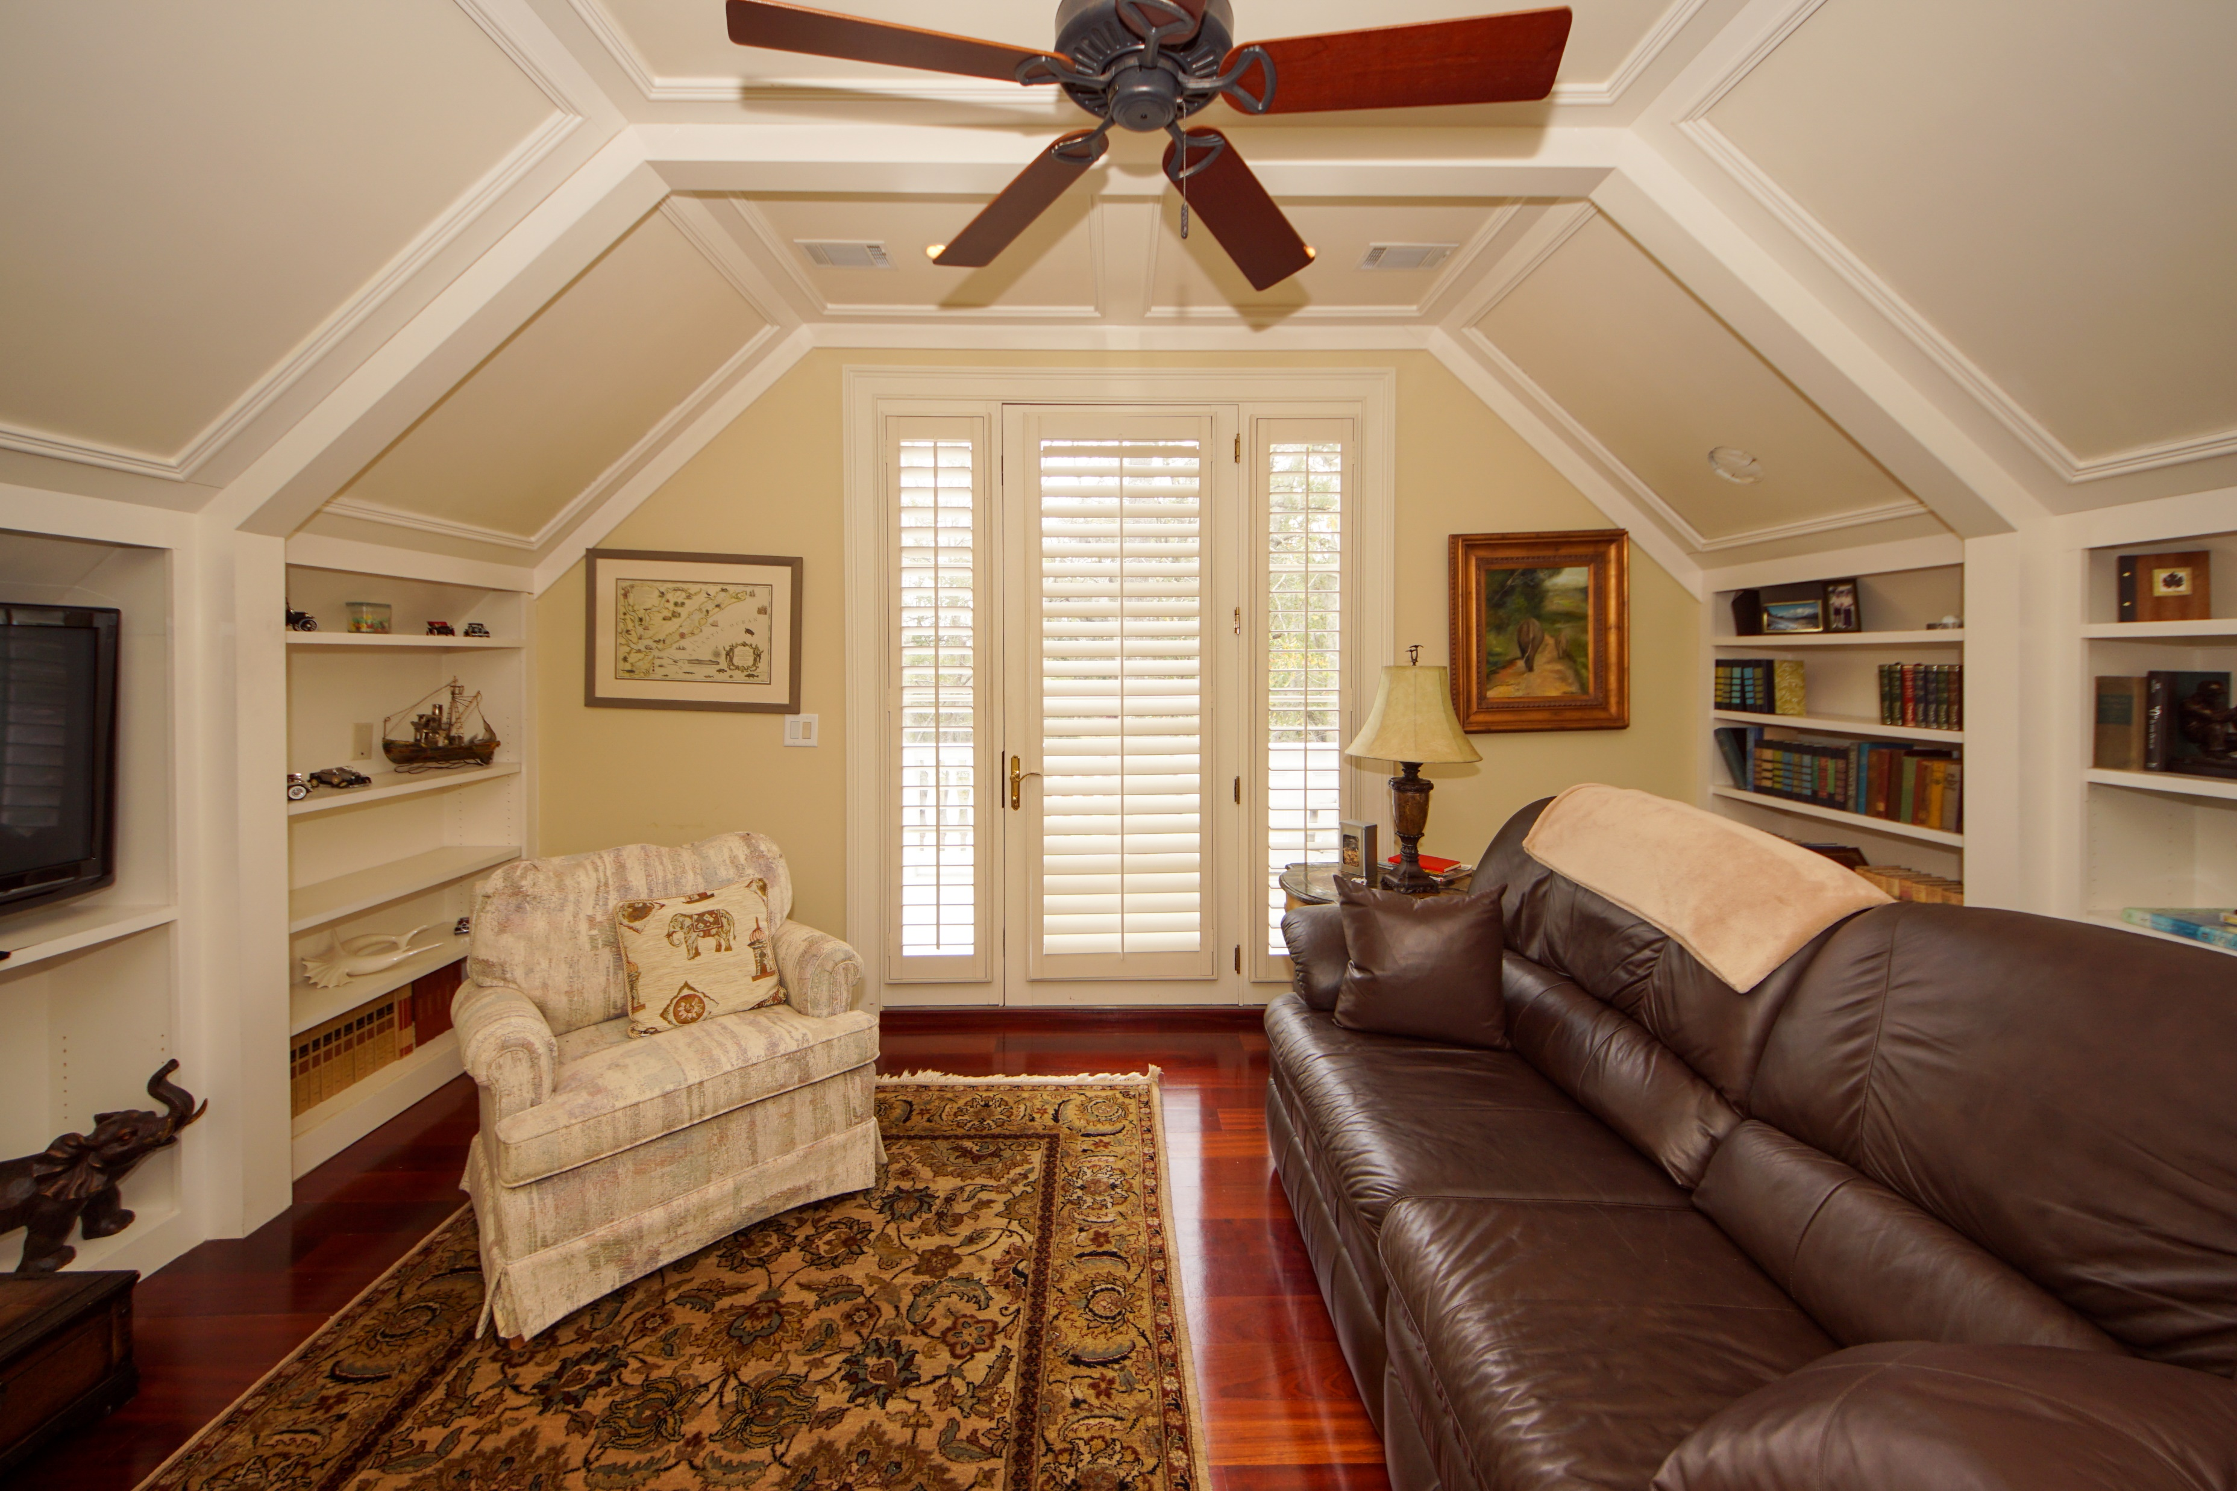
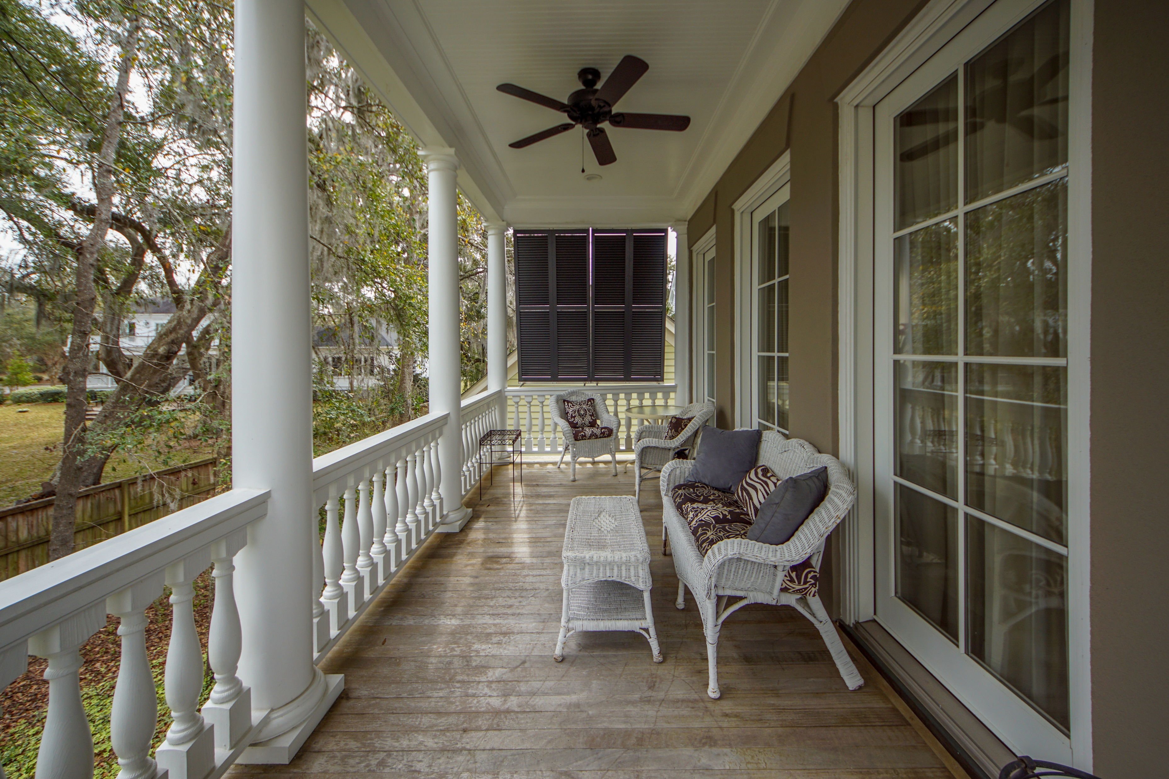
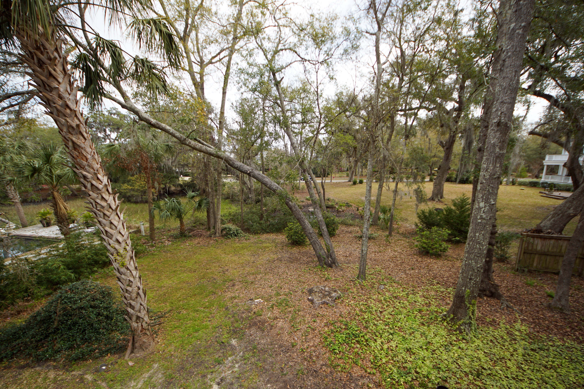
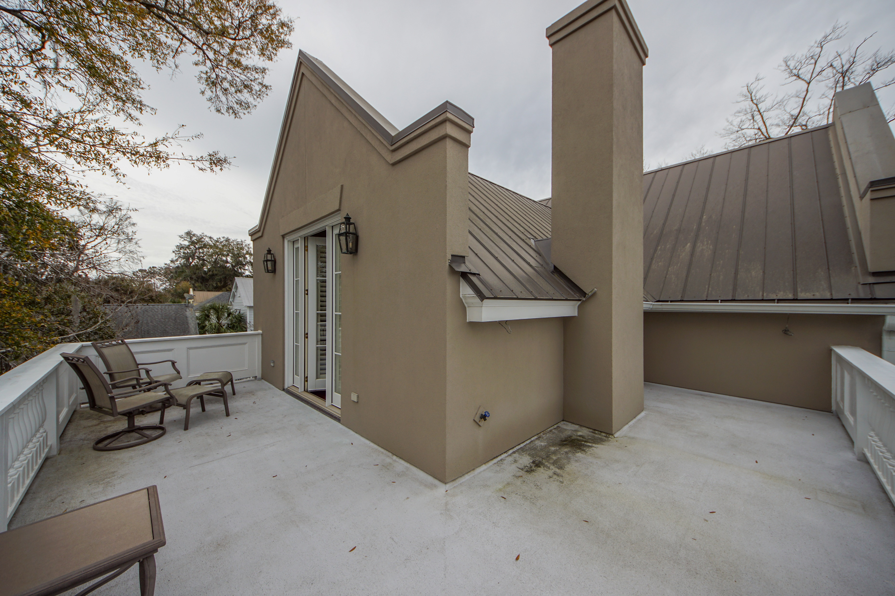
I’On Beauty
58 Saturday Road
I'On ~ Mount Pleasant ~ MLS# 20006606 ~ $1,595,000
One of the nicest interior lots in I'on. Close to the clubhouse. Stucco exterior, wrought iron fencing, gated driveway. Parking pad in front, oversized 2 car garage, and ample parking up to 5 vehicles. Lower level has a large storage area and a heated/cooled office /Rec area. Elevator from lower level to 1st level floor. First level has a foyer, dining room, laundry, kitchen w breakfast bar and great room. Master bedroom has large closets. Master bath with jetted tub. Second level has sitting area, 3 bedroom and 2 baths. Open deck area on 3rd floor. Front features curved stairway with wrap around porches on front and rear of house. Fountain in front courtyard. Generator will not convey. Brazilian Cherry floors throughout. Top of the line appliances. Extensive moldings. Irrigation System.
Bonnie Miller
843.884.3901 O ~ 843.693.2647 M
bcm.olddom@gmail.com
Old Dominion, REALTORS · 890 Johnnie Dodds Blvd · Mt Pleasant, SC 29464

