Slide 1
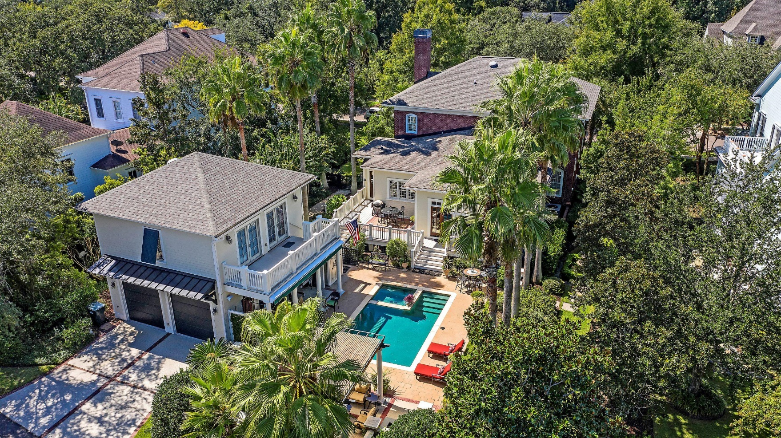

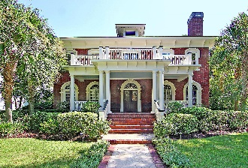
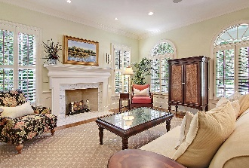
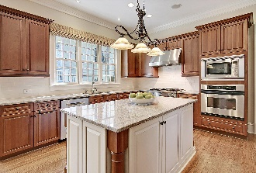
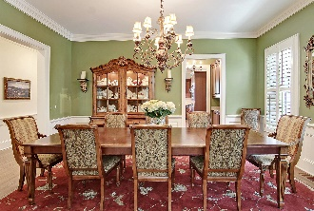
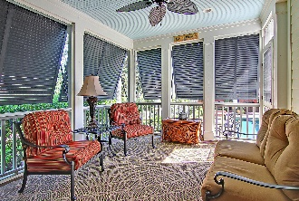
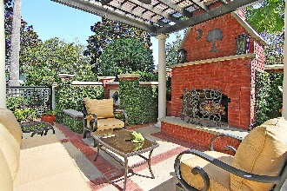
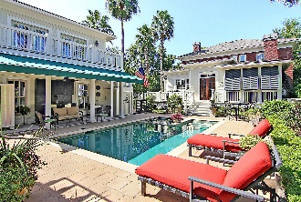
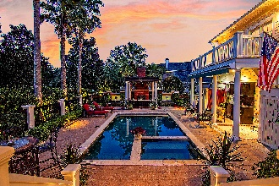
Daniel Island Park With Pool!
58 Woodford Street
Daniel Island Park | Charleston | MLS# 20027368 | $1,795,000
Traditional meets tropical in this custom built home nestled on a quiet street in the Lowcountry's premier golf course community of Daniel Island. Enjoy outdoor island living year round in this 5 bed, 5.5 bath home. The private backyard oasis offers endless nights of entertaining with a heated saltwater pool & spa, outdoor shower, pergola with outdoor fireplace & seating area, outdoor bar with retractable awning, grilling deck and screened in porch. FROG over detached 2-car garage features separate bedroom, full bath, living room/home office with built-in cabinets, and balcony overlooking the pool and gardens. First floor master suite has a walk-in closet with custom built-ins. Upstairs you will find 3 bedrooms all with ensuite baths and a loft area. Chef's kitchen features stainless steel appliances, center island and Butler's pantry with wine fridge. Breakfast area with French doors that open to the deck and pool area. Elegant formal living room with fireplace and pocket doors open to a spacious dining room perfect for gatherings with family & friends. Additional highlights include hardwood floors, surround sound and speakers throughout the main living areas. Daniel Island amenities include 2 private golf courses, 2 resort style pools, tennis courts and state of the art fitness center. Community amenities include miles of walking/biking trails, multiple playgrounds, community boat ramp, shops, restaurants and the Volvo Car Stadium - a great venue for concerts and sporting events.
Paige Rhodes 843-830-3281
paige.rhodes@carolinaoneplus.com

