Slide 1
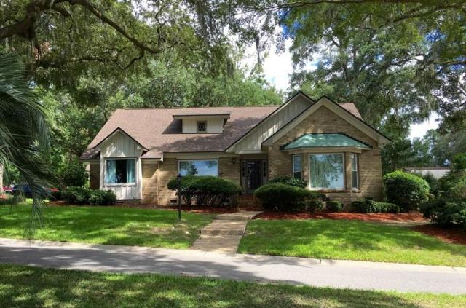
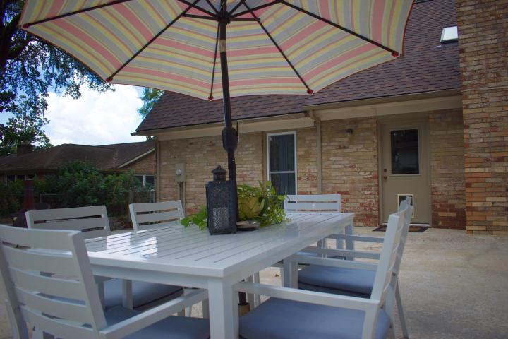
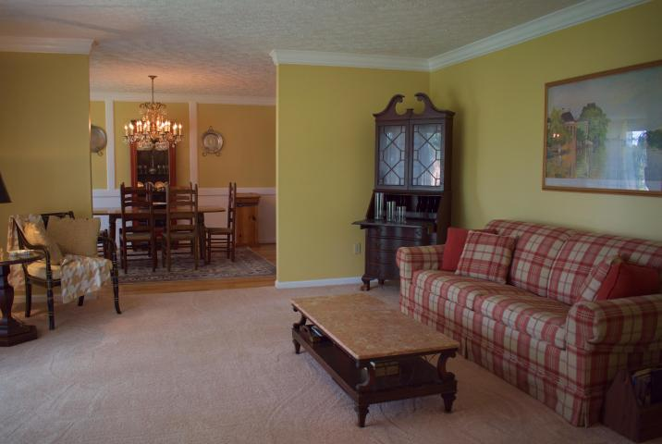
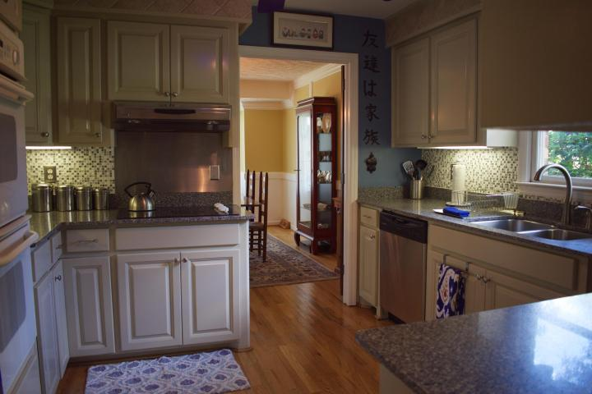
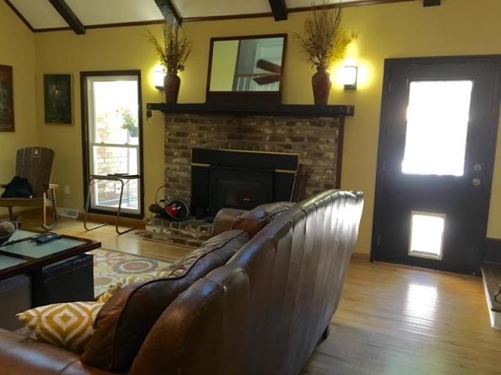
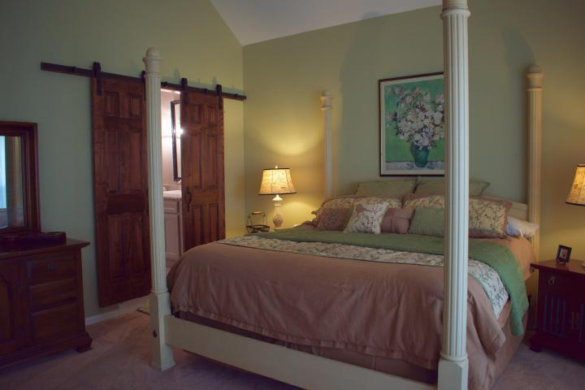
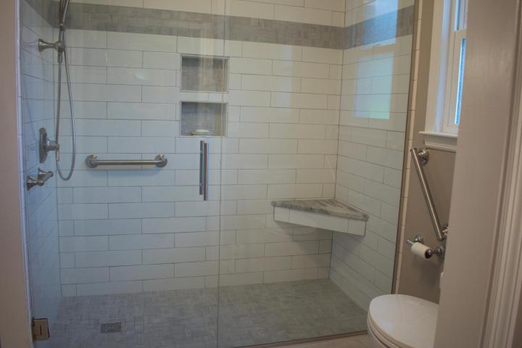


5907 Kings Court
Hanahan ~ MLS# 17021677 ~ $435,000
Move-in Ready Home in Dominion Hills
5 Bed / 4½ Bath
3,889 Sq Ft
Custom Home
Desirable Location
Hardwood Floors
2-Story Great Room
Great Backyard
Superior custom built home in the one of the most desirable neighborhoods in Hanahan, Dominion Hills. This home sits on a corner and a cul-de-sac lot off Dominion Drive. The great room offers Cathedral beamed ceilings with skylights which allows for lots of natural light. The first floor offers the master bedroom with it own newly remodeled master bath. There is also a 1st floor guest bedroom and an office. There are two bedroom upstairs with their own bathrooms. The FROG is currently used as a game room but could be used as a 5th bedroom or as a mother-in-law suite with it's own bath as well. The current owners have added several improvements over the years, new SC safe roof with impact resistant skylights installed 2014, new dishwasher and refrigerator 2017, several doors replaced 2017. All window are replacement windows, 5 downstairs windows have been replaced recently. The home has an over sized two car garage along with a lit carport perfect for a boat or RV, trees have recently trimmed, two separate HVAC systems ( downstairs unit replaced 2016), recently pressured washed, doggy door out to back fenced yard. This is a great home for a growing family that needs a lot of space. This home is being sold AS-IS, this home has been well cared for and is in move-in ready condition, but it is not a NEW HOME!! Pool table conveys with the sale of the home.
Leah M. Rust
843-709-9211 Mobile
843-856-8800 Office
leahmrust@gmail.com
Coldwell Banker RESIDENTIAL BROKERAGE

