Slide 1

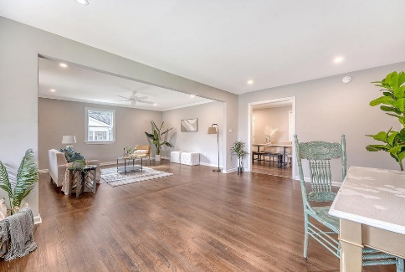
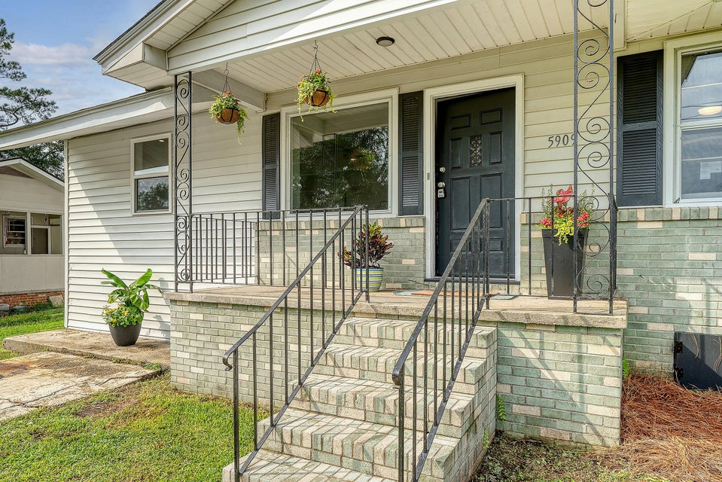
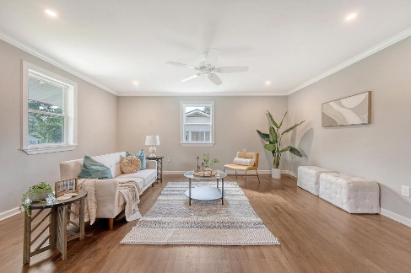
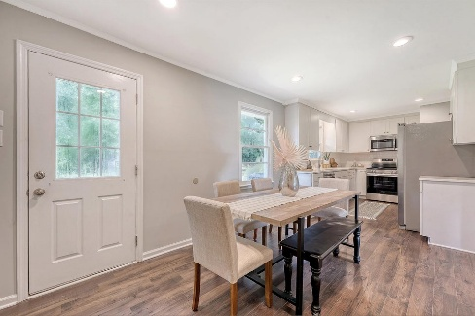
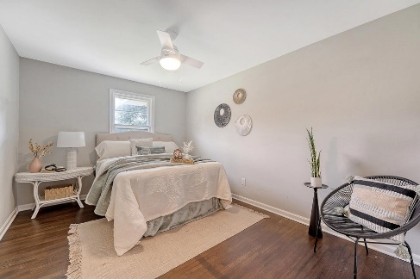
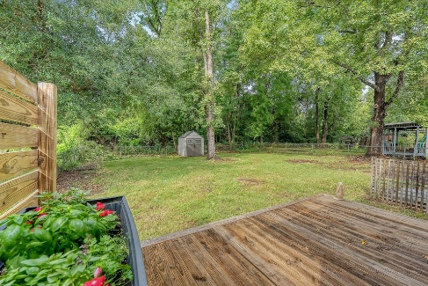
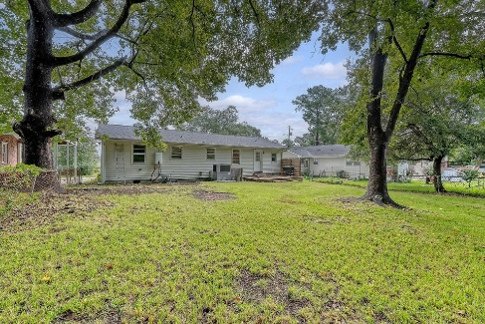


5909 OAK STREET
River Side · Hanahan, SC 29410
MLS# 25021524 · Reduced to $360,000
New Price!
Saturday, May 5th At 11:00a
Welcome home to this adorable completely renovated ranch. Brand new roof, gorgeous kitchen cabinets, quartz countertops and stainless steel appliances.
Gorgeous flooring throughout the whole house. Renovated full hall bath with new vanity and shower with tiled walls. 2nd bath with a shower and new vanity and room for washer/dryer.
Great kitchen fits a large dining room table for entertaining or family meals. The great room area has tons of space for multiple sitting areas for the whole family to enjoy. Tons of natural light through the whole house.
Fantastic fenced in yard with great back deck for grilling, family fun or gardening. River Side is an amazing location close to it all.
1/2 mile from Hanahan High School. 15 minutes from Charleston, Mt. Pleasant or Summerville. Won't last long.
ANN EVANS
Carolina One Real Estate
843-452-4605
aevans@carolinaone.com
www.charlestonluxuryrealestate.com
Carolina One Real Estate
195 W Coleman Blvd
Mt Pleasant, SC 29464-3495

