Slide 1

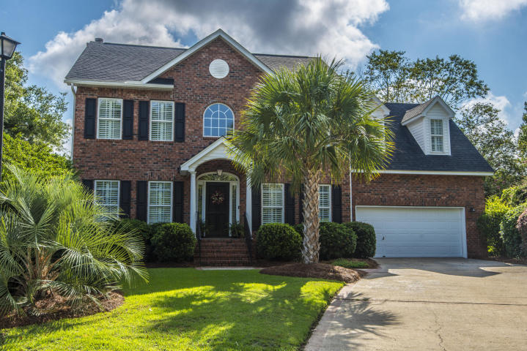
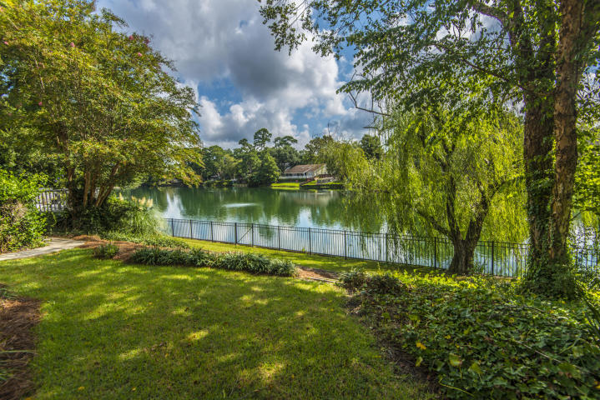
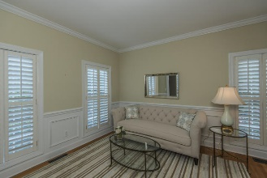
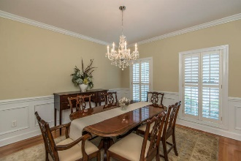
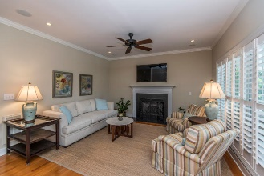
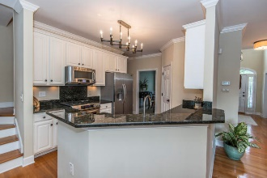
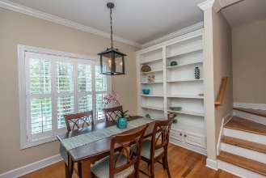
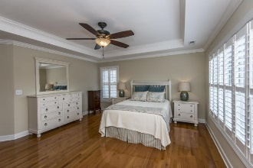
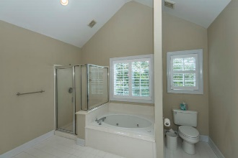
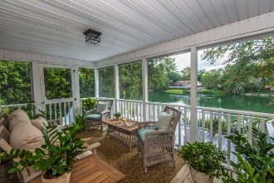
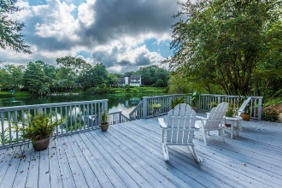
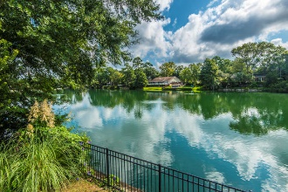

Well Maintained Brick Home On The Lake And Close To Everything!!
590 Heron Pointe Boulevard
Heron Pointe | Mount Pleasant, SC 29464 | MLS# 19023605 | $689,000
Enjoy the views of the 5 acre lake in the backyard from the screened porch, deck, master bedroom, family room, breakfast room and 4th bedroom. This home features high ceilings, natural light, hardwood floors upstairs and downstairs. As you walk in the front door you are greeted by a large foyer with a formal living room on the left and a dining room on the right. You will see the beautiful lake from the family room which has a door to the screened porch. Spacious kitchen with ample counter top space and cabinets. Breakfast area with built ins is a great place for a meal! Upstairs you will find the master bedroom on the back of the home with a large bathroom and walk in closet. The secondary bedrooms are a nice size and share a full bathroom. The 4th bedroom could be an office, play room or extra den. The outdoor living space in this home is not to be missed. Screened porch leading to a large deck that is great for entertaining and grilling out. The 5 acre lake is a wonderful accent to the backyard!!! There is a nice size grass area - all fenced in.
Carolina One Real Estate
195 W Coleman Blvd
Mt Pleasant, SC 29464-3495
Jennie Hood Emerson (843) 327-0384
jhood@carolinaone.com
www.yourcharlestonhomes.com

