Slide 1
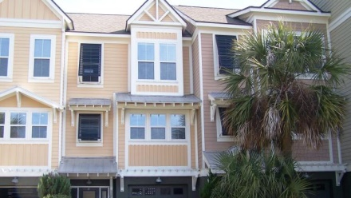
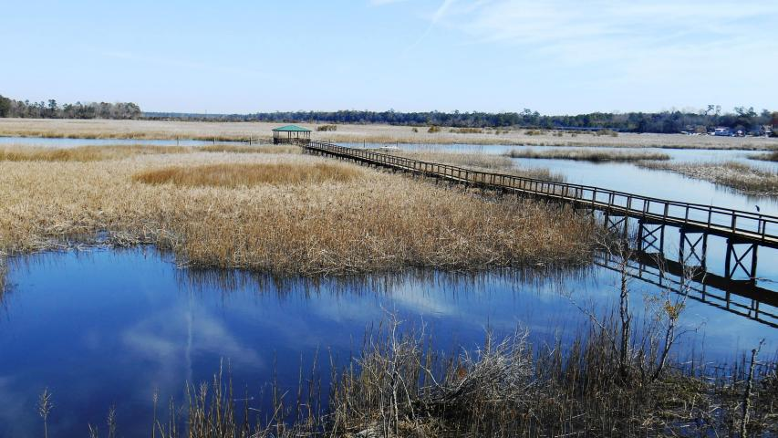

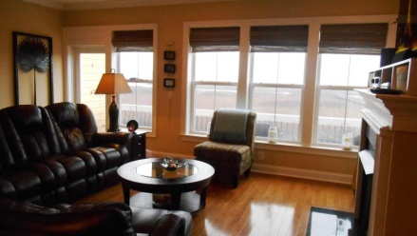
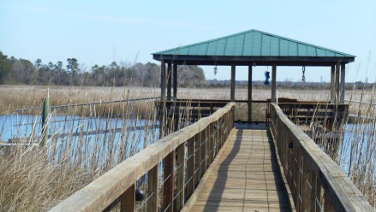
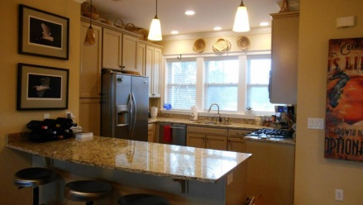



MILLION DOLLAR VIEW
210 Barberry St
White Gables
Summerville
MLS# 1417492
$209,900
5911 Steward Street #18
Dominion Village MLS# 15005296
$334,900
BREATH TAKING marsh and water views from the deck of this townhome in Dominion Village with direct access to the Charleston harbor. Located in Hanahan on a tributary of the Cooper River, it offers excellent waterfront opportunity complete with 200 linear ft. of dock space (7 to 9 ft. at low tide), private boat ramp and a 20-foot covered area, perfect for fishing or picnics. This custom townhome with over $10,000 in upgrades includes a fireplace with gas logs, upgraded cabinetry and retractable awning for the deck. It features Architectural shingle roof, metal accents on most dormers, Hardi-plank siding, Bahama style shutters and 2 plus-car garage. Interior features include hardwood floors in living room, dining room, and stairs; granite countertops, crown molding, an optional elevator, Jacuzzi with tile surround, Frigidaire professional series stainless appliance package including refrigerator, microwave, gas range with drawer warmer and dishwasher. Master bath has full tiled shower. Hall bath has Jacuzzi with tiled floor and walls. Washer and dryer to convey with home.
This is true LOWCOUNTRY living...once you get here you won't want to leave!
Diane Watkins, ABR
Cell: 843-813-0276
Office: 843-821-1111
diane@milerproperties.com www.milerproperties.com
Miler Properties | 625 Old Trolley Rd | Summerville, SC 29485

