Slide 1

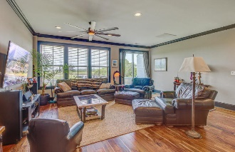
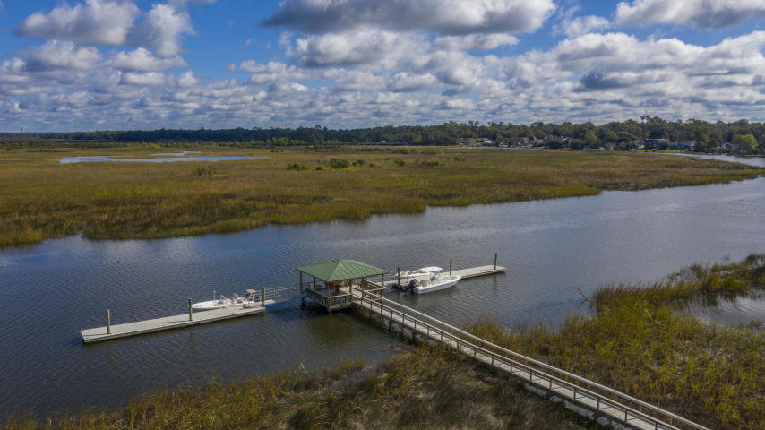

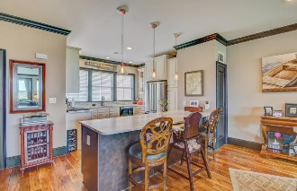

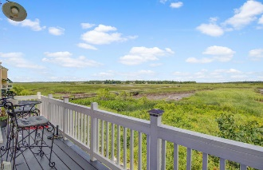

Waterfront Townhouse with Deep Water Dock This townhouse is move in ready! May be purchased fully furnished with a reasonable offer.
5911 Steward Street #9
Dominion Village | Hanahan | MLS# 20015283 | $399,000
An amazing opportunity to own a Waterfront Townhouse with Boat ramp, shared Dock with boat slips and views of the Cooper River! Welcome to your waterfront home in Dominion Village! The exterior of this custom townhome features metal roof awnings, Bahama shutters, hardy plank siding, paver driveways and a huge 700 sq ft three-car garage for storage and parking. The interior is just as impressive! The open floor plan shows off the breathtaking views of Goose Creek and opens up to the Cooper River. You will be dazzled by the premium features such as hardwood throughout, 9 foot ceilings with crown molding, custom raised cabinetry, granite/marble countertops, stainless steel appliances, gas range, tankless gas water heater and even an option to install a dumbwaiter or elevator.
The Master bedroom boasts incredible views of the river from the oversize windows. The Master bath is well designed with marble vanity and ceramic tile floors and shower. The second bedroom is spacious and there is a third floor loft perfect for an office or third bedroom.
Take a stroll around the two ponds and walking trails. There is a boat ramp and 200 feet of community dock space. Dock your large boat safely here in one of the shared slips, at low tide there is still 7-9 feet, and easy access to the Charleston Harbor. The HOA is a low $75 per month and includes boat ramp, dock maintenance and landscaping.
Centrally located with easy access to the 526 so you can enjoy being close to the airport, downtown or the Charleston beaches. Similar units in the Charleston area sell for $450,000 or more, priced below others with similar upgrades. This will not last long!
Melanie Bias
(843) 990-2631 | melanie@topcharlestonagents.com
BHHS Carolina Sun Real Estate | 1440 Ben Sawyer Blvd ste 1503 | Mt Pleasant, SC 29464

