Slide 1
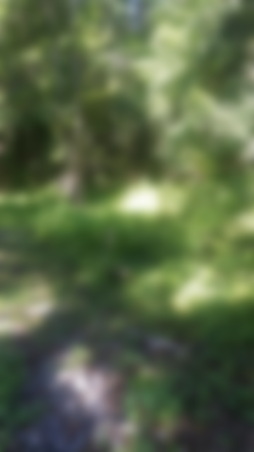
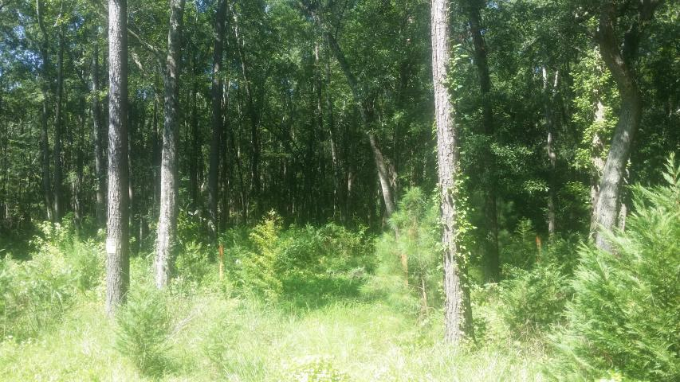
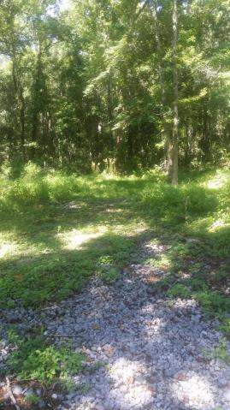
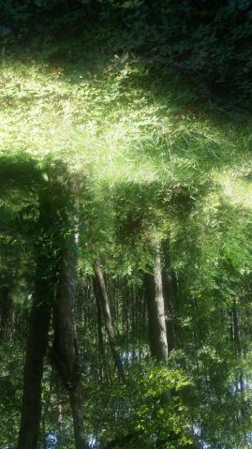

5919 Miley Hill Road Palmetto Terrace ~ Ravenel ~ MLS# 17020343 ~ $45,000
Almost An Acre With Septic Permit
Motivated Seller!
Well Priced .95 Wooded lot with SEPTIC PERMIT and ELECTRICITY is off of Savannah Highway in the sought after town of Ravenel. You will see where the septic system is laid out. Shopping and entertainment are close by and both Summerville and downtown Charleston as well as Edisto Beach are short drives. So if you are looking for a piece of land, come and take a look at this winning combination of location and price!
Liz & Bob Simonds
843-261-7138 O | 843-437-9696 M lizandbob@agentownedrealty.com
AgentOwned Realty Co. Premier Group, Inc. | 141 A N. Main St | Summerville, SC 29483

