Slide 1
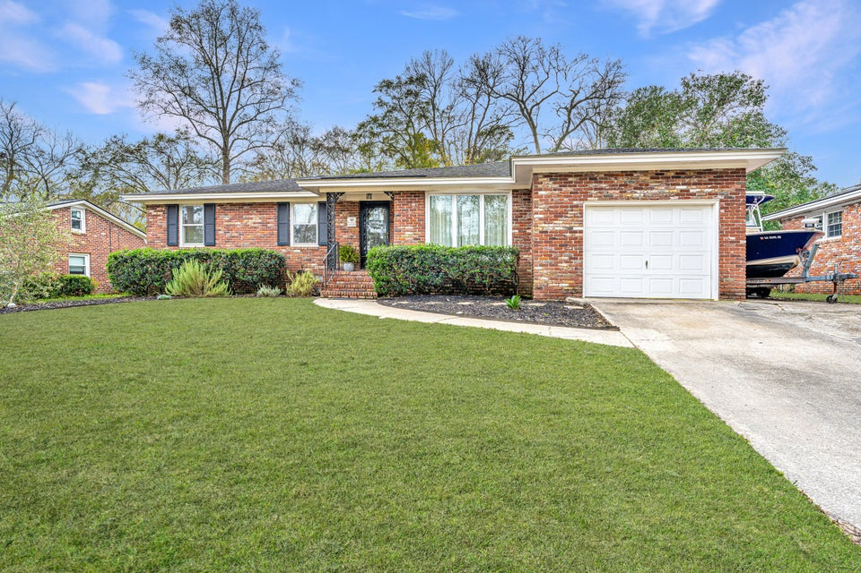
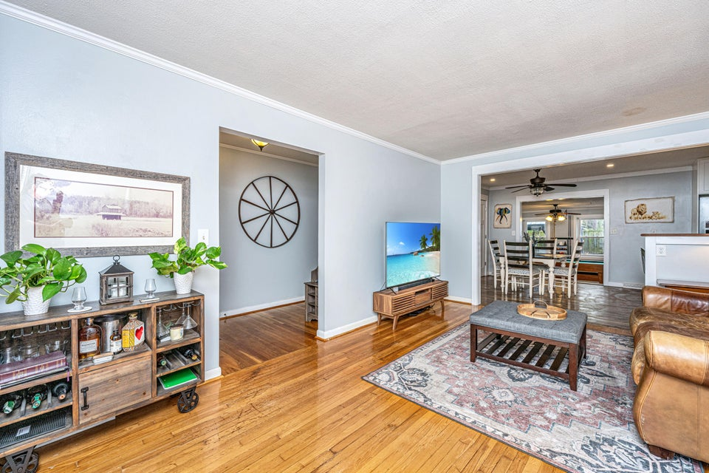
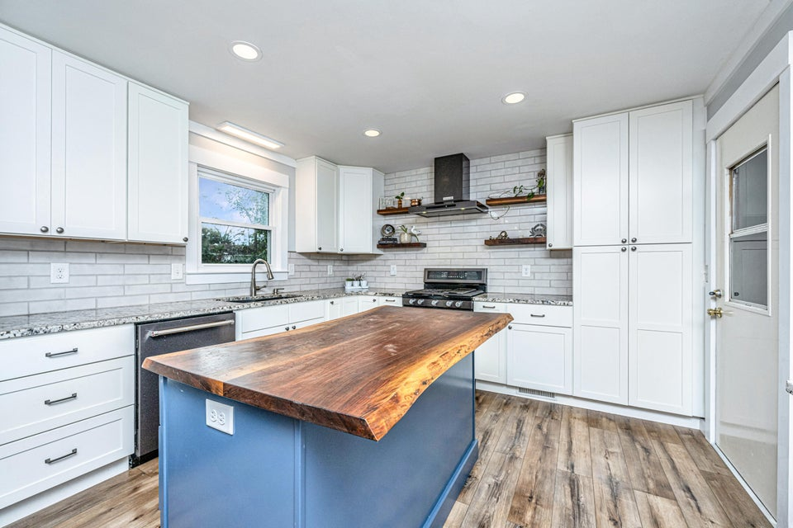

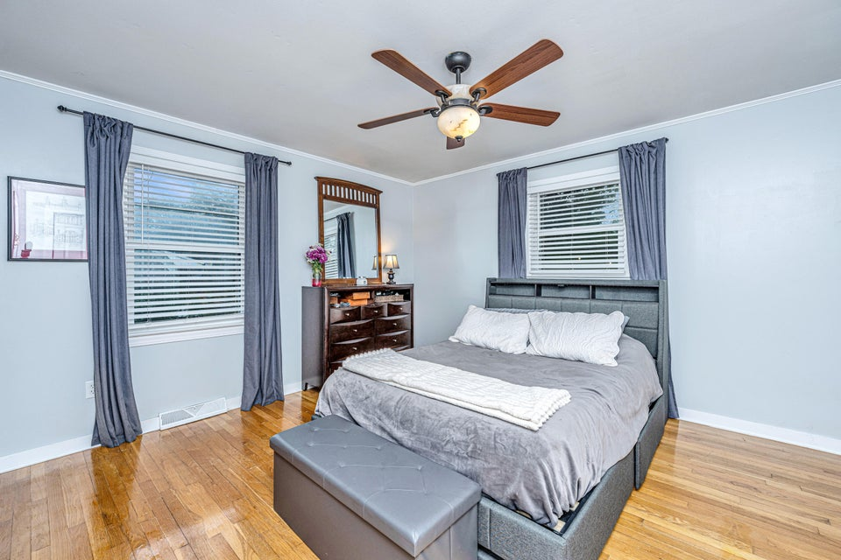
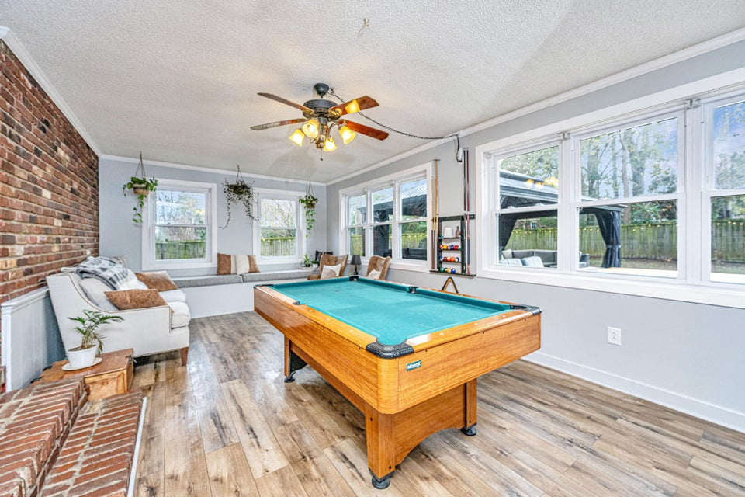
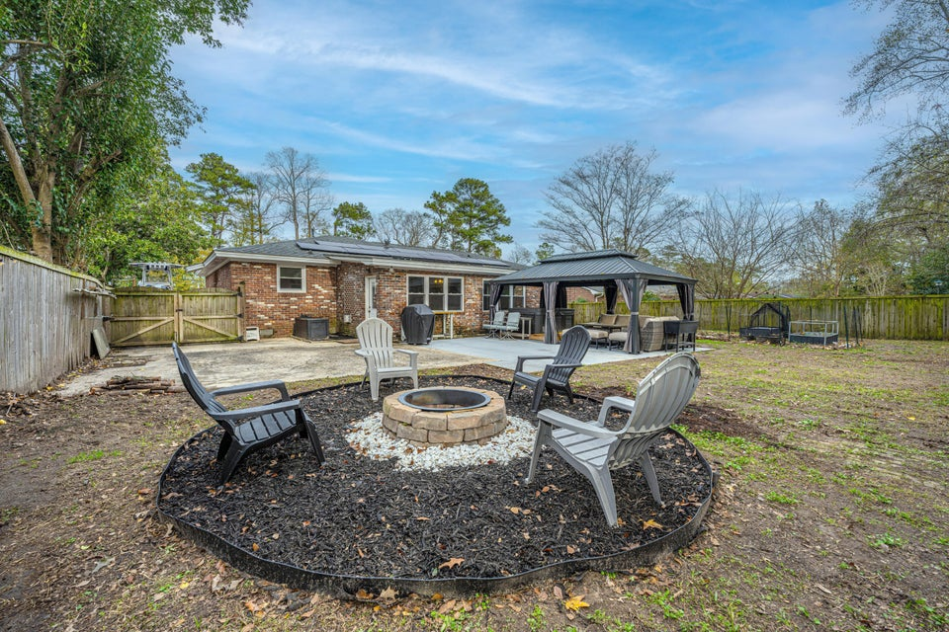

Renovated Gem
5919 Murray Drive
Belvedere Estates | Hanahan, SC 29410 | MLS# 25000024 | $440,000
This beautifully renovated 3-bedroom, 2-bathroom home located in Belvedere Estates offers the perfect blend of classic character and contemporary upgrades. Step inside to discover a thoughtfully redesigned interior featuring a brand-new kitchen complete with gleaming countertops, custom cabinets, and top-of-the-line stainless steel appliances—perfect for both cooking and entertaining. The spacious living areas have plenty of natural light and a seamless flow, ideal for modern living. The huge room at the rear of the home offers additional entertaining space with numerous possibilities...and don't miss the large bank of built in storage cabinets that double as window benches! All 3 bedrooms are nicely sized and the primary bedroom has a fully renovated bathroom with 2 shower heads and a built-in bench.
Outside, the home's large, fenced-in backyard with covered gazebo and hot tub offers endless possibilities...whether you're hosting summer barbecues, gardening, or just enjoying the privacy of your own outdoor oasis. There is also a large double gate leading to the rear yard which has a large concrete pad which is perfect for boat, RV, and equipment storage. The elevated location provides added peace of mind, while the convenient proximity to schools, parks, shopping, and dining ensures easy access to everything you need. This home is a rare find, blending timeless charm with modern amenities. Please see the attached list of upgrades during current home ownership!
ENJOY A VIRTUAL TOUR
Justin Jureka
843-290-3272
jjureka@carolinaoneplus.com
http://www.justinjureka.com/
Carolina One Real Estate
191 Rutledge Ave
Charleston, SC 29403

