Slide 1
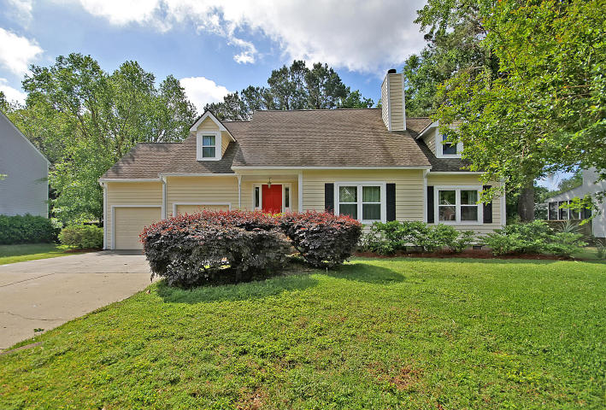
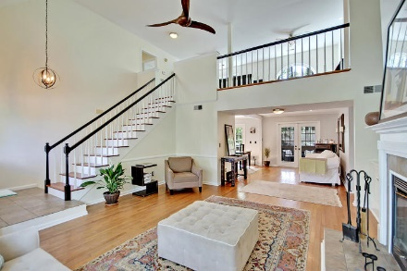
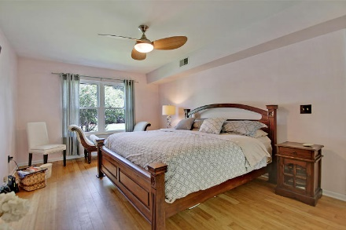
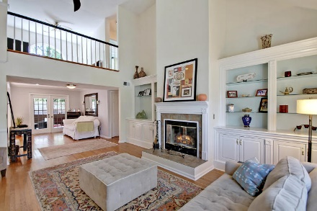
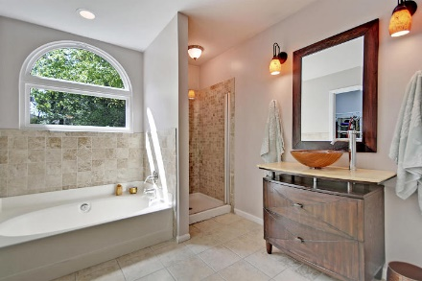
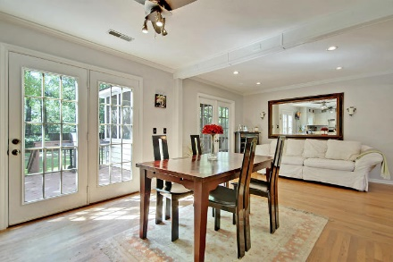
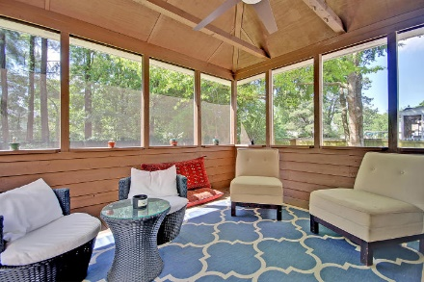
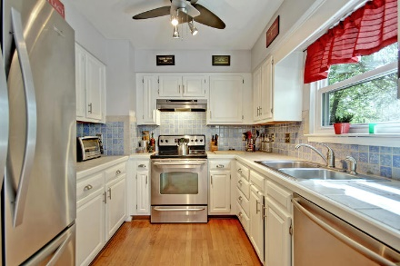
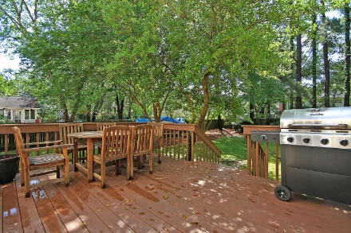
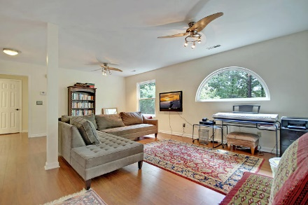
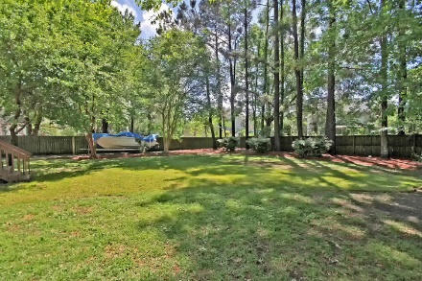
Price Reduced!
MOTIVATED SELLER!!
591 Fishermans Bend
Hidden Cove ~ Mount Pleasant ~ MLS# 18011743 ~ $499,000
Beautifully situated in Mount Pleasant's Hidden Cove subdivision, not only is there a spot to park your boat in the fenced-in yard, the community boat launch gives you quick, easy access to the Hobcaw Creek practically from your backyard! The 2 story contemporary style home boasts hardwood floors, a soaring cathedral ceiling, a fireplace in the living room, first floor master suite, spacious loft area & great outdoor living spaces with the deck and screened-in porch looking over the private yard. You'll fall in love with this location as it allows easy access to 526, shopping, dining, schools, the beach & downtown Charleston. With tennis courts, a sparkling pool, pavilions, the dock at the boat launch, & comfortable accommodations at this home.
Additional features include:
New certified green technology windows in 2018
Fresh interior paint in 2018
New siding and exterior paint in 2017
New deck and heavy duty stain in 2017
New screens and stain in the screened-in porch in 2017
New garage doors with a lifetime warranty in 2017
New gutters in 2017
New water heater in 2017
Bamboo flooring in the master bedroom
Hardwood flooring in living room, dining room, and kitchen
Engineered flooring in upstairs living space and all three bedrooms
Refinished master bathroom
Refinished floors in master closet and upstairs bathroom
Stone flooring in the entrance and around the fireplace
Kitchen includes stone counter tops and back splash
Roof added in 2013 with architectural shingles with a 25 year life
HVAC added in 2013 with a 10 year warranty
Great boating community
Oversized two car garage
Gravel boat storage area
Amazing location in Mt Pleasant - close to shopping and dining
Book your showing today!
Angela Miller angela@mattoneillteam.com 404-276-6355

