Slide 1
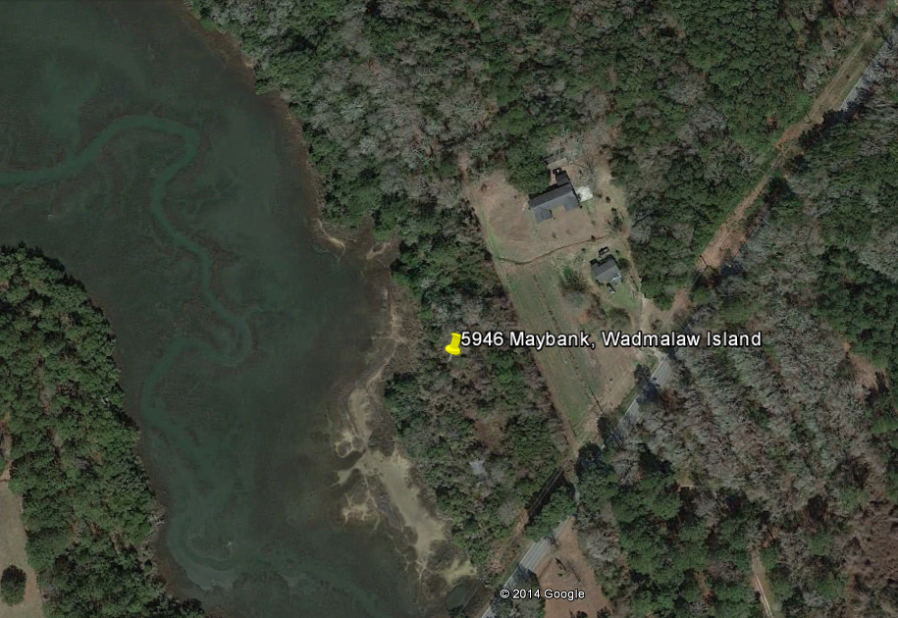
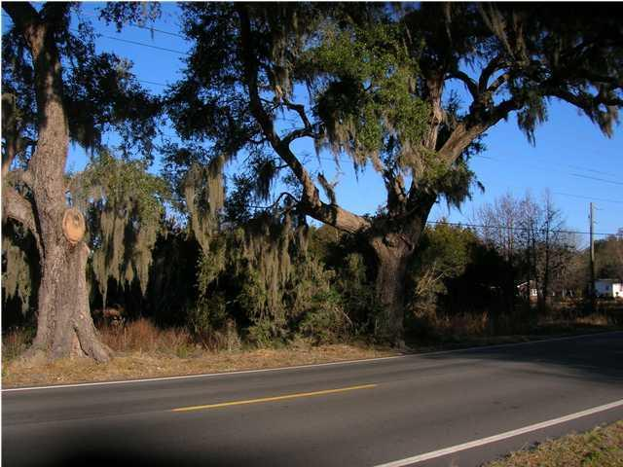
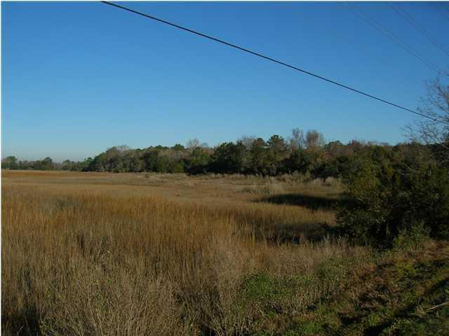
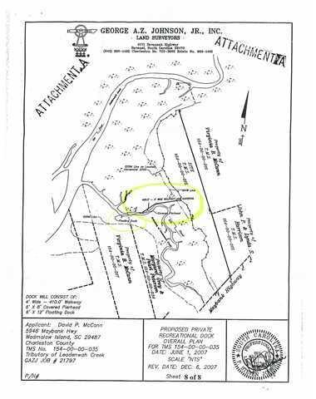
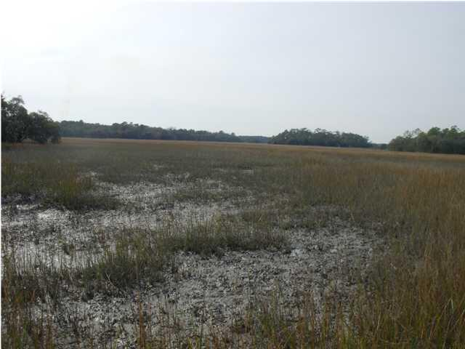
William S. Smith, Broker
Hartnett Realty Co., Inc.
134 Meeting St, Chas, SC 29401 wssmith@hartnettrealty.com
(843) 723-7222
PRICE REDUCED $25,000
**SELLER FINANCING**
5946 Maybank Hwy
Wadmalaw Island, SC
Beckett
$325,000
MLS# 1100664
This is a wonderfully situated piece of land for an individual or family looking to create an idyllic retreat far from the madding crowd. 4 acres of lush, wooded, highland (Tract A tax map #154-00-00-035) fronting on dry marsh of Leadenwah Creek. OWNER HAS IN HAND A TRANSFERABLE DOCK PERMIT, INCLUDING RIGHT TO A COVERED PIERHEAD PLUS 485 FT. WALKWAY. Property is zoned AGR/RES allowing 1 dwelling per acre.

