Slide 1

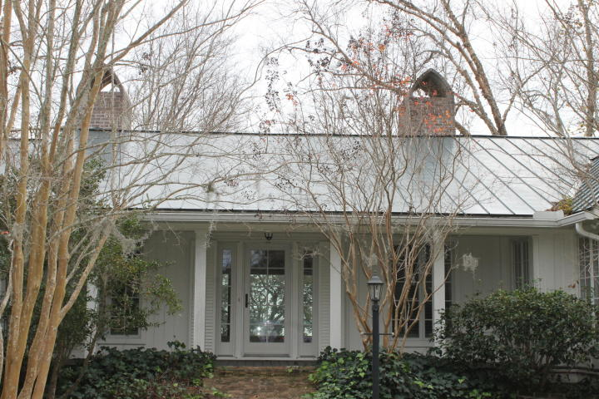
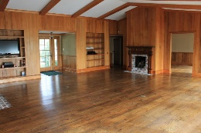
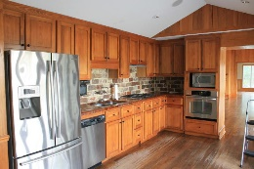
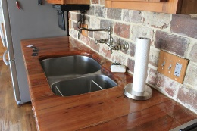
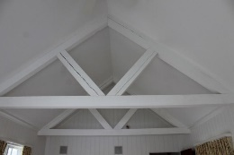
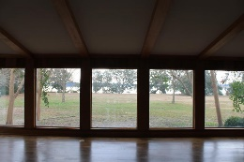
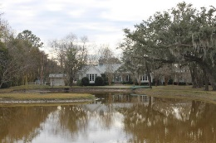
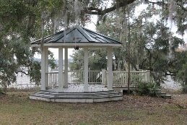
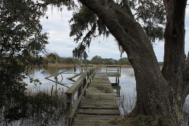
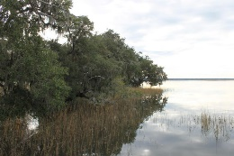
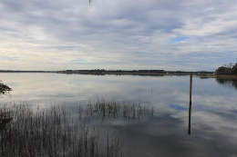

Meggett Beauty ~ Just Reduced!
5977 Shealy Drive Meggett, SC 29449 • MLS# 16032145 • $895,000
"Unique" and "beautiful" are not descriptive enough to describe this 2863 sq. ft., 4 bedroom, 3.5 bathroom home on 3.17 acres in Historic St. Paul's Parish and Meggett. Overlooking Wadmalaw sound, this home with a metal roof includes: 3 gas fireplaces (2 with antique mantels), white oak hardwood floors, cypress paneling, paneled pine doors, a sound system, stainless steel appliances, hurricane-proof glass windows, and one handicapped-accessible bath with a TV. The yard is beautifully landscaped (attracting wildlife including eagles), a gazebo with power, a dock, a man-made small lake, tree lighting and an irrigation system. There is approximately 900 feet water/marsh frontage.
Ron Rash, REALTOR
(843) 822-8886
ron.rash99@comcast.net
Elaine Brabham and Associates, LLC • 1890 Sam Rittenberg Boulevard, Suite 217 • Charleston, SC 29407

