Slide 1
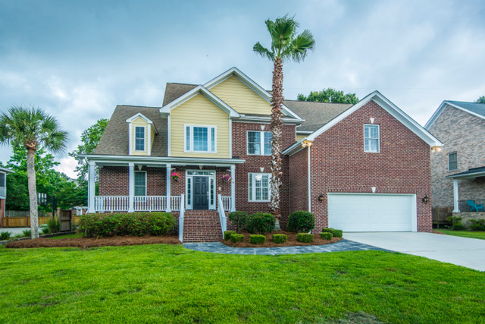
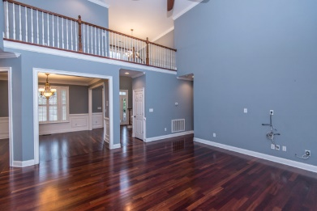
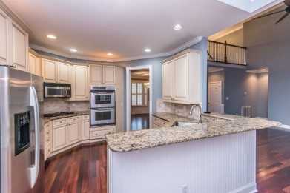
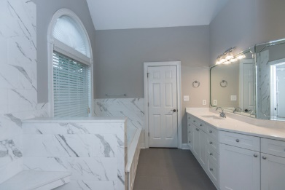
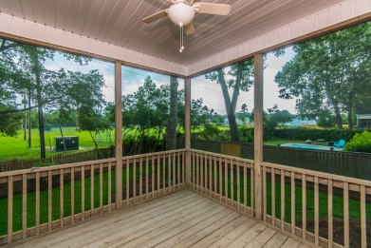


Executive Home Located On Premium Lot
New Price!
597 White Chapel Circle
Woodward Pointe ~ Charleston, SC 29412 ~ MLS# 18016467 ~ $655,000
Executive home located on premium lot in Woodward Pointe. House backs up to Stiles Point HOA playground and park. Master down and guest room down with it's own bathroom. Owner has been working on house for over 1 year. Upgrades include: -New heat and air (both units) replaced in 2017 -new paint throughout common areas -brand new custom master bathroom with marble style tile, frameless shower glass and quartz counter tops with undermounted sinks. -Brazilian cherry hardwood floors throughout all living areas and bonus room (5th bedroom) -home comes with stainless kitchen appliances, Refrigerator, washer and dryer, and gas grill on rear deck. No detail left undone. This home is empty and ready to go. Agent is owner.
Randy Stuckey
M (843) 906-7997 | O (843) 795-8011
randystuckey@msn.com
ERA Wilder Realty, 125-F Wappoo Creek Dr, Charleston, SC 29412

