Slide 1
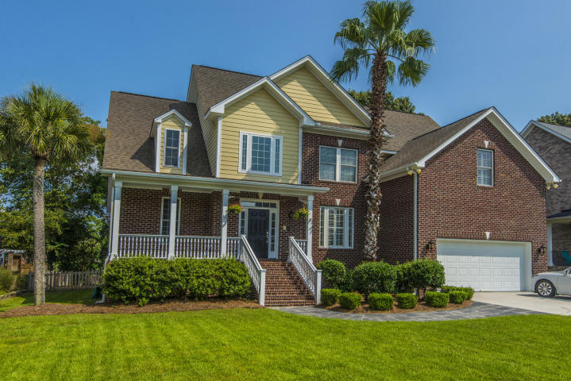
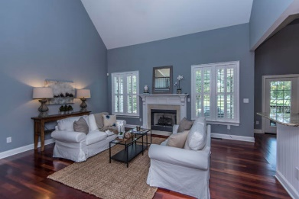
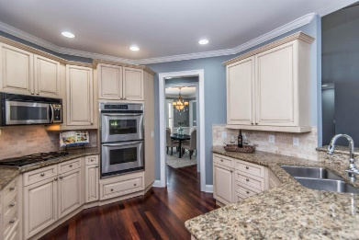
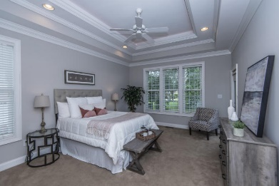
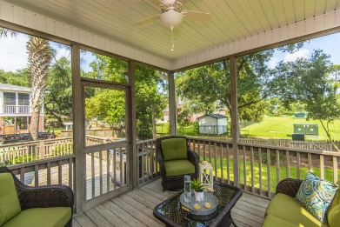


Beautiful Home - Great Location
New Price!
597 White Chapel Circle
Woodward Pointe ~ Charleston, SC 29412 ~ MLS# 18023340 ~ $620,000
Executive home located on premier lot in highly sought after Woodward Pointe subdivision. House backs up to Stiles Point HOA playground and park. Master bedroom down as well as a guest bedroom that has its own bath. Upgrades include: new HVAC units upstairs and down, replaced in 2017. New paint throughout common areas. Brand new custom master bathroom with marble-style tile, frameless shower glass and quartz countertops with undermounted sinks. Brazilian cherry hardwood floors throughout all living areas and bonus room (5th bedroom). Home comes with stainless steel kitchen appliances, including refrigerator, double oven and natural gas cook top. Washer and dryer & gas grill convey as is.
Randy Stuckey
M (843) 906-7997 | O (843) 795-8011
randystuckey@msn.com
ERA Wilder Realty, 125-F Wappoo Creek Dr, Charleston, SC 29412

