Slide 1
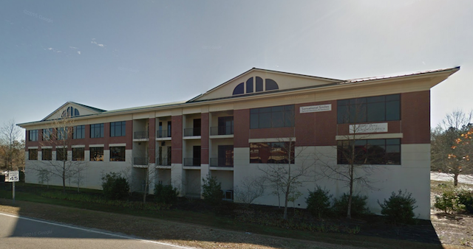
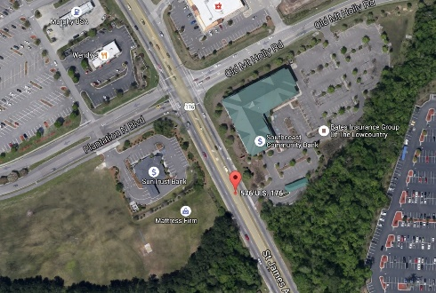
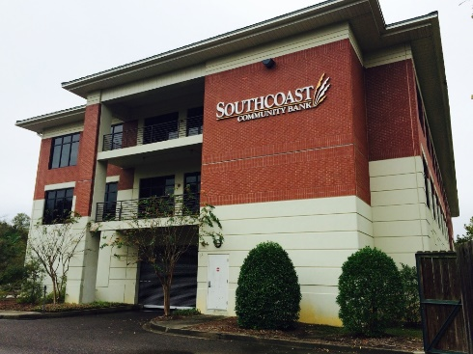
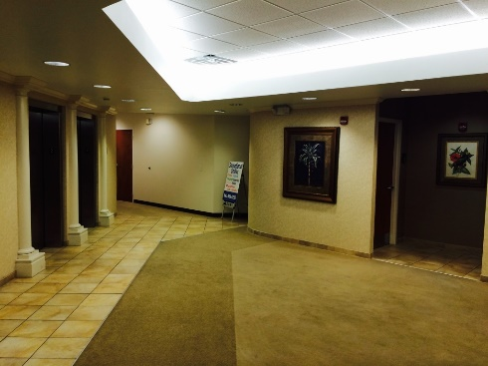
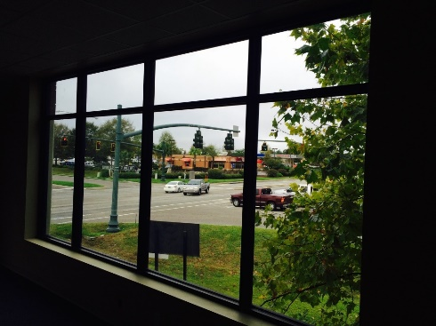
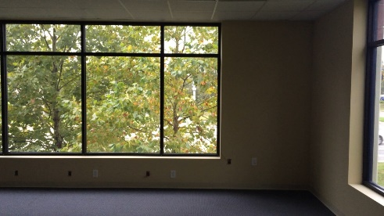


Goose Creek Office for Lease
597 Old Mt Holly Rd #201
Goose Creek, SC 29445
OFFICE FOR LEASE
A vacant office ready for occupancy in a professional office building with abundant parking and an elevator. Many offices have large windows and the floorplan offers many flexible shared or dedicated areas. Reception, Conference Rooms, Copy Room, Break Area and Private Offices. Many local businesses closely for places to eat and shop. The adjacent and contiguous suite is also available for both purchase and sale and is also on the market.
Catylist ID: | #29895173
Contiguous Space: | 2,900 - 4,992 SF
Lease Rate: | $18 PSF (Annual) / $4,350 - 7,488 (Monthly)
Lease Types: | NNN
Class of Space: | Class B
Property Visibility: | Excellent
Zoning: | GC - General Commercial District
County: | Berkeley
Tax ID/APN: | 234-07-07-004
David H Seay
CCIM, BIC, CCIM, REALTOR
(843) 364-6720
david@seaydevelopment.com
Seay Development, LLC
3404-202A Salterbeck Street
Mt. Pleasant, SC 29466 www.seaydevelopment.com

