Slide 1
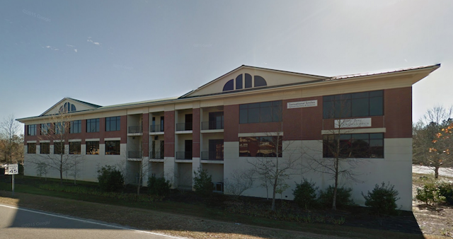
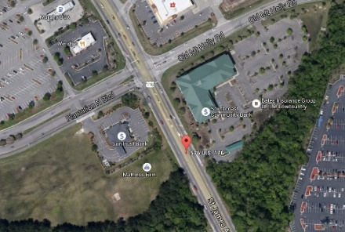
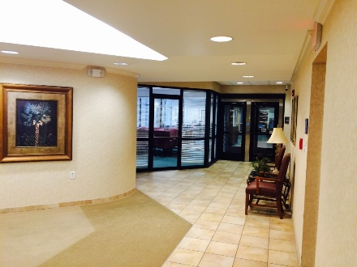
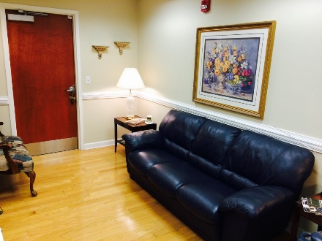
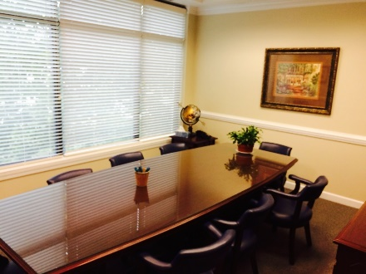
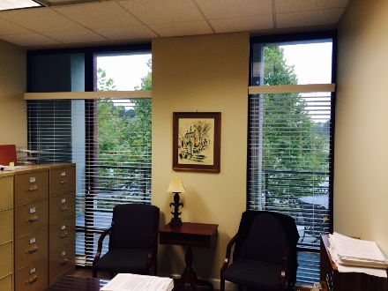


Goose Creek Office Space for Sale
597 Old Mt Holly Rd #202
Goose Creek, SC 29445
OFFICE FOR SALE
Well appointed office space in a professional office building with abundant parking and an elevator. Many offices have large windows and the floorplan offers many flexible shared or dedicated areas. Reception, Conference Room, Break Area and Private Offices. Many local businesses close by for places to eat and shop. The adjacent and contiguous suite is also available for both purchase and sale and is also on the market. This space has been operated as the Wooddy Law Firm for many years.
Catylist ID: | #29895176
Contiguous Space: | 2,900 - 4,992 SF
Sale Price: | $357,732 - 853,632
Unit Price: | $171 - 408.05 PSF
Class of Space: | Class B
Property Visibility: | Excellent
Zoning: | GC - General Commercial District
County: | Berkeley
Tax ID/APN: | 234-07-07-003
David H Seay
CCIM, BIC, CCIM, REALTOR
(843) 364-6720
david@seaydevelopment.com
Seay Development, LLC
3404-202A Salterbeck Street
Mt. Pleasant, SC 29466
www.seaydevelopment.com

