Slide 1
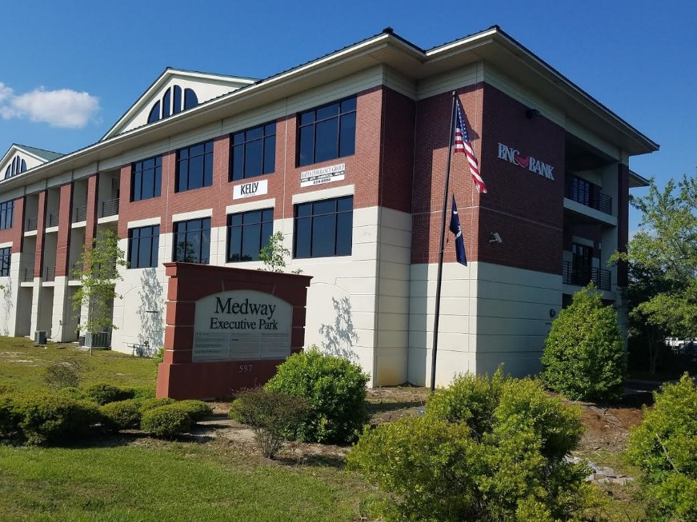
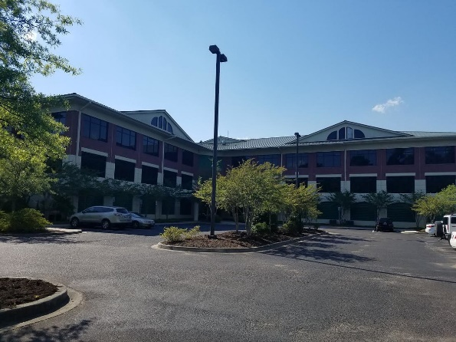
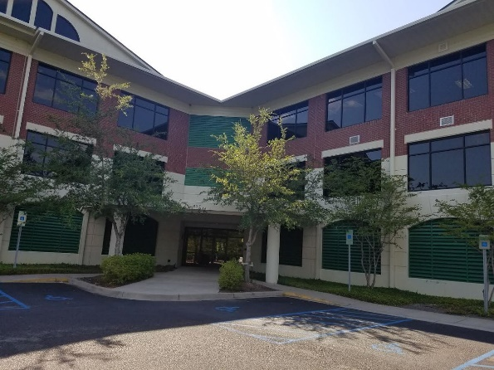
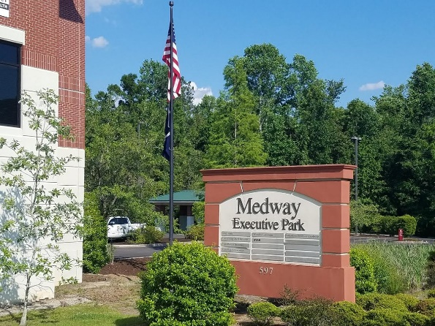



597 Old Mt Holly Road #203 Goose Creek, SC 29445 ~ CMLS# 30083897 ~ $625 - 675 (Monthly)
Executive Offices For Lease
Executive office suites in Class A building located beside Chick Fila, in front of Lowes and across from Wal Mart. Rate includes electric, water, sewer and regime fee. Tenant responsible for phone service, secure internet can be added for a fee. 2 elevators and ample parking. Current building tenants include real estate office, attorneys, dentist, Orthodontist, bank and Highway Patrol.
Michelle Riser
(843) 860-1229
mriser@ccim.net
Palmetto Group of AgentOwned | 597 Old Mt Holly Rd Ste 202 | Goose Creek, SC 29445

