Slide 1
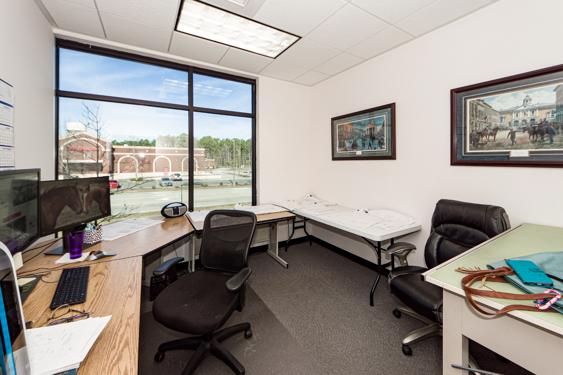
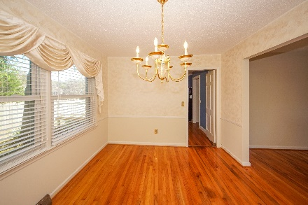
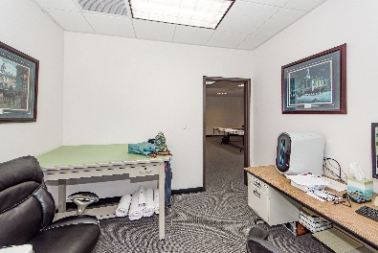
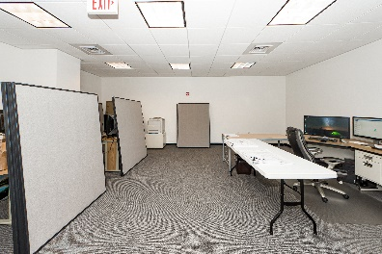
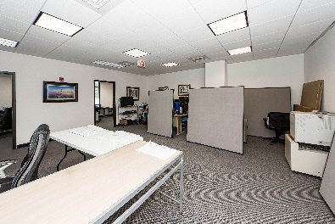
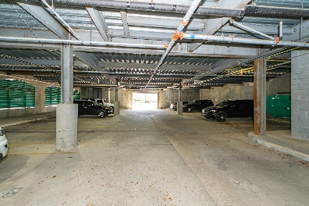
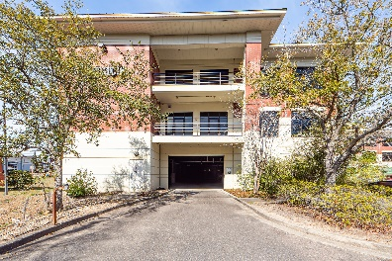


597 Old Mt Holly Road #204
Medway Executive Park | Goose Creek | CMLS# 31000411 | $448,000
Otranto Beauty
$318,000
Executive Office Space Available
Open House Sunday 12:30-3:30
Executive Office Condo available for sale in excellent condition! Located in Goose Creek Midway Executive Park. This condo is a total of 2,000 sf with an excellent layout! The suite consists of 5 Executive private offices, a large ''Group Gathering Room'', conference room, outside balcony, private restroom, kitchenette, access to common area restrooms and 1 parking space in parking garage. This is a perfect opportunity for a small business looking for an executive office in a convenient location priced right! The space is accessible via elevator and is accessible 24-7. This suite is located in Medway Office Building - Class A building. Located at the corner of Old Mount Holly and US Hwy 176 (i.e., St. James Avenue). A lighted intersection bordered by a shopping center which is anchored by Lowe's Home Improvement Store. Convenient to retail such as Chick-Fil-A, Walmart, Starbucks and Roper St. Francis Hospital at Carnes Crossroads. Other professionals in the multi-tenant building include law offices, medical, Pinnacle Bank, Highway patrol, and many more. Original owner. Condo in excellent condition and updated. Plenty of parking.
Come take a virtual tour: https://charlestonvirtualhomes.com/20230022
Connie White, Broker
843-532-3356
connie@conniewhiteteam.com
conniewhiterealestate.com
Connie White Real Estate & Design, LLC · 102 Six Point Court· Goose Creek, SC 29445

