Slide 1
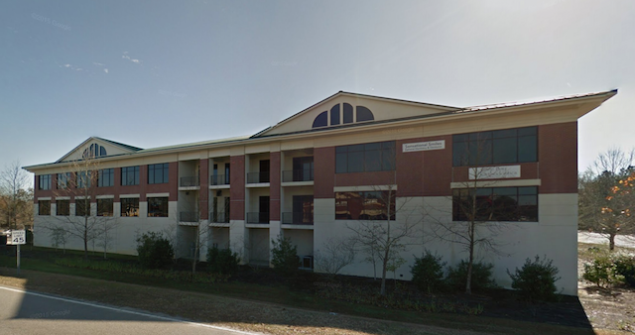
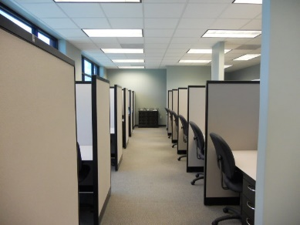
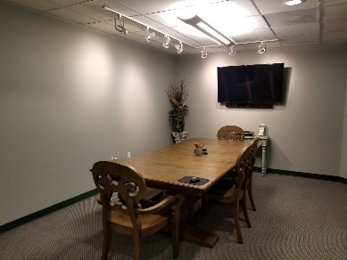
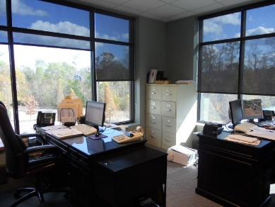
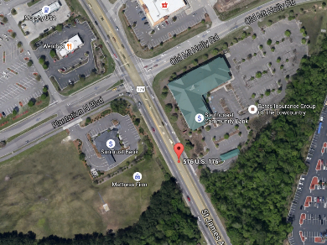


597 Old Mount Holly Rd #301 Goose Creek, SC 29445 CMLS# 30366681 :: $395,000 :: 2,519 SF
Commercial Condo Office Space With Owner Financing Available
$390,000
Just Reduced!
Suite 301 is a combination of two tax map numbers 234-07-07-017 and 234-07-07-018 for a total of 2519 square feet. Currently used for a real estate company, this suite offers 5 offices (3 with window views), kitchen, work room, conference room and reception area. Included with the suite are 22 removable cubicles with desks (14 of the cubicles have a window view).
Perfect space for a physician with the Roper St. Francis Medical Campus opening October 2019!! Features of Medway Office Building include state-of-the-art, high-quality constructed office park with all of the features you would imagine, including well decorated common areas and elevators.
There are over 150 parking spaces available. There is covered parking and storage space available to purchase separately. It is conveniently located at the busy, signaled intersection of Hwy 176 (St. James) and Old Mount Holly Road.
Connie White, Broker
843-532-3356
connie@chrepros.com · conniewhiterealestate.com
Charleston Homes · 597 Old Mt. Holly Road · Suite 301 · Goose Creek, SC 29445

