Slide 1
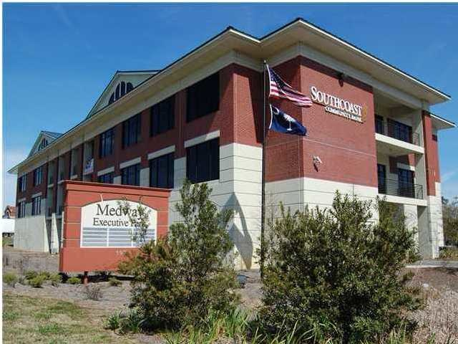
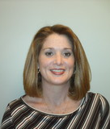
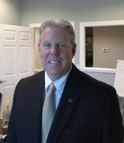
597 Old Mount Holly Road ~ Suite A&B Goose Creek, SC 29445 ~ CMLS# 29977264 ~ $179,900
Class A Office Investment
CLASS A OFFICE. SET UP AS A DUPLEX WITH 300 +/- sf LEASED TO A MASSAGE THERAPIST . THE REMAINING SPACE IS 3 OFFICES ( ONE 2 PERSON 12' X 20' ) A GOOD SIZED CONFERENCE / BREAK AREA . ( 810 SF) leased to Kelly Services . This includes one parking gated garage space utilized by Kelly Services. ADDITIONAL GATED GARAGE SPACES AVAILABLE @ $8800.00 PER SPACE
Property Subtypes: | Office Building | Building Size (RSF): | 1,110 SF
Sale Price: | $179,900 | Property Use Type: | Investment
Unit Price: | $162.07 PSF | Taxing Authority: | Berkeley & Goose Creek
Sale Terms: | Cash to Seller | Tax ID/APN: | 234-07-07-019
Cap Rate: | 12.0% | Zoning: | GC - General Commercial District
Bob Glover, CCIM
(843) 572-0000
bobgloverccim@gmail.com
Bob Glover Real Estate LLC | 105 A Old Hwy 52 | Moncks Corner, SC 29461

