Slide 1
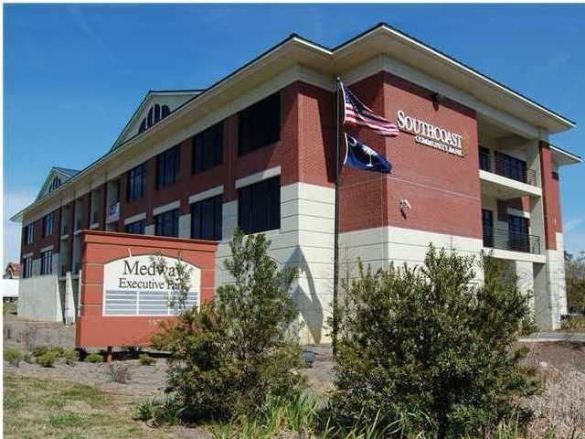
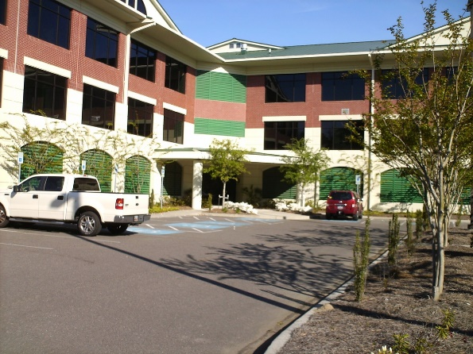
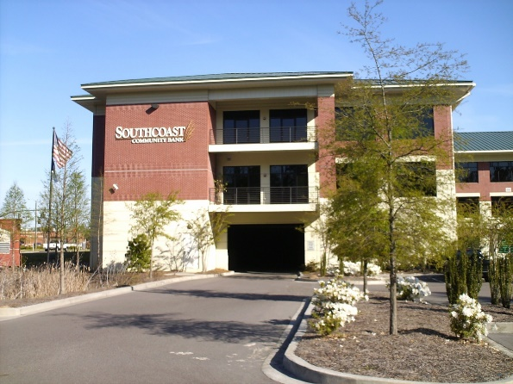
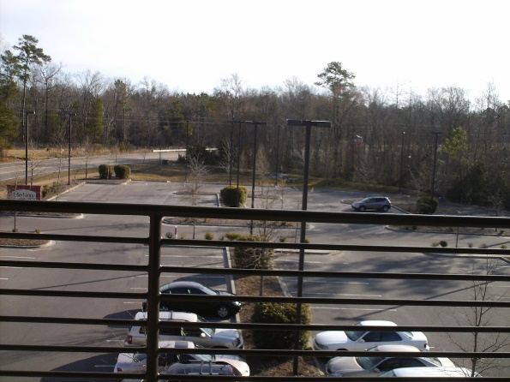


597 Old Mt Holly Road Goose Creek, SC 29445 ~ CMLS# 29928536 ~ $347,325
Ready To Be Built-Out Class A Office
Last remaining office shell / vanilla box space on the 3rd floor. Class A property. Plenty of parking. Garage parking for sale @ $10,000 per space. Garage storage lockers for sale $10,000 per unit. The owner make up is Law, real estate, engineer, dentist, Bank, credit card processing, Orthodontist and Dept. of Public Safety.
1.6 miles from the new Roper St Frances Hospital “coming soon”.
Bob Glover, CCIM
(843) 572-0000
bobgloverccim@gmail.com
Bob Glover Real Estate LLC | 105 A Old Hwy 52 | Moncks Corner, SC 29461

