Slide 1
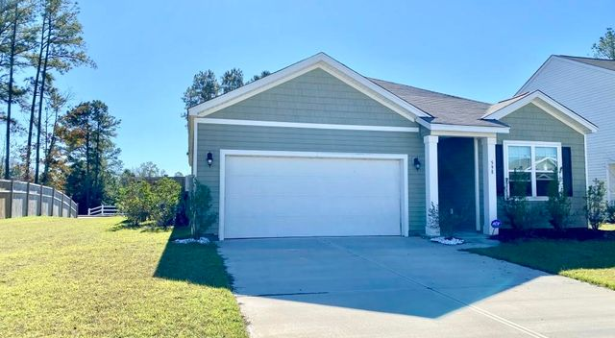
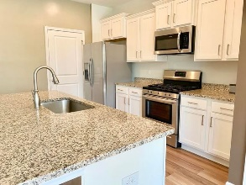
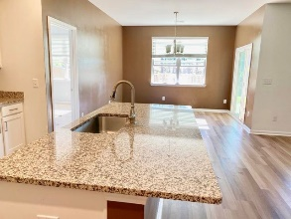
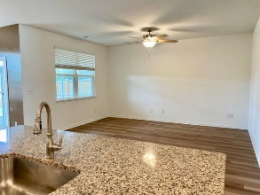
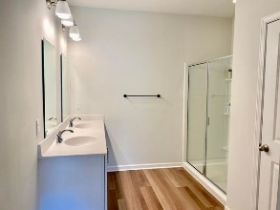
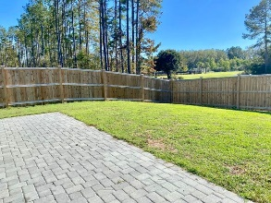
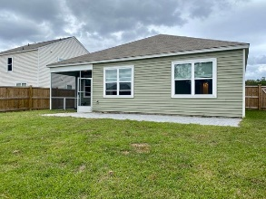
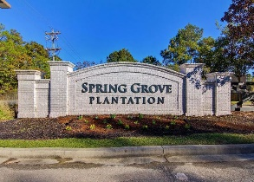
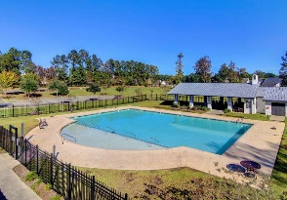


Just Listed!
New Price!
598 Wayton Circle
Spring Grove Plantation | Moncks Corner, SC 29461
MLS# 20031420 | $249,900
LIKE NEW- built in 2019.
Gourmet kitchen with all stainless steel appliances, granite counter tops, gas range, LARGE kitchen Island.
Open floor plan provides plenty of room for entertaining.
Screened porch leads to the paved patio and Private fenced in backyard.
You will be steps away to the pool, play park, sports fields and dog run.
Spring Grove Plantation is less than 15 min to the Navel Weapons Station, 25 min to the Joint Base Charleston, 25 min to Boeing.
Carey Budds
843-475-1505
cdft73@aol.com
Tracy Arnett
843-973-2314
tracyarnett5@gmail.com
ERA Wilder Realty, 122 Coleman Blvd, Mt. Pleasant, SC 29464

