Slide 1
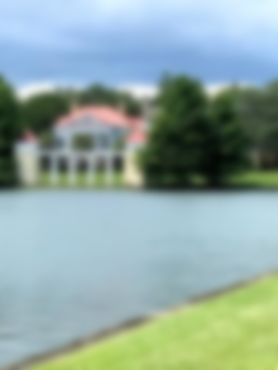
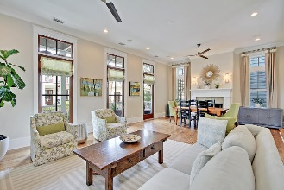
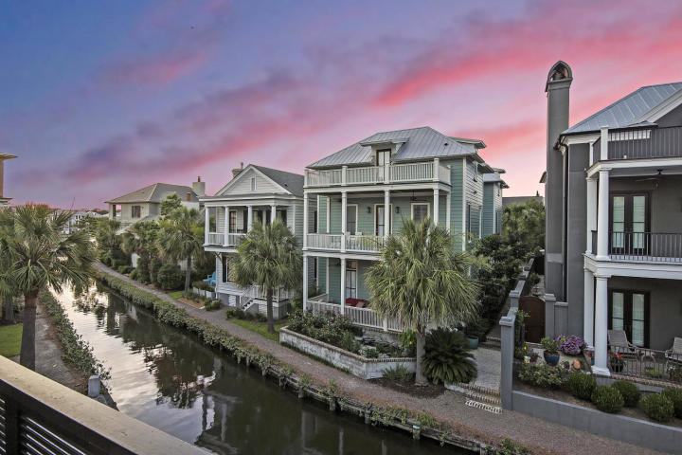
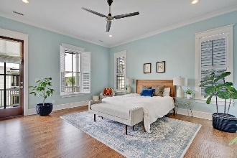
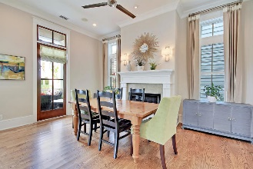
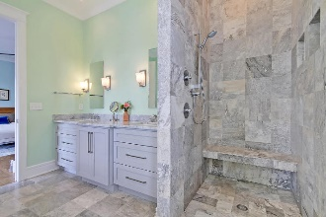
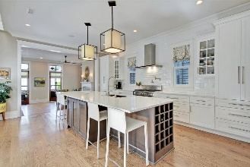
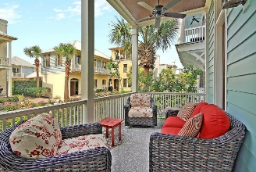
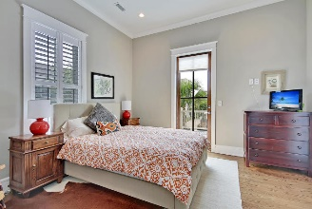
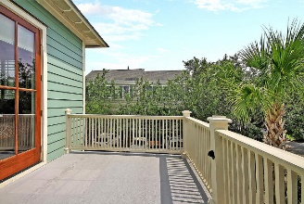
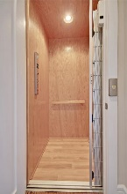
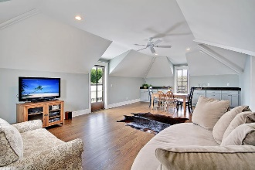
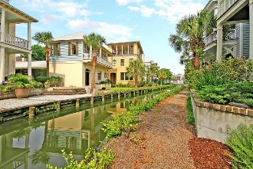


59 Krier Lane Mount Pleasant, SC 29464 | MLS# 19018267 | $1,674,000
On the Canal in I’On!
Come see this rare I'On CANAL FRONT home w/ ELEVATOR. There's a private MOTHER-IN-LAW suite above the oversized garage via back steps that has its own balcony overlooking the streets of I'On w/ peaks of East Lake. Home is designed by Phil Clarke. Bright & open first floor is centered around a gourmet kitchen complete w/ a large quartz top island,5 burner fisher/paykel oven & stainless appliances. Generous cabinets & a large pantry. The kitchen also features a three-story drop ceiling & opens to a private courtyard & spacious family room overlooking the canal w/breathtaking views There are 10 & 11-foot ceilings throughout w/ crown moldings, over-sized windows & a stereo/speaker system. 1st floor includes flex room/dining/office, laundry, mudroom. An elevator leads to 2nd floor where you'll find the large master bedroom w/ luxury bath and his & her closets & a private balcony. Down the hall are two guest rooms & a full bath. There is a fabulous office space w/ wainscoting & great light. Enter the third floor to find another guest room w/ bath, a large entertaining room w/ a wet bar overlooking the canal & West Lake. Great views from all balconies. There are two climate-controlled attic spaces w/ spray foam insulation & ample storage. Throughout the home are beautiful plantation shutters & Hunter Douglas remote control blinds. The A/C is a three-zone system keeping everyone comfortable. The wide white oak hardwood floors are in perfect condition. Outside welcomes you to lounge on the comfortable porch dining al fresco on the canal. The pretty Koi pond w/ the sound of flowing water & roses greet you as you relax by the serene view of the turtles meandering in the canal. The beautiful landscaping and butterfly garden has an irrigation system. Buyers to pay .15% (.0015 x sales price) transfer fee to the I'On assembly at closing.
Asking $1,200,000
MLS# 17023051
3,692 SqFt
4 Bed/3½ Baths
Short Drive to Historic Downtown Charleston & Beaches
Gay Slough (843) 452-9708 gslough@carolinaone.com Carolina One Real Estate • 195 W Coleman Blvd • Mount Pleasant, SC 29464
www.gayslough.com

