Slide 1

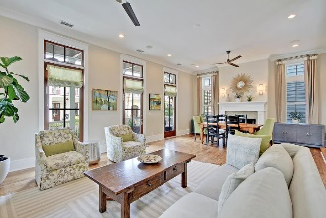
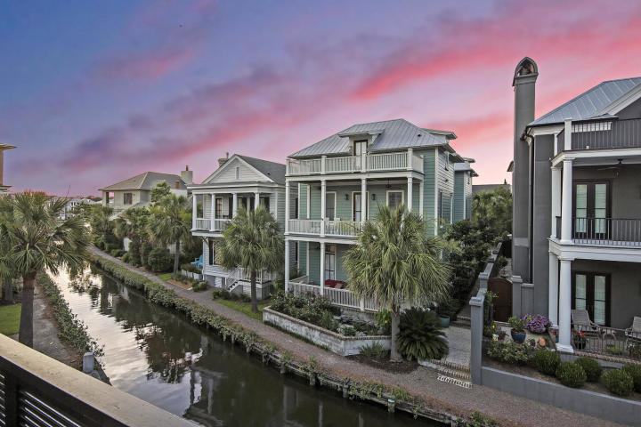
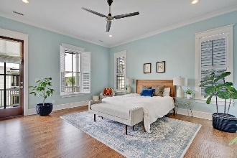
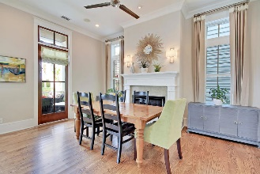
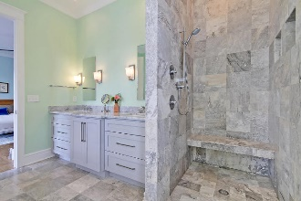
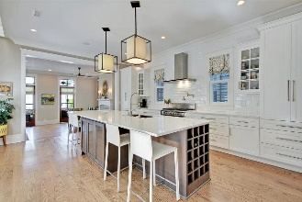
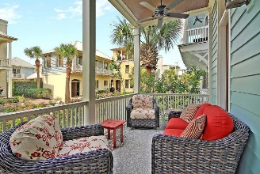
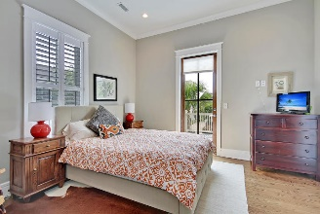
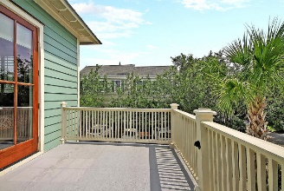
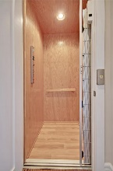
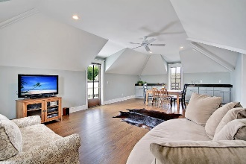
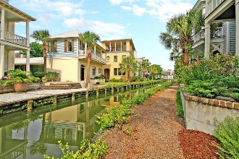


59 Krier Lane
Mount Pleasant, SC 29464 | MLS# 19018267 | $1,674,000
Great Home on the Canal in I’On!
Beautiful peaceful & quiet coveted I'On canal front home w/ ELEVATOR designed by Phil Clark built in 2012. Mother in law suite has a full bath & balcony w/ peaks of Eastlake. Bright & open first floor is centered around a large gourmet kitchen that overlooks the canal complete w/ a beautiful quartz top island w/ seating, 5 gas burner fisher/paykel oven, stainless appliances, generous cabinets & a large pantry. Off the kitchen is a private side courtyard for alfresco dining. Open to the kitchen is a family room w/ fireplace & overlooks the canal. Open French doors to breathtaking views of the water.First floor includes dining room,laundry,wet bar,elevator, mudroom,1/2 bath. Ceilings are 11+ feet throughout w/ crown molding & over-sized windows. Elevator leads to second floor master bedroom w/ luxury bath and his & her closets. French doors lead to a private balcony overlooking the canal. Down the hall are two guest rooms & a full bath. There is a fabulous office space w/ wainscoting & great light. Enter the third floor to find another guest room w/ bath. Down the hall is a large room for either entertaining, workout or office space w/ a wet bar and French doors to balcony overlooking the canal & Westlake. Great views from all three balconies. There are two climate controlled attic spaces w/ spray foam insulation & ample storage. Throughout the home are beautiful plantation shutters & Hunter Douglas remote control blinds. The A/C is a three-zone system keeping everyone comfortable. The wide white oak hardwood floors are in perfect condition. The outside welcomes you to lounge on the comfortable porch dining al fresco on the canal. The pretty Koi pond w/ the sound of flowing water & roses greet you as you relax by the serene view of the turtles meandering in the canal. The beautiful landscaping and butterfly garden has an irrigation system. A $2,000 Lender Credit is available and will be applied towards the buyer's closing costs and pre-paids if the buyer chooses to use the seller's preferred lender. This credit is in addition to any negotiated seller concessions.
Buyers to pay .15% (.0015 x sales price) transfer fee to the I'On assembly at closing and any fees associated with HOA information.
Asking $1,200,000
MLS# 17023051
3,692 SqFt
4 Bed/3½ Baths
Short Drive to Historic Downtown Charleston & Beaches
Gay Slough
(843) 452-9708
gslough@carolinaone.com
Carolina One Real Estate • 195 W Coleman Blvd • Mount Pleasant, SC 29464
www.gayslough.com

