Slide 1

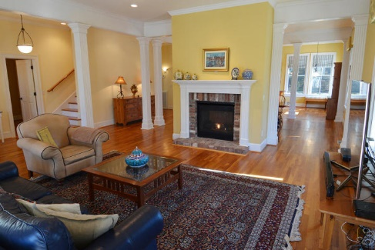
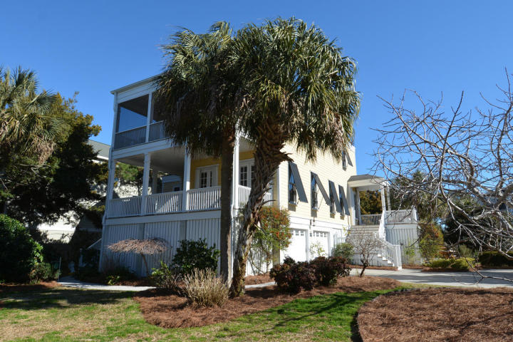
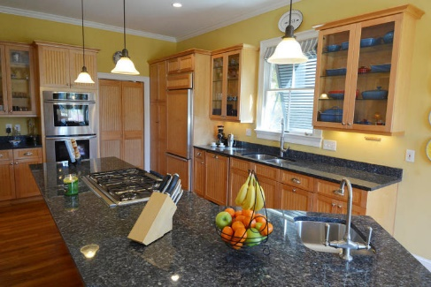
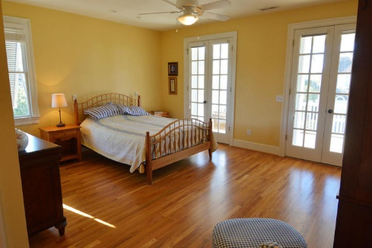
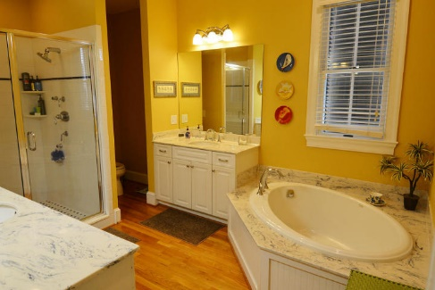
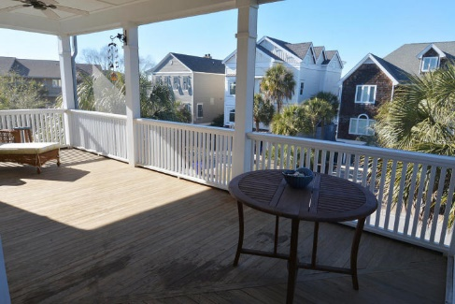
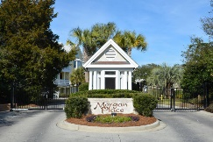
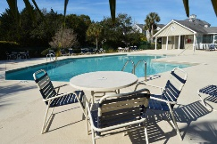
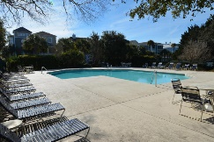
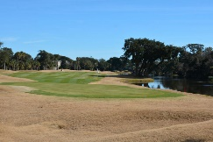

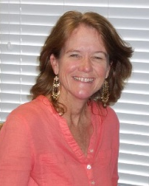
59 Morgan Place Drive Wild Dunes ~ Isle of Palms MLS# 16005986 ~ $900,000
New Price!
Morgan Creek At Wild Dunes Custom Build
GOLF CART COMES WITH THE SALE-CLUB CARTS NEW DESIGN!! Stunning custom built home by Pat Ilderton Contractors. Wonderful open floor plan for perfect island living. Gorgeous custom cabinets in the kitchen with high end appliances including Thermador and Bosch. The breakfast bar is open to the dining room and living room beyond. While cooking for the family or entertaining you can't miss a thing. Fabulous Chef's kitchen. Fantastic hardwood floors throughout the entire house with the exception of one, newly carpeted upstairs bedroom. Beautiful two sided brick fireplace separating the living room and dining room. Custom Bahama shutters to give the house a cozy, island feel while at the same time acting as hurricane shutters. Oversized pantry/laundry room off the kitchen. The upstairs master is gorgeous...with double French Doors leading to a private screened deck. Two other bedrooms are upstairs including a nice nook in the hallway, perfect for a computer for kids to do their homework. Brand new carpet in the upstairs bedroom. There are also accordion hurricane shutters on all doors and french doors. The house is wired for the Invisible Fence for your pets and the house also will convey a generator that hasn't been used. Gorgeous mature yard with tons of plants, flowers and the most amazing fig tree I have every seen. The amenities at Wild Dunes are fantastic. Tennis, golf membership available, multiple pools and the beautiful Beach on the Atlantic Ocean. Great family house but also wonderful second home or vacation rental property.
ANN EVANS
REALTOR, ABR
Office - (843) 884-1800 | Mobile - (843) 452-4605
aevans@carolinaone.com
www.charlestonluxuryrealestate.com
Carolina One Real Estate
195 W Coleman Blvd
Mt Pleasant, SC 29464-3495

