Slide 1
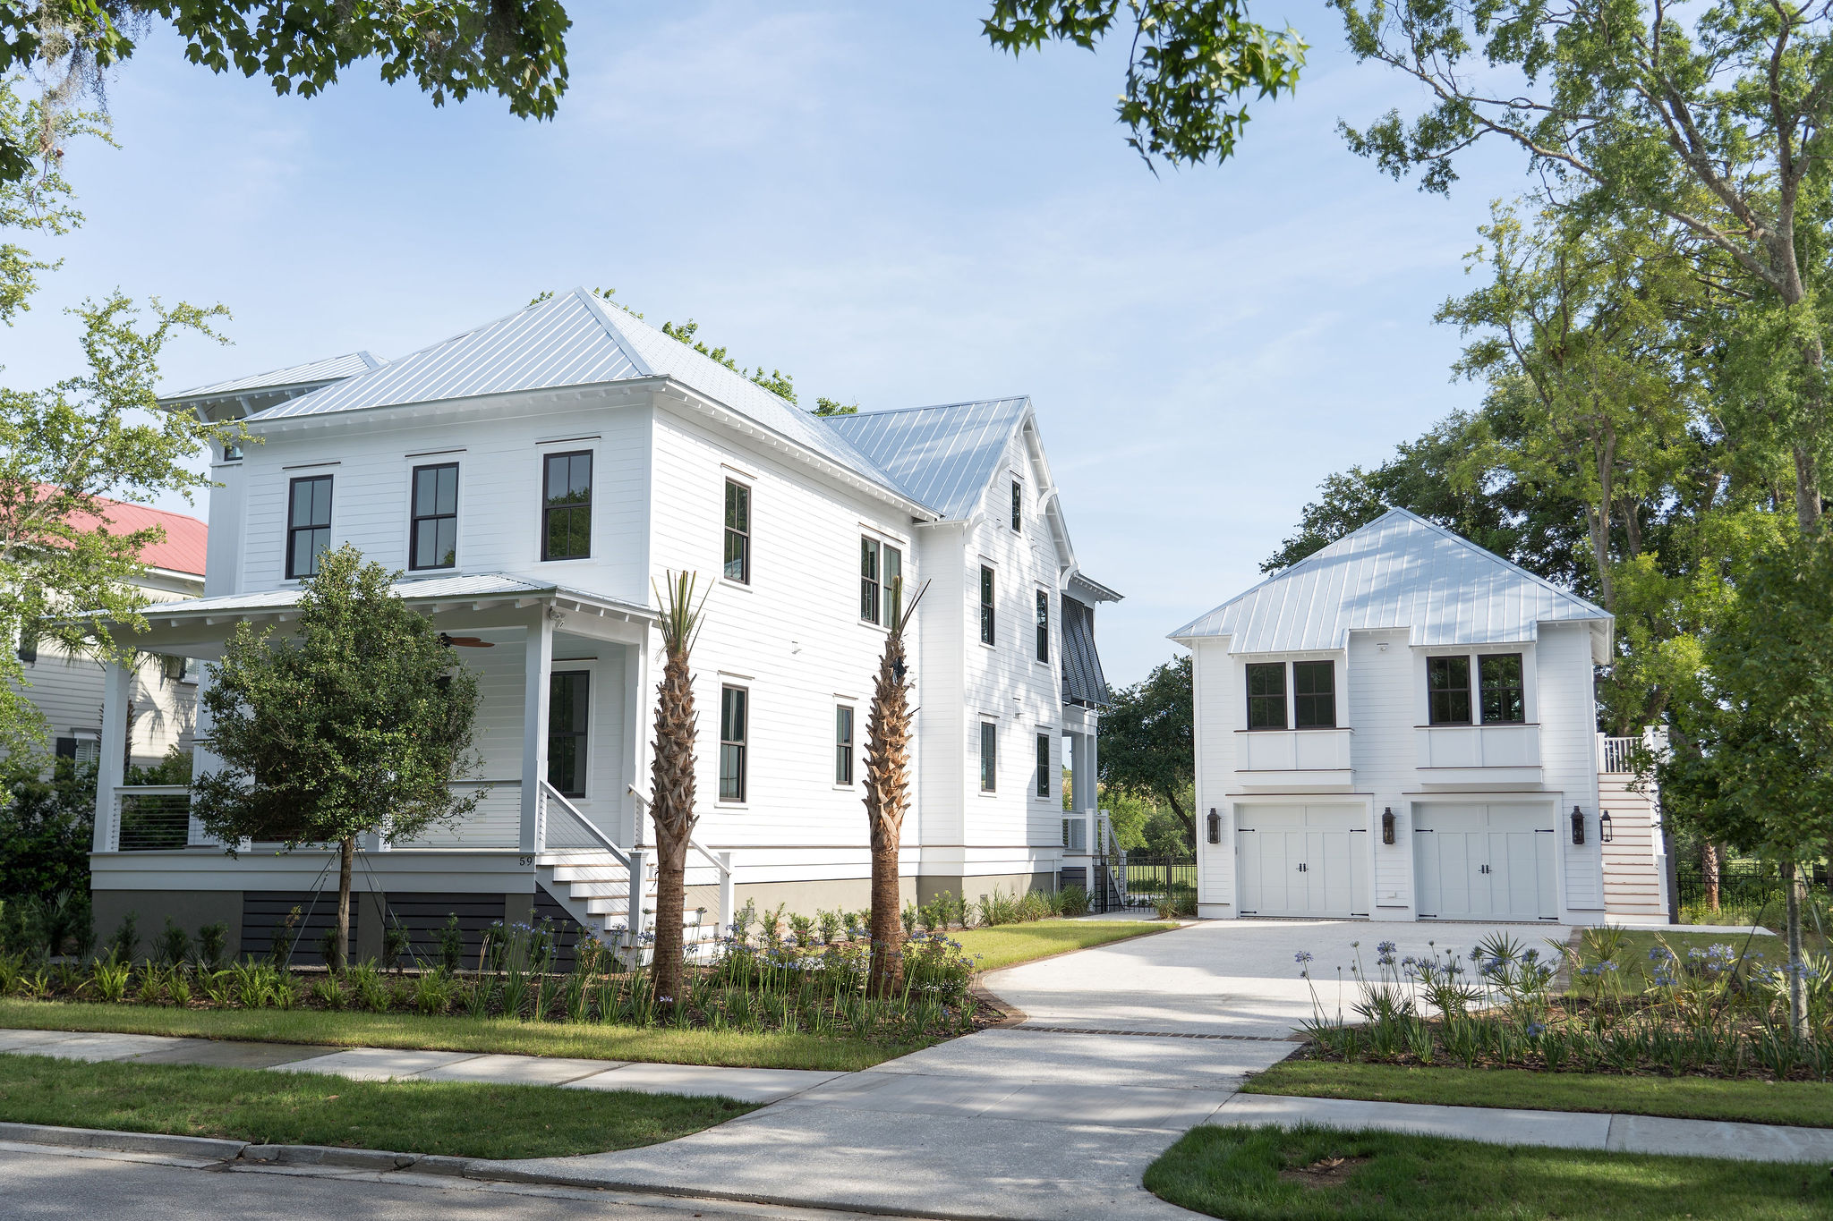
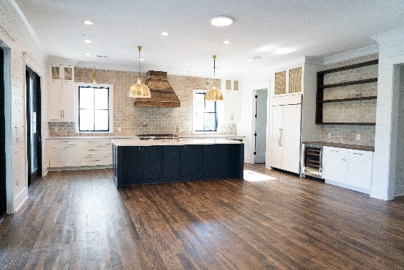
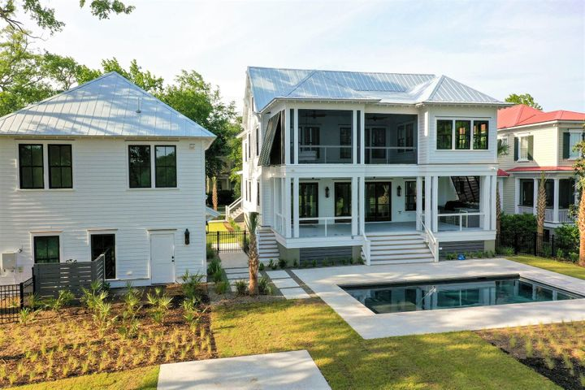


59 Dalton St Saturday May 29, 1:00 - 3:00 PM Sunday May 30, 12:00 - 3:00 PM
Luxury New Construction
Daniel Island Open Houses
This Weekend!
New
Construction
5 Bedrooms, 4.5 Baths
Resort Style Pool and Patio Areas
Exceptional Rental History
Rare Double Lot
Block from Beach
2 Huge Great Rooms
Expansive Screened Porches
Separate Grilling and Observatory Decks
Multiple Fireplaces
Short walk to Restaurants & Shopping
This elegant Lowcountry inspired home boasts breathtaking views of the 13th fairway of the Beresford Creek Golf Course and a tranquil marsh. The main home offers 3866 Sqft, 4 Bedrooms, 4.5 Baths and the Suite over the detached garage is 705 sqft, has 2 Bedrooms, a Full Bath and large living area with Kitchenette. You will be mesmerized by the stunning antique reclaimed oak flooring and lovely views! The Kitchen features Sub-Zero Refrigerator/Wolf Appliances, custom cabinetry and range Hood, and a walk-in Pantry complete with rolling ladder to reach everything you need! The Kitchen flows seamlessly into the Dining and Living areas with a bricked fireplace as a focal point. These areas open to an expansive porch with an Outdoor Kitchen overlooking a fabulous saltwater pool. The Master Suite features a Sitting Room, 2 Extra Large Closets, and gorgeous Bath. The Master Bedroom and Bath lead to a private screened-in oasis where you can relax in your very own Charleston BedSwing! Each of the 2 spacious Guest Rooms have their own ensuite bathrooms. This home is MOVE IN READY!!!
Wendy Arnsdorff
843-364-8619 – M :: 843-284-1800 – O
wendy.arnsdorff@carolinaone.com www.wendyarnsdorff.com
Carolina One Real Estate :: Mt. Pleasant North Office :: 2713 N Highway 17 :: Mt. Pleasant, SC 29466

