Slide 1
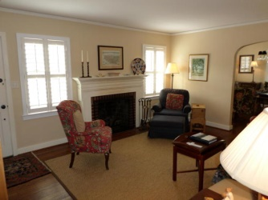
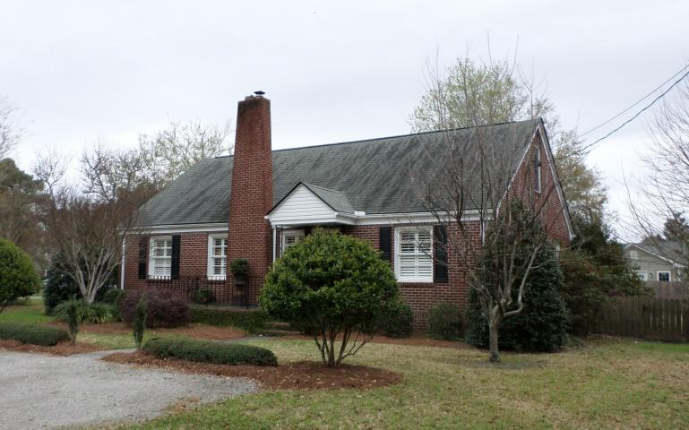
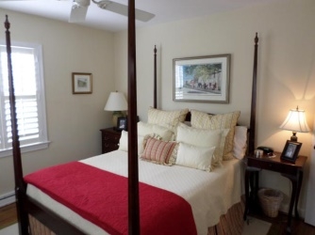
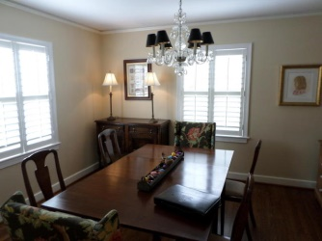
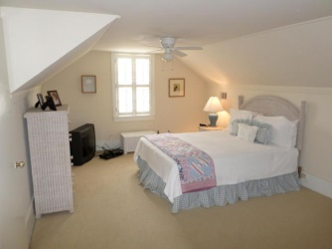
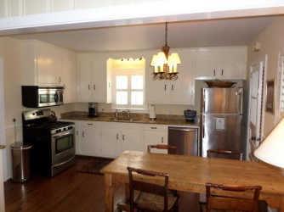
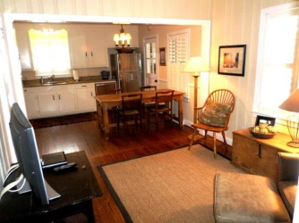
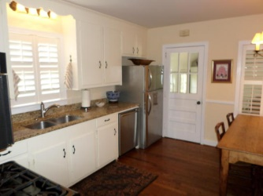
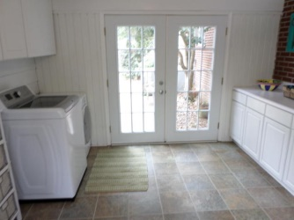
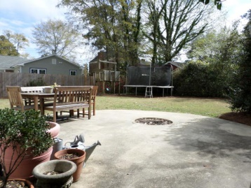
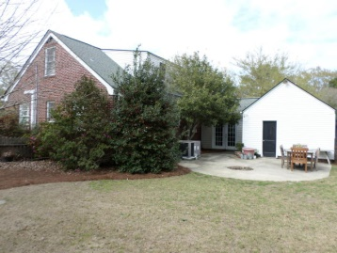
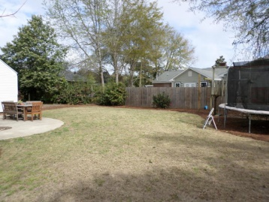
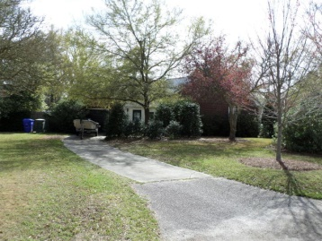
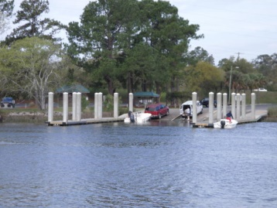


Open House Thursday 11a-1p
Just Reduced!
5 Jamaica Drive
South Windermere - Charleston - MLS# 15007643 - $449,000
Price reduction in established, highly sought after neighborhood-- South Windermere-- in West Ashley. This location allows one to be close to it all--including the new Saint Andrews School of Math & Science. Imagine the pleasing curb appeal of a wonderfully landscaped lot(.32ac) on which a traditional brick home is situated. Enjoy the warm feeling entering onto hardwood flooring in living area, dining, and 2 bedrooms. The kitchen has been updated with granite and stainless steel appliances. Cozy den is located just off kitchen as is the spacious laundry room (which connects to garage and allows access to large, fenced back yard.) Upstairs you have the flexibility of a large master suite with walk-in closet, office or sewing area. Could also be situated for a game room.
Jerry Wise, Realtor
843-442-7633
jwise@eratidesrealty.com
ERA Wilder Realty, 125-F Wappoo Creek Dr, Charleston, SC 29412

