Slide 1
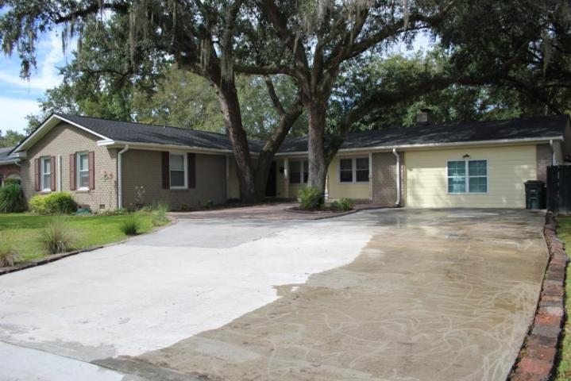
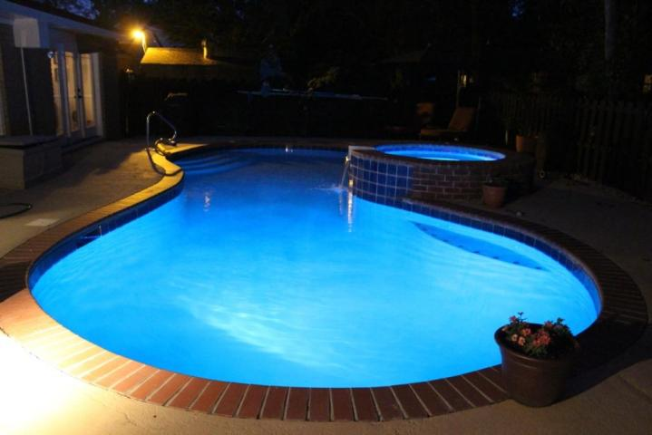
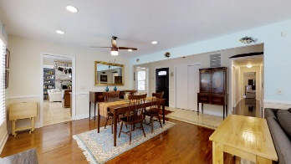
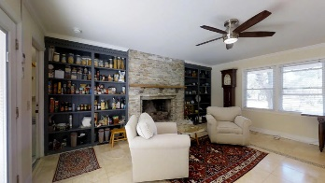
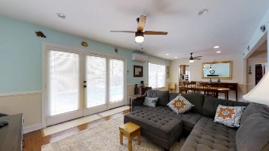
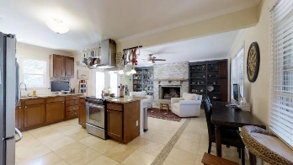
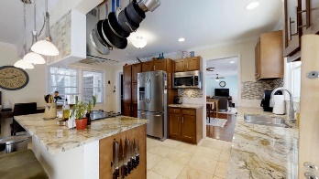
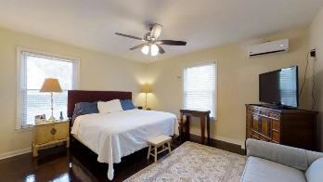
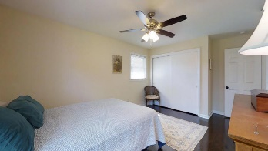
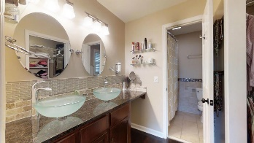
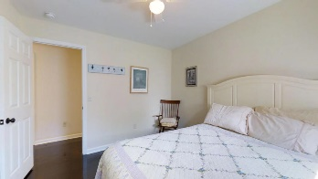
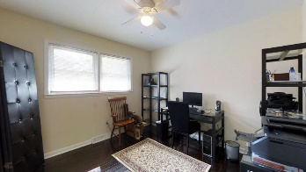
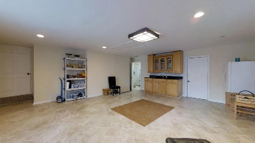
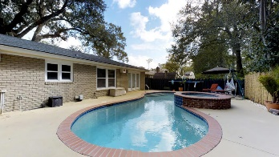
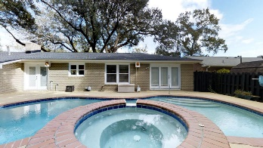
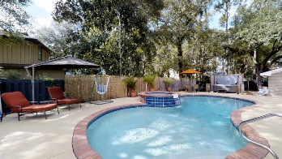
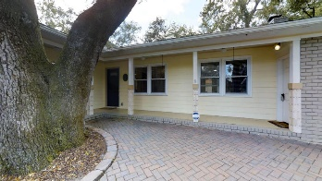



Newly Renovated with Pool
5 S Basilica Avenue
Otranto | Hanahan
MLS# 17026129 | $339,000
4 Bed | 2 Baths | 2,828 Sq Ft
RENOVATED & NO FLOOD INSURANCE REQUIRED! Tankless Water heater, Roof and HVAC ONLY 2 YEARS OLD, Private in ground Pool . Beautifully RENOVATED Gourmet Kitchen with tall custom cabinets, recessed lighting and custom tiled backsplash. Stainless steel appliances matching perfectly with the custom granite countertop and island against the Travertine Marble Floor. Large brick/ stone gas Fireplace is the perfect addition to the already perfect kitchen. This house is complete with hardwood floors down the hallway & the bedrooms. The master bdrm/bath has a walk-in closet, granite countertop and tiled shower/whirlpool tub. The additional 3 bedrooms are nicely sized with ceiling fans. The family room has lots of windows with an inviting view of the in-ground pool. Converted garage has its own entry.
Charles Lent
REALTOR, AIC
843-864-6426
charles.lent@agentownedrealty.com
www.charleslentrealty.com
AgentOwned Charleston Group | 902 Savannah Hwy | Charleston, SC 29407-7802

