Slide 1
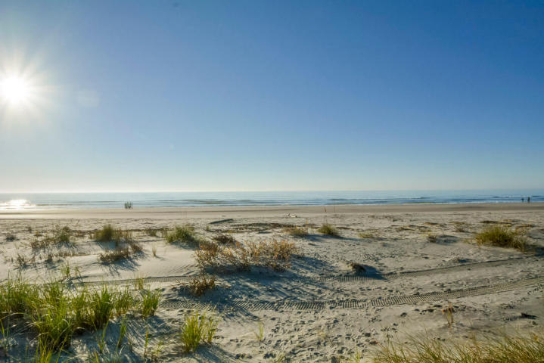
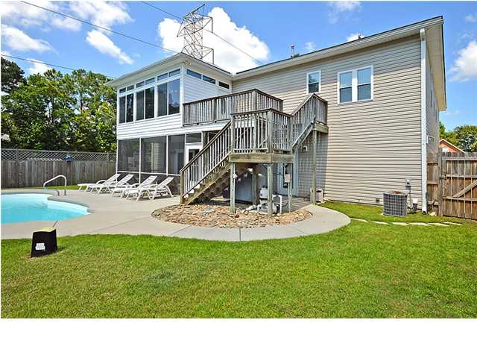
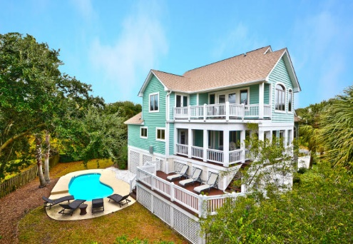
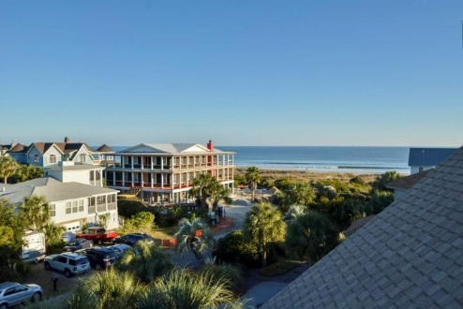
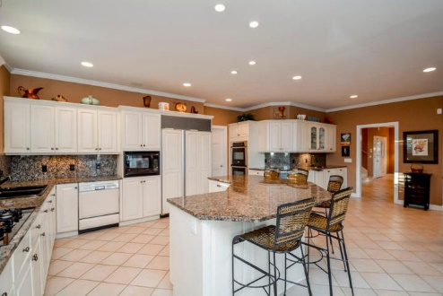
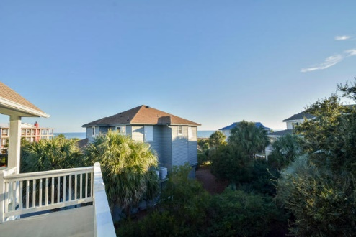
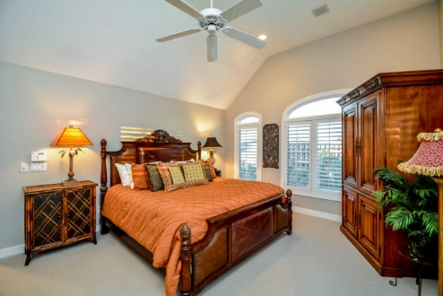
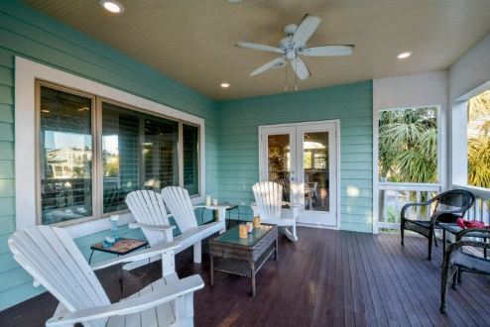
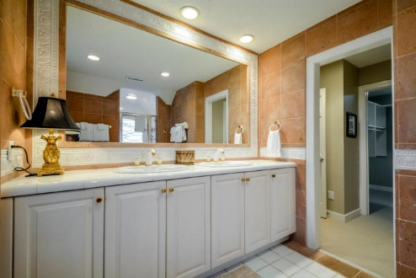
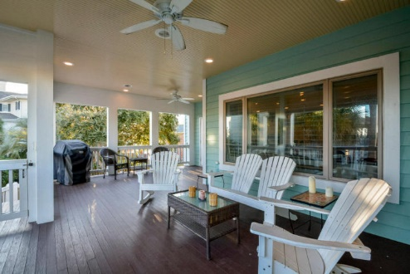

100k Price Reduction
Priced To Sell
5 45th Avenue ~ Isle of Palms ~ MLS# 14031008 ~ $1,595,000
Towering palms, a crystal clear pool, four separate decks to enjoy the outdoors and views, and located just steps from white sand beaches, this four bedroom, four bath, three car garage home on Island of Palms has it all! Inside luxurious living awaits you with 3,110 square feet of quality craftsmanship and attention to detail at every turn. Stepping into the foyer you’ll begin to notice tasteful finishes from the crown molding, high ceilings, recessed lighting, tile flooring laid on a diagonal and plantation shutters. The spacious living room is sun soaked from the many windows and has a double sided fireplace that connects to the dining area. Prepare to indulge your wildest cooking dreams in this chef's delight with granite counters and backsplash, a large center island with breakfast bar, gas range, double oven and a built-in wine cooler. The owner's retreat upstairs is one you won't want to leave with a vaulted ceiling and access to your own private deck. The custom walk-in closet is amazing and the en-suite bath boasts a dual vanity, custom tile work and a walk-in shower with a built-in seat. Make your way to the observation deck on the third floor for the one-of-a-kind bird's eye view of the sunset and ocean. The covered deck off of the kitchen area is ideal for entertaining and looks out to the pool. The kidney shaped pool in the fenced-in backyard is the perfect destination after a day in the sun and sand at the beach. Conveniently located to shopping, dining, Mount Pleasant and downtown so you can spend less time on the road and more time at home. If you've been waiting for a home where everyday will feel like a vacation, be sure to take advantage of this opportunity.
For more information, contact
Spencer Gibson
Spencer@MattONeillTeam.com | 843-467-5677

