Slide 1
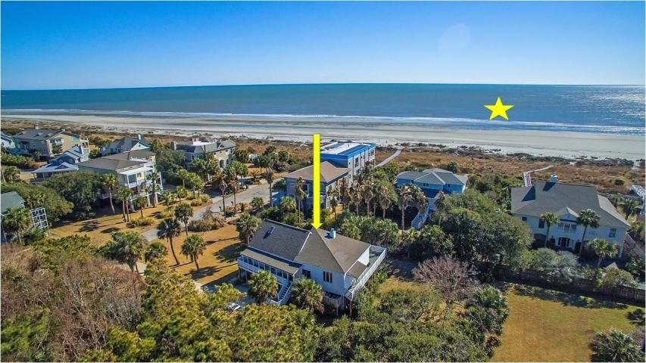
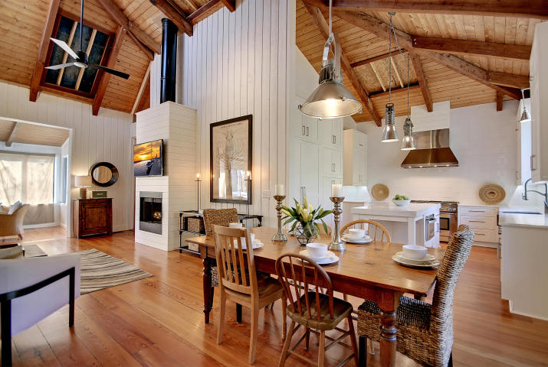
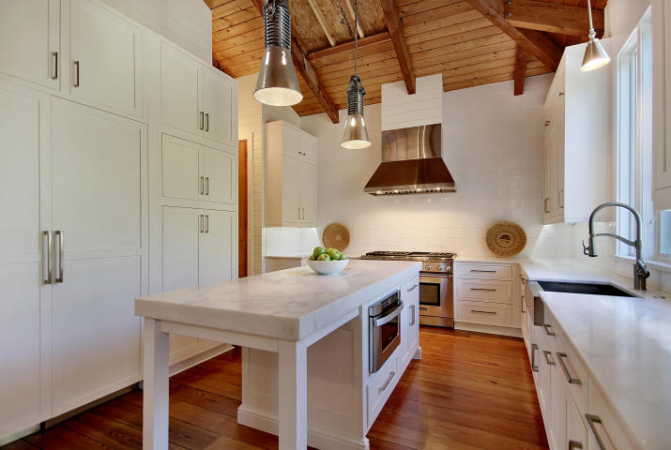
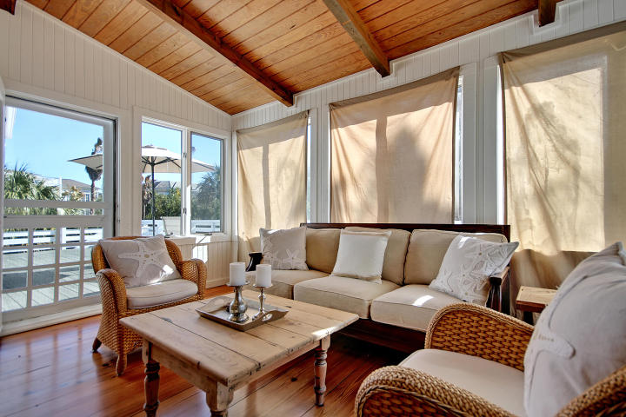
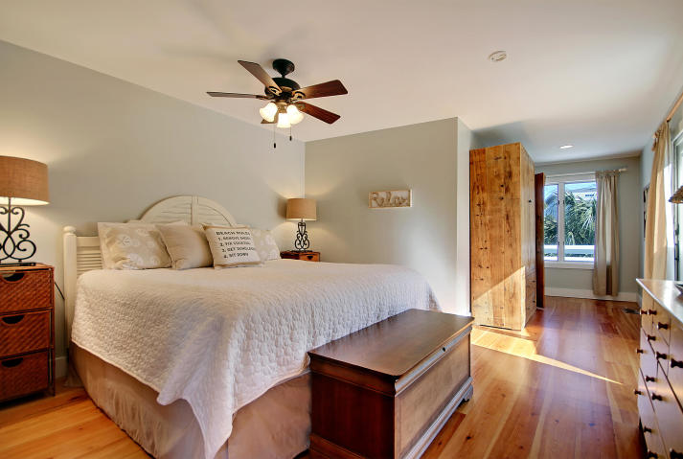
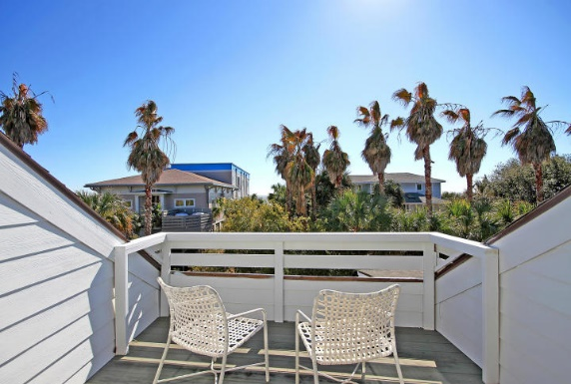
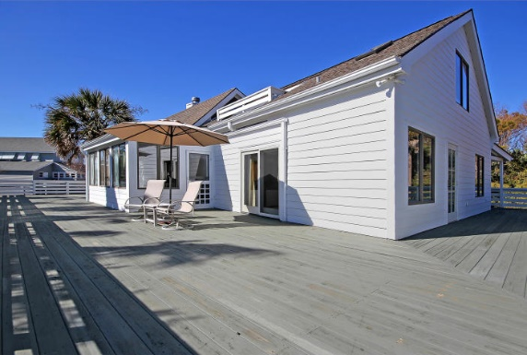
Steps to the Ocean
Price Reduced!
5 49th Avenue
Isle of Palms, SC 29451 ~ MLS# 18030917 ~ $1,699,000
Literally just steps away from the relaxing shores at Isle of Palms, this remodeled contemporary home that sits on a double lot leaves you with many options! A huge, wrap around deck and a balcony off the top floor bedroom both boasts calming, ocean views. The soaring high ceilings compliment the open floor plan with its gourmet kitchen with center island and fireplace in the living room. Lots of windows allow the surf sun to pour in and the layout easily lends itself to outdoor entertaining. You could move in immediately and start making memories today as it is, OR custom build the home of your dreams. Whatever your plan is, do not miss out on this rare chance to be so close to the ocean and a part of this amazing community!
Additional features include:
Beautifully remodeled
Shiplap
Gorgeous heart pine floors
Second row from beach
The kitchen features marble countertops, abundant cabinet space, a farm house sink, a Thermador gas range with vent, and a subway tile backsplash
Book your viewing today!
Tyler Hawkins tyler@mattoneillteam.com (843) 908-2734

