Slide 1
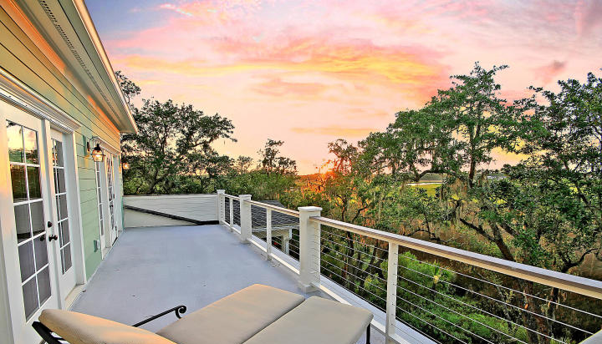

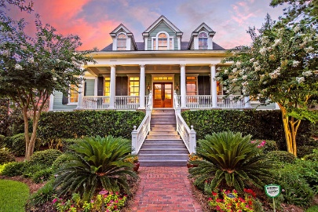
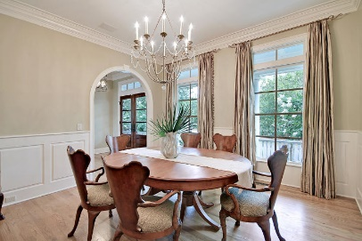
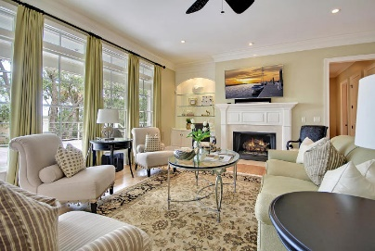
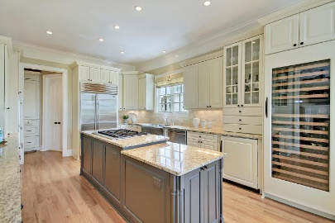
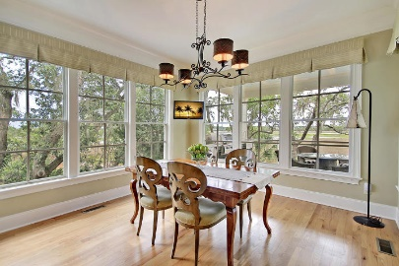
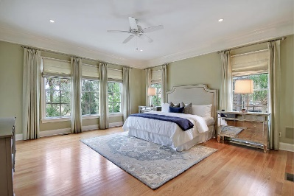
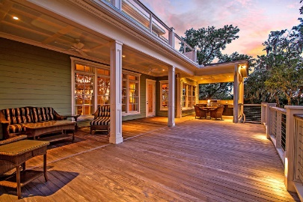
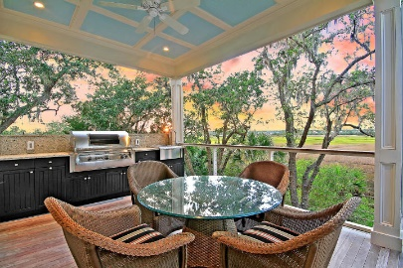
Great Downtown Investment Opportunity
Great Marsh Front Home!!
5 Hazelhurst Street Daniel Island, SC 29492 ~ MLS# 19020455 ~ $1,650,000
Custom home by Allen Custom Homes
Master bathroom has his and her vanities and large soaking tub
Tray ceiling in Master Bedroom
Second floor features two bedrooms with ensuite baths in addition to a second Master suite
Large storage area located on unfinished 3rd floor of home
Custom built in shelves and cabinets in home office
Kitchen features granite counter tops, Bosch appliances, double ovens, and a large center island breakfast bar with seating
Living room features fireplace with granite surround and custom built-ins
Brazilian Cherry hardwood flooring throughout the entire home
Surround sound with individual volume control in each room throughout the main level of the home
Wainscoting and crown moulding throughout the home
Hurricane shutters for all windows and doors which are easily installed from INSIDE the home
Lawn Irrigation System
Gutters with Leaf Guard
Great location close to Smythe Park, Daniel Island schools, public Library and community pools.
Community amenities include - miles of walking/biking trails, pools, multiple playgrounds and community boat dock, shops, restaurants and the Family Circle Tennis Center - a great venue for sporting events and concerts.
Indulge in the best of the best with this stunning custom home that's perfectly nestled at the end of a quiet cul-de-sac in the Lowcountry's favorite golf course community of Daniel Island. This 4,200+ sf Charleston style home sits on a premier lot overlooking the marsh with views of Nowell Creek. The construction of this home was tailored to capitalize on the spectacular views that can be seen throughout the back of the home on the main & top level as well as the balcony, expansive deck, covered porch & outdoor kitchen. This home has high end finishes throughout with extensive trim work, archways, coffered ceiling, a fireplace in the living room, a Dacor range, Sub-zero fridge & an elevator that services all three levels. It is a car collector's dream with room for 5+ cars in the garage!
The owner's retreat boasts 2 walk-in closets with custom built-ins and private access to the back deck overlooking the marsh. The en-suite master bath has dual vanities, a walk-in tile shower & a free standing tub. Enjoy a glass of wine or iced tea while watching the spectacular sun set over the creek and marsh every evening from this stunning home! NOTE:This home comes with Daniel Island Club social membership privileges with access to the club's swim, tennis, fitness and dining facilities, plus the opportunity to upgrade to an original deeded, transferable, fully refundable and non-recallable golf membership.
Book your viewing today!
Paige Rhodes 843-830-3281 paige@mattoneillteam.com
Ben Laaper 843-642-3546
ben@mattoneillteam.com

